Slide 1
FIS
Financial Information System
UC Common Chart of accounts
(CCoA)
- FIS Subproject -

Slide 2
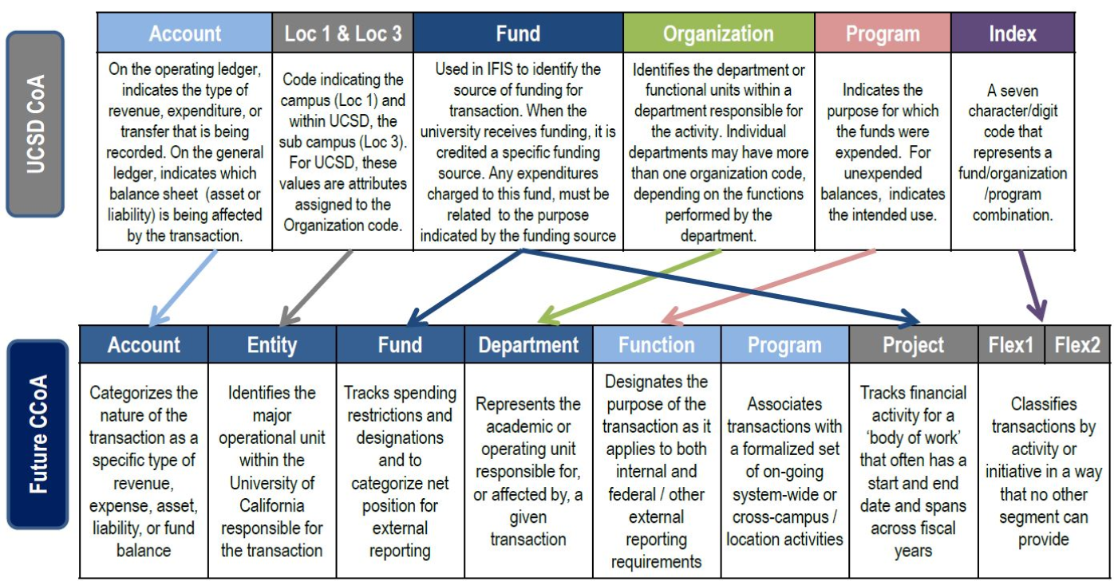
FIS
Financial Information System
COMMON CHART OF ACCOUNTS
The goal of UC CCoA is to enhance system-wide reporting, budgeting, and financial management.
The Common Chart of Accounts serves as the basis for recording and reporting the day-to-day financial operations at UC San Diego. The structure segments (or dimensions) record the financial effect (balance sheet, P&L, etc.) of each transaction.
WHAT?
HOW?
The UC Common Chart of Accounts (CCoA) Design project was initiated in June of 2012 to consolidate and standardize financial operations, reduce need for extensive and expensive data reconciliations across locations, and streamline the reporting needs of the campuses and/or University system-wide.
WHY?
Notes:
Much of our current financial and budgetary reporting and analytical challenges stem directly from a Chart of Accounts, the listing of all accounts used in the general ledger, that has become outdated and hard to manage. The ESR program includes the adoption of a Common Chart of Accounts that will meet the needs of campus budget, accounting, administration, institutional research and the Office of the President users as well as stakeholders inside and outside of the university. Data will be normalized across business systems and campuses, so you can be assured the data you see is accurate.

Slide 3
FIS
Financial Information System
CCoA TIMELINE
Orientation (October 2017)
Workgroup of Stakeholder Representatives
CCoA Development
Chart Design Subgroups
Initiate Documentation and Baseline Design
CFO Approval (September 2018)
Business Process Implementation in ESR-FIS
Proof of Concept Testing and UCOP Alignment
Final Document

