Slide 1
FIS
Financial Information System
Financial Information System
ESR-FIS Project

Slide 2
FIS
Financial Information System
ESR Program: The Enterprise Systems Renewal (ESR) program is a multi-year initiative that will reshape the way UC San Diego does business. With input from subject matter experts from central offices and academic departments across campus, the program’s focus is optimization of core business and administrative practices as well as delivery of new systems that will effectively meet the needs of our growing university.
Document & analyze current business processes.
Procure software solutions.
Build new systems based on business needs.
Implement the systems.
ESR Projects
Financial Information Systems
Facilities Information Management
Research Administration
Human
Resources
and Payroll
Data and Analytics
Technology Infrastructure
Student
and Faculty Information

Slide 3
FIS
Financial Information System
ESR OVERVIEW
The Enterprise Systems Renewal program commenced in July 2017 and will last four years, affecting key service areas: Finance, Human Resources, Research Administration, and Students.
ESR is essential to ensuring that the campus business systems and infrastructure can adequately
support UC San Diego’s growth and mission as one of the top 15 research universities in the world.
Existing systems can no longer adequately support core business functions. In many areas of campus,
outdated systems are causing inefficiencies and friction for staff functions.
ESR is leveraging the talent and experience of subject matter experts from across campus and medical centers, ensuring we streamline processes and select systems that align with our needs. These subject matter experts will
also become campus experts on the newly-implemented systems.
The program addresses key goals identified in UC San Diego’s Strategic Plan, including creating an agile, sustainable and supportive infrastructure. (http://plan.ucsd.edu/)

Slide 4
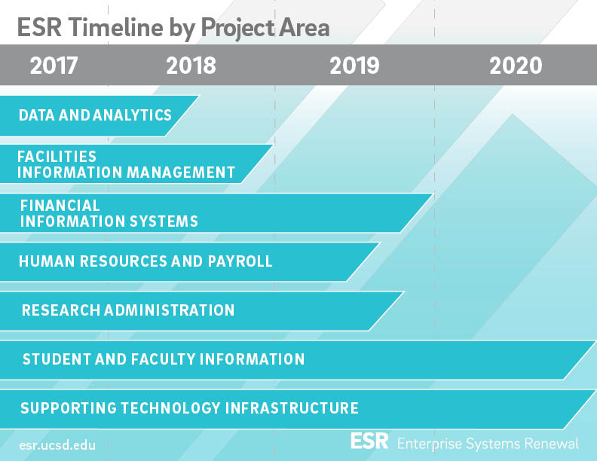

Slide 5

FIS
Financial Information System
FINANCIAL INFORMATION SYSTEMS
Visualizing Data Management, System Integrations, Key Domains, & Business Processes
FIS Project: The Financial Information Systems (FIS) project is the portion of the ESR program focused on campus and medical centers financial business processes and systems used for the general ledger, expense and revenue management, financial reporting and budget governance.
The project goals are to reduce difficult and redundant processes in current systems, replace outdated financial systems with new, flexible technology and to integrate data across systems.
MyPayments
Marketplace
UC Common Chart of Accounts
Procure
to Pay
MyTravel
ECManager
General Ledger
Budget/Governance
General Ledger
Central Office
& Campus
Expense
Post Award
Revenue
FIS
Accounts Receivable
Med Centers
& CPO
Cash Management
Budget
Notes:
Current state friction examples:
Manually re-keying or processing data
Use many different systems
Multiple applications with similar purposes and overlapping
Working with redundant copies of data
Using kludges and workarounds to get the job done
Technology at work is less capable than you have at home

Slide 6



FIS
Financial Information System
PROJECT GOVERNANCE
The Project Governance Committee provides leadership on strategic decisions and actions and responds to escalated conflicts.
Steer project by making decisions impacting strategy, scope, timeline, and budget
Provide or refer subject matter expertise
Resolve and/or escalate conflicts
Support the change in words, behaviors and actions
Provide functional leadership and oversight
Engage VC/Admins as needed to facilitate resolution of organizational change resistance and conflict
Engage ITS/Health IS to provide technical leadership and inform decision-making
Liaises to Program and Sponsors as appropriate
Project Sponsors ensure project
success through leadership support.
Deliver major project announcements
Ensure presence at key events; communicate changes
Proactively learn about and socializes the project
Respond to escalated conflicts
Provide executive decision-making
Engage with employees outside schedules events
SPONSORS
GOVERNANCE
TEAM
Project Team ensures successful launch
and continuous support.
Reduce redundant processes, replace outdated system with more flexible technology, and enable data across systems.
Acquire project resources and leverage local SME expertise.

Slide 7
FIS
Financial Information System
Enterprise Information Services Committee (EISC)
FIS
Financial Information System
Project
Sponsors
Pierre Ouillet
VC-CFO
Lori Donaldson
CFO Health
ESR Project
Escalation
Cheryl Ross
ITS & Health IS
Adam
DiProfio
Arlynn
Renslow
Bill
McCarroll
Charles
Wei
Don
Portugal
Project
Governance
Irene
Xavier
Marlene
Shaver
Pearl
Trinidad
Reid
Hollyfield
Sylvia
Lepe
Ted
Johnson

Slide 8








FIS
Financial Information System
PROJECT TEAM
The Financial Information Systems (FIS) project team will deliver an efficient, transparent enterprise-wide accounting and financial management system that supports staff and the business operations of campus and medical centers.
Adam DiProfio
Change Lead, Academic
Director, Finance/Budget, Office of the Vice Chancellor- Academic Affairs
adiprofio@ucsd.edu
Arlynn Renslow
Change Lead, Central Financial
Director, Business & Financial Services General Accounting
arenslow@ucsd.edu
Bill McCarroll
Build Lead
Senior Director, Business & Financial Services General Accounting
wmccarroll@ucsd.edu
Bill Sweetman
Technical Lead
Director, Financial /HR Information Systems, IT Services
sweetman@ucsd.edu
Jenn Glassman
Configuration Lead
Assistant Director, Technical Customer Solutions, Business & Financial Services Procurement
jglassman@ucsd.edu
Elliot Kim
Process Lead
Senior Project Analyst, Business & Financial Services General Accounting
etkim@ucsd.edu
Erin Kilburn
Project Manager
Technical Project Manager, Information Technology Services
ekilburn@ucsd.edu
Laura Blankenship
Change Practitioner
Senior Project Analyst, Business & Financial Services General Accounting
lsblankenship@ucsd.edu

Slide 9
FIS
Financial Information System
PROJECT MILESTONES
Vendor Demo CRPs & Selection
Conference Room Pilots (CRP) March to July 2018. 3 vendor demos of financial solutions, capabilities, and final assessments.
Configuration & Testing (Cont.)
Go Live!
December 2019
End-User Testing
Data Migration
Implement a controlled change process; set up a change control process to approve/reject change requests and customizations.
Customize FIS configuration options that affect functionality and look-and-feel.
Vendor Negotiations/Technical Prep
Requirements Gathering
Vendor selection is planned within 2 weeks after conclusion of demos and scoring.
Current application and process analysis (tech prep and review)
Friction analysis/scope of impact
Analysis of business processes, applications and data hierarchies
3,000+ requirements synthesized into 100 functional and 75 non functional vendor questions
CCoA Approval
CFO approval September 2018. Business process implementation in ESR-FIS
RFP Issued
Compilation of business process and user scenarios from SMEs. 27 scenarios in 8 major financial subdomains in CRP packages.
End User Training
Configuration & Testing
Roll-out comprehensive end-user training and resistance plans
Perform configuration, configuration items, and baselines.
2017
2018
2019
2020

Slide 10
FIS
Financial Information System
UC Common Chart of accounts
(CCoA)
- FIS Subproject -

Slide 11
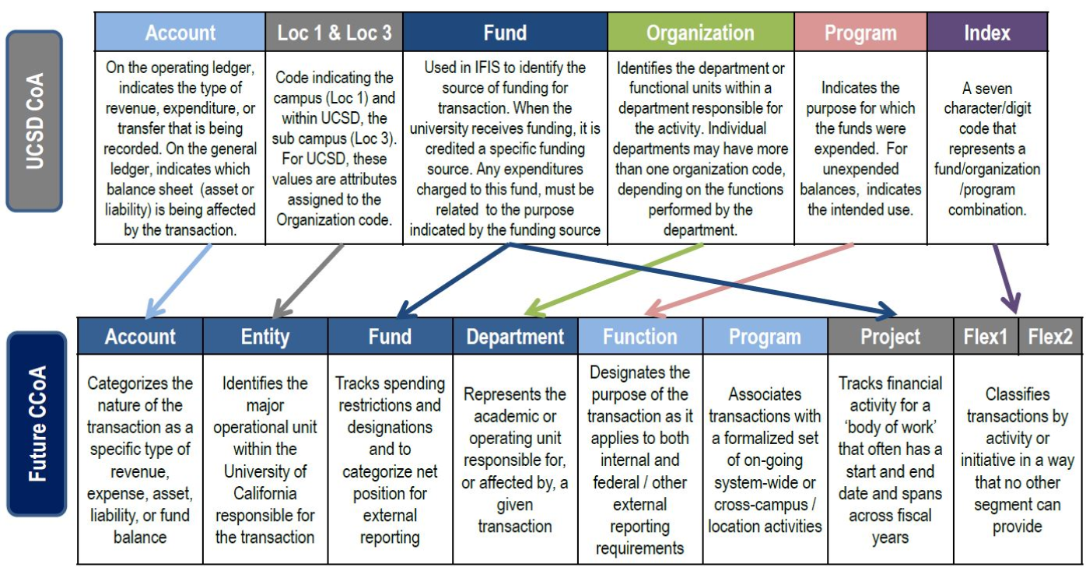
FIS
Financial Information System
COMMON CHART OF ACCOUNTS
The goal of UC CCoA is to enhance system-wide reporting, budgeting, and financial management.
The Common Chart of Accounts serves as the basis for recording and reporting the day-to-day financial operations at UC San Diego. The structure segments (or dimensions) record the financial effect (balance sheet, P&L, etc.) of each transaction.
WHAT?
HOW?
The UC Common Chart of Accounts (CCoA) Design project was initiated in June of 2012 to consolidate and standardize financial operations, reduce need for extensive and expensive data reconciliations across locations, and streamline the reporting needs of the campuses and/or University system-wide.
WHY?
Notes:
Much of our current financial and budgetary reporting and analytical challenges stem directly from a Chart of Accounts, the listing of all accounts used in the general ledger, that has become outdated and hard to manage. The ESR program includes the adoption of a Common Chart of Accounts that will meet the needs of campus budget, accounting, administration, institutional research and the Office of the President users as well as stakeholders inside and outside of the university. Data will be normalized across business systems and campuses, so you can be assured the data you see is accurate.

Slide 12
FIS
Financial Information System
CCoA TIMELINE
Orientation (October 2017)
Workgroup of Stakeholder Representatives
CCoA Development
Chart Design Subgroups
Initiate Documentation and Baseline Design
CFO Approval (September 2018)
Business Process Implementation in ESR-FIS
Proof of Concept Testing and UCOP Alignment
Final Document

Slide 13
FIS
Financial Information System
Procurement Approach
- FIS Subproject -

Slide 14
FIS
Financial Information System
TWO-STAGE RFP
First Stage | The first stage consists of providing all bidders (software vendors) with a concise list of approximately 100 questions that will be weighted and scored. The questions determine which functionality will be available “out of the box”, verses requiring configuration or customization. The goal is to select finalists that can meet as many of our needs as possible through functionality that is already available through their solution.
Second Stage | The second stage, Conference Room Pilots (CRPs), consists of UC San Diego subject matter experts outlining several use case scenarios that are built by the finalists (vendors) for evaluation and testing by those who will ultimately use the system. The goal is to select a product based on evaluating something tangible vs. relying on a written response to questions. UC San Diego will have the opportunity to try before we buy, with key components of the solution already built at the time of purchase, as opposed to starting from scratch once the contract is awarded.
Notes:
REQUEST FOR PROPOSAL (RFP)

Slide 15
FIS
Financial Information System
REQUIREMENTS GATHERING PROCESS
Created by business units and extracted from other Campus RFPs
Mapped by ESR
Architect and reviewed by Process SMEs
~100 Questions
Requirements
Over 3,000+ requirements were synthesized into 100 functional and 75 non-functional vendor screening questions.
Requirements Traceability
Matrix (RTM)
RFP Qualifying
Questions
Business Processes
RTM to be used again during the configuration project phase
~1000 processes/tasks collected from Process SMEs

Slide 16
FIS
Financial Information System
CONFERENCE ROOM PILOTS
During conference room pilots, the FIS Project Team and Procurement require finalists to demonstrate their financial systems out of the box solutions, including validating system capabilities such as workflow, user roles and security, data migration and performance.
Sample CRP Demo
DOMAIN & TOPIC
KEY TESTING PROCESS
BUSINESS INTELLIGENCE
  Cashiering and Cash
  Management Process
  Deposits and cashiering
  Monthly bank reconciliation
  Wire transfer/ACH processing
  Trace bank statement to original transactions
  Period closing
  Monthly bank reconciliation report
  Exception report during bank reconciliation process and other cases
  Daily wire transfer/ACH report
  Cash summary report

Slide 17





FIS
Financial Information System
PROCUREMENT MILESTONES
FRICTION ANALYSIS
RFP REQUIREMENTS
CRP SCENARIOS
VENDOR DEMOS CRPs
VENDOR SELECTION
Analysis of business processes, applications and interfaces. Identification and confirmation of process friction, scope and strategic value.
3000+ requirements synthesized into 100 functional and 75 non-functional vendor screening questions.
RFP issued 11/7/17
Negotiations 1/30/18
Compilation of business process scenarios and user cases from SMEs. 27 scenarios in 8 major financial subdomains in Conference Room Pilot (CRP) packages.
CRPs May to July 2018. Vendor demos of financial solutions and capabilities and final assessments.
Vendor selection is planned within 2 weeks after conclusion of all scheduled vendor demos and scoring.

Slide 18


FIS
Financial Information System
PROCUREMENT TIMELINE
Process and Requirements Documentation
RFP Issued
Supplier Demo's
AWARD
Traditional RFP
Process and Requirements Documentation
RFP Issued
Supplier Demo's
AWARD
Financial System RFP - Bake Off Method
Month 1
Month 2
Month 3
Month 4
Month 5
Month 6
Month 7
Month 8

Slide 19
FIS
Financial Information System
PROGRESS AND NEXT STEPS
Request for Proposal and Selection
Implement Business Processes
Financial System Launch
Configure the Software
FIS Is Here!
Vendor negotiations are complete
and Conference Room Pilots are underway!

Slide 20
FIS
Financial Information System
ORGANIZATIONAL Change management
- FIS project -

Slide 21
FIS
Financial Information System
ORGANIZATIONAL CHANGE MANAGEMENT
Organizational Change Management is the approach to transition an organization, including its people, from their current state to a new state. The ESR program is collaborating with Staff Education & Development (SED) to ensure that each project team is incorporating ADKAR- Awareness, Desire, Knowledge, Ability, and Reinforcement.
PHASE 1:
Preparing
for Change
PHASE 2:
Managing
Change
PHASE 3:
Reinforcing
Change
Change Management Strategy
Communications Plan
Sponsor Roadmap
Coaching Plan
Training Plan
Resistance Mgmt Plan
Adoption, Usage Measurement
The Prosci ADKAR change model gives leaders a simple framework for helping people embrace and adopt changes and provides clear goals, outcomes, and common language for change management. The FIS project team is committed to providing individuals with the support they need to move from their current states to their future states.
Readiness
Assessments
Sustainment
Compliance
Corrective Action
Prepare Change Team and Identify Sponsors
Integration into
Project Management Plan
Recognition
Success Celebrations
Lessons Learned

Slide 22
FIS
Financial Information System
Prosci recognized industry activities will be customized to achieve FIS project outcomes.
Project Management Activities
Change Management Activities
Initiate Project
Conduct readiness assessments and impact analysis
Scope Project
Identify and begin building sponsor coalition
Select and prepare change management team
Plan Project
Establish objectives
Identify and address anticipated resistance
Document approach
Define team and budget requirements
Communicate why change is happening (sponsors)
Design Solution
Prepare and equip managers and supervisors
Benchmark and gather data
Continue communications and sponsorship activities
Generate ideas and select concepts
Model solutions
Launch group and coaching sessions and
reinforce key messages with sponsors
Document requirements
Develop Solution
Continue communications and sponsorship activities
Evaluate alternatives
Identify training requirements and develop training
Architect solution
Continue communications, sponsorship and coaching activities
Notes:
The FIS team is integrating the technical side of change (Project Management) with the people side of change (Change Management) to provide a unified approach to implementing the new financial management system.

Slide 23
FIS
Financial Information System
ENGAGEMENT APPROACH
Sponsorship
Communication
Implementation
Training
Inclusion
Sponsor & Governance briefings
Provide subject matter expertise
Executive decision-making
Communicate changes
Respond to conflicts
FIS Project Website
Project Newsletter
Project Inbox/Email
Surveys
Share go-live updates
Application Inventory
Focus Groups, User Testing, & Feedback
Identify Work Stream Dependencies/ Customizations
Assess Outcomes
People Managers training
Assess end-user needs
Determine delivery methods/segments
Create training program
Ensure training is available for new employees
Change Network
Mini Roadshows
1-on-1 Meetings
Extended Team Meetings
Conference Room Pilots
Engagement Activities
Notes:
The FIS project team is committed to timely and transparent updates, and providing the change network (sponsors, change champions, supervisors, and end users) with the information they need to learn/support/reinforce financial system changes. Activities in engagement categories will be repeated as necessary by the project team to reinforce knowledge and changes continuously.

Slide 24
FIS
Financial Information System
BUILDING AWARENESS
Roadshow Presentations
VC areas, executive leadership and key stakeholder groups. Over 600 unique attendees since ESR Program launch.
ORGANIZATIONAL CHANGE MANAGEMENT (OCM) TRAINING
Staff Education & Development (SED) Workshops
SED has and will continue to deliver change management workshops and training to staff by role: Change Practitioner, People Manager, All Staff according to project needs.
INTERNAL EXPERT SOURCING
Involvement and Expertise – Requirements, RFP, CRP
Partnership with SMEs gives functional ownership
and enhances desire to participate and support this change.
ESR-FIS MONTHLY NEWSLETTER
First issue on February 23
Project updates, news and information, calendar of events and contacts. Website esr.ucsd.edu launched Fall 2017.
CONTINUOUS OUTREACH
Departments and One-on-One
Responding to questions, resistance and requests from the UC San Diego community on ESR plans and activities, concerns and applying change management approach.
EXPANDING THE CHANGE NETWORK
Identifying Sponsorship Coalition Members and Change Champions
Empowering change partners across campus and med ctr.
Since 2017, more than 600 individuals have attended presentations about the financial system project. Over 200 SMEs engaged in the initial analysis and discovery process; 56 SMEs were engaged for RFP requirements and scenarios representing stakeholder groups and VC areas including med center.
Notes:
Above are instances of change activities the team has and/or is scheduled to carry out.

Slide 25










FIS
Financial Information System
TOP BENEFITS FOR FIS USERS
Reduce redundant processes and working with redundant copies of data.
INTEGRATED
Information
SECURITY &
Regulatory Compliance
STREAMLINE
Processes & Efficiency
Keep our financial data safe and regulated with built-in protections.
Automate financial business operations; eliminate re-keying or processing data. Reduce the need for multiple applications with similar purposes and overlap.
UC San Diego financial data housed in one location.
PRODUCTIVITY
Centralized data will bolster interdepartmental, central office, and med center collaboration.
The FIS implementation
will thrive with
your support.
ONE LESS
SPEADSHEET
ELIMINATE
FORECASTING &
Reporting
Your spreadsheets
may be:
Address today’s needs and tomorrow’s challenges. A new financial system will make it easier for you to budget, plan, and forecast.
Slow
Reduce kludges and work-arounds to get the job done; less need for IT assistance.
Error Prone
COLLABORATION
Inflexible
SUPPORT GROWTH

Slide 26
FIS
Financial Information System
RESOURCES
Learn more about ESR and how the program is reshaping the way UC San Diego does business: http://esr.ucsd.edu/
Go behind the scenes with the monthly ESR-FIS Program News. Click here →
Learn more about the Financial Information Systems project on our webpage.
The FIS team will be asking for input and help configuring/testing the new system. Email esrfisp@ucsd.edu if you are interested in participating.
Arlynn Renslow, Adam DiProfio, and Laura Blankenship are your resources for information about financial systems renewal. Contact them with your questions or to request presentations for your group or team.
SUBSCRIBE TO ESR PROGRAM NEWS!
Adam DiProfio
Project Change Lead, Academic
Director, Finance/Budget, Office of the Vice Chancellor- Academic Affairs
adiprofio@ucsd.edu
Arlynn Renslow
Project Change Lead, Central Financial
Director, Business & Financial Services General Accounting
arenslow@ucsd.edu
Laura Blankenship
Change Practitioner
Senior Project Analyst, Business & Financial Services General Accounting
lsblankenship@ucsd.edu

Slide 27
FIS
Financial Information System
Financial Information System
Launching December 2019

