Slide 1
Financial Information System
Town Hall | January 31st, 2019
Notes:
Kevin (~1 minutes)

Slide 2
Agenda
The Future with Oracle
Pierre Ouillet and Lori Donaldson
Preparing for Oracle
Cheryl Ross and Bill McCarroll
90 Day Plan
Erin Kilburn
ESR Change Resources
Bernadette Han
Managing Change
Adam DiProfio and Arlynn Renslow
Notes:
Kevin (~1 minutes)
Vision/Introduce sponsors/turnover to Pierre

Slide 3

Vision
Empower your organizations with truly modern systems
Maximize optimization to streamline our business practices
Enhance decision making with unified systems
Break from the ordinary to make room for excellence
Build a strong future for our financial community
Notes:
Pierre (~6 minutes)

Slide 4

Notes:
Pierre (~5 minutes)

Slide 5

UC San Diego Health
UC San Diego Health is a vital component of our University community
We have grown significantly over the past decade into a nationally recognized academic health system
Our physicians and nearly 9,000 employees provide comprehensive world class care to our community and beyond
Last year UC San Diego Health provided over 800,000 outpatient visits and 78,000 ED visits
The ESR FIS renewal will increase UC San Diego Health’s integration with campus while retaining existing budgeting, procurement, and support systems.
UC San Diego Health’s finance and system leaders are co-leading and participating in the implementation design teams.
Notes:
Lori (~3 minutes)

Slide 6
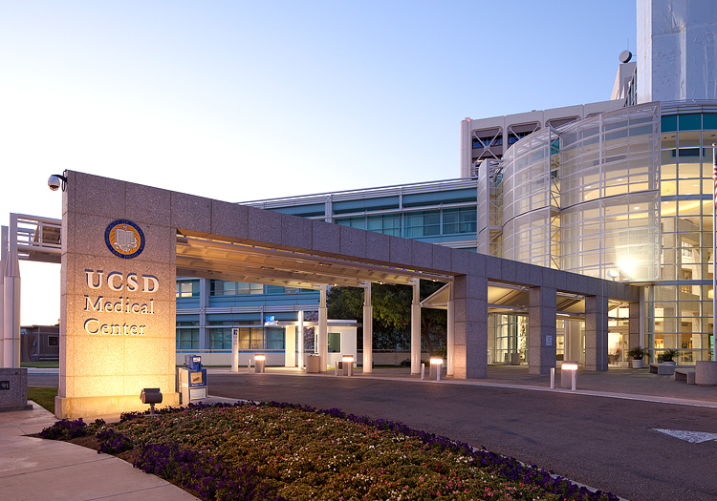

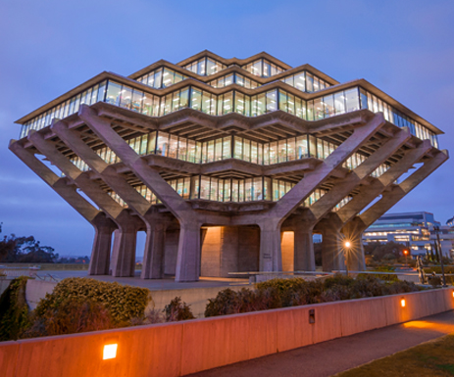
Health
Campus
Foundation
Notes:
Lori (~3 minutes)

Slide 7
This automation will drive more efficiency into our health system and provide real time information necessary to manage a complex health system.
  Have one source of data for decision making
  Simplify work processes and stop being reactionary
  Allow more time for value added analytics
  Provide better service to our customers across the health system, campus, UCOP and external interests
  Improve staff satisfaction and provide opportunities for career enhancement
Notes:
Lori (~3 minutes)

Slide 8
Design Principles
Design financial processes and reporting to take maximum advantage of new UC San Diego chart of accounts.
Full functional partnership with UC San Diego Health and Foundation in a common financial system and linked chart of accounts, and successful integration with defined enterprise systems (student systems, payroll, etc.).
Adopt full budget system, centralize non-student AR, and develop or modify policies as required to match new core business processes.
Meet user needs in the context of what’s best for the institution as a whole.
Lead with UC San Diego’s internal resources and external guidance and support from an implementation partner.
Visit Financial Information System project Guiding Principles to learn more.
Notes:
Cheryl (~5 minutes)

Slide 9

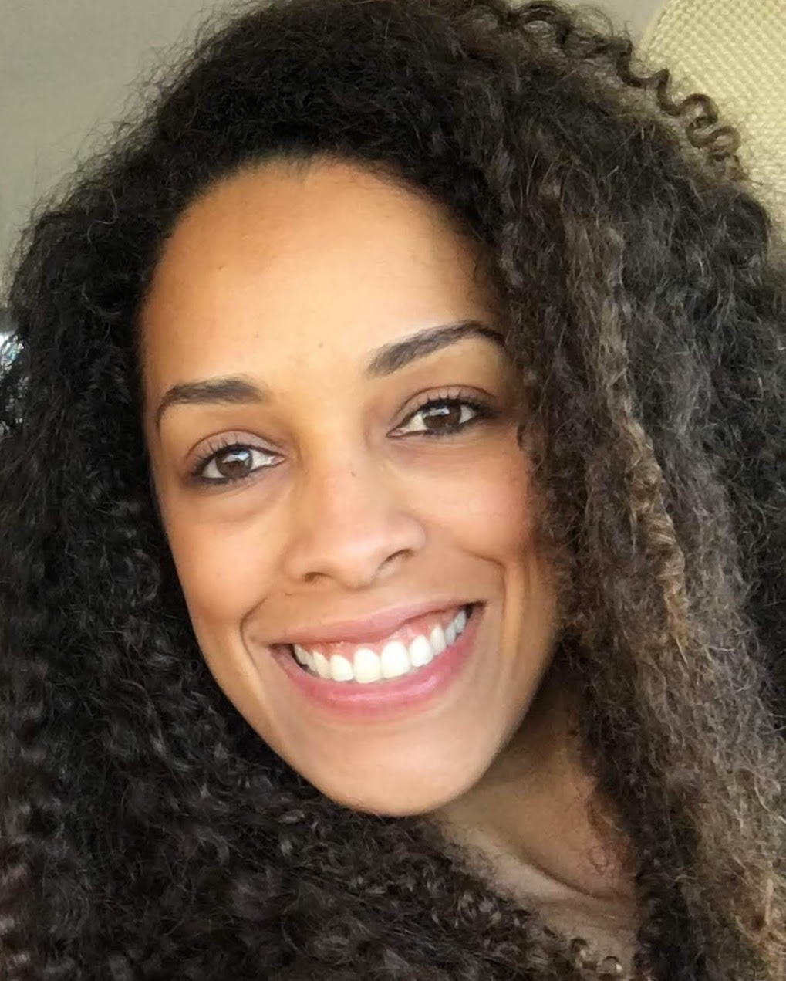
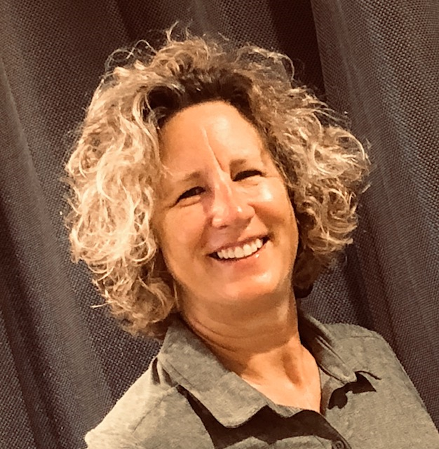
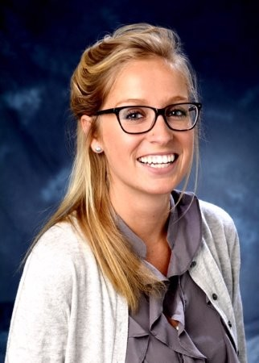
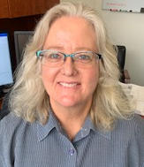
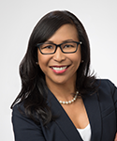
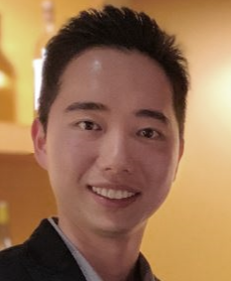
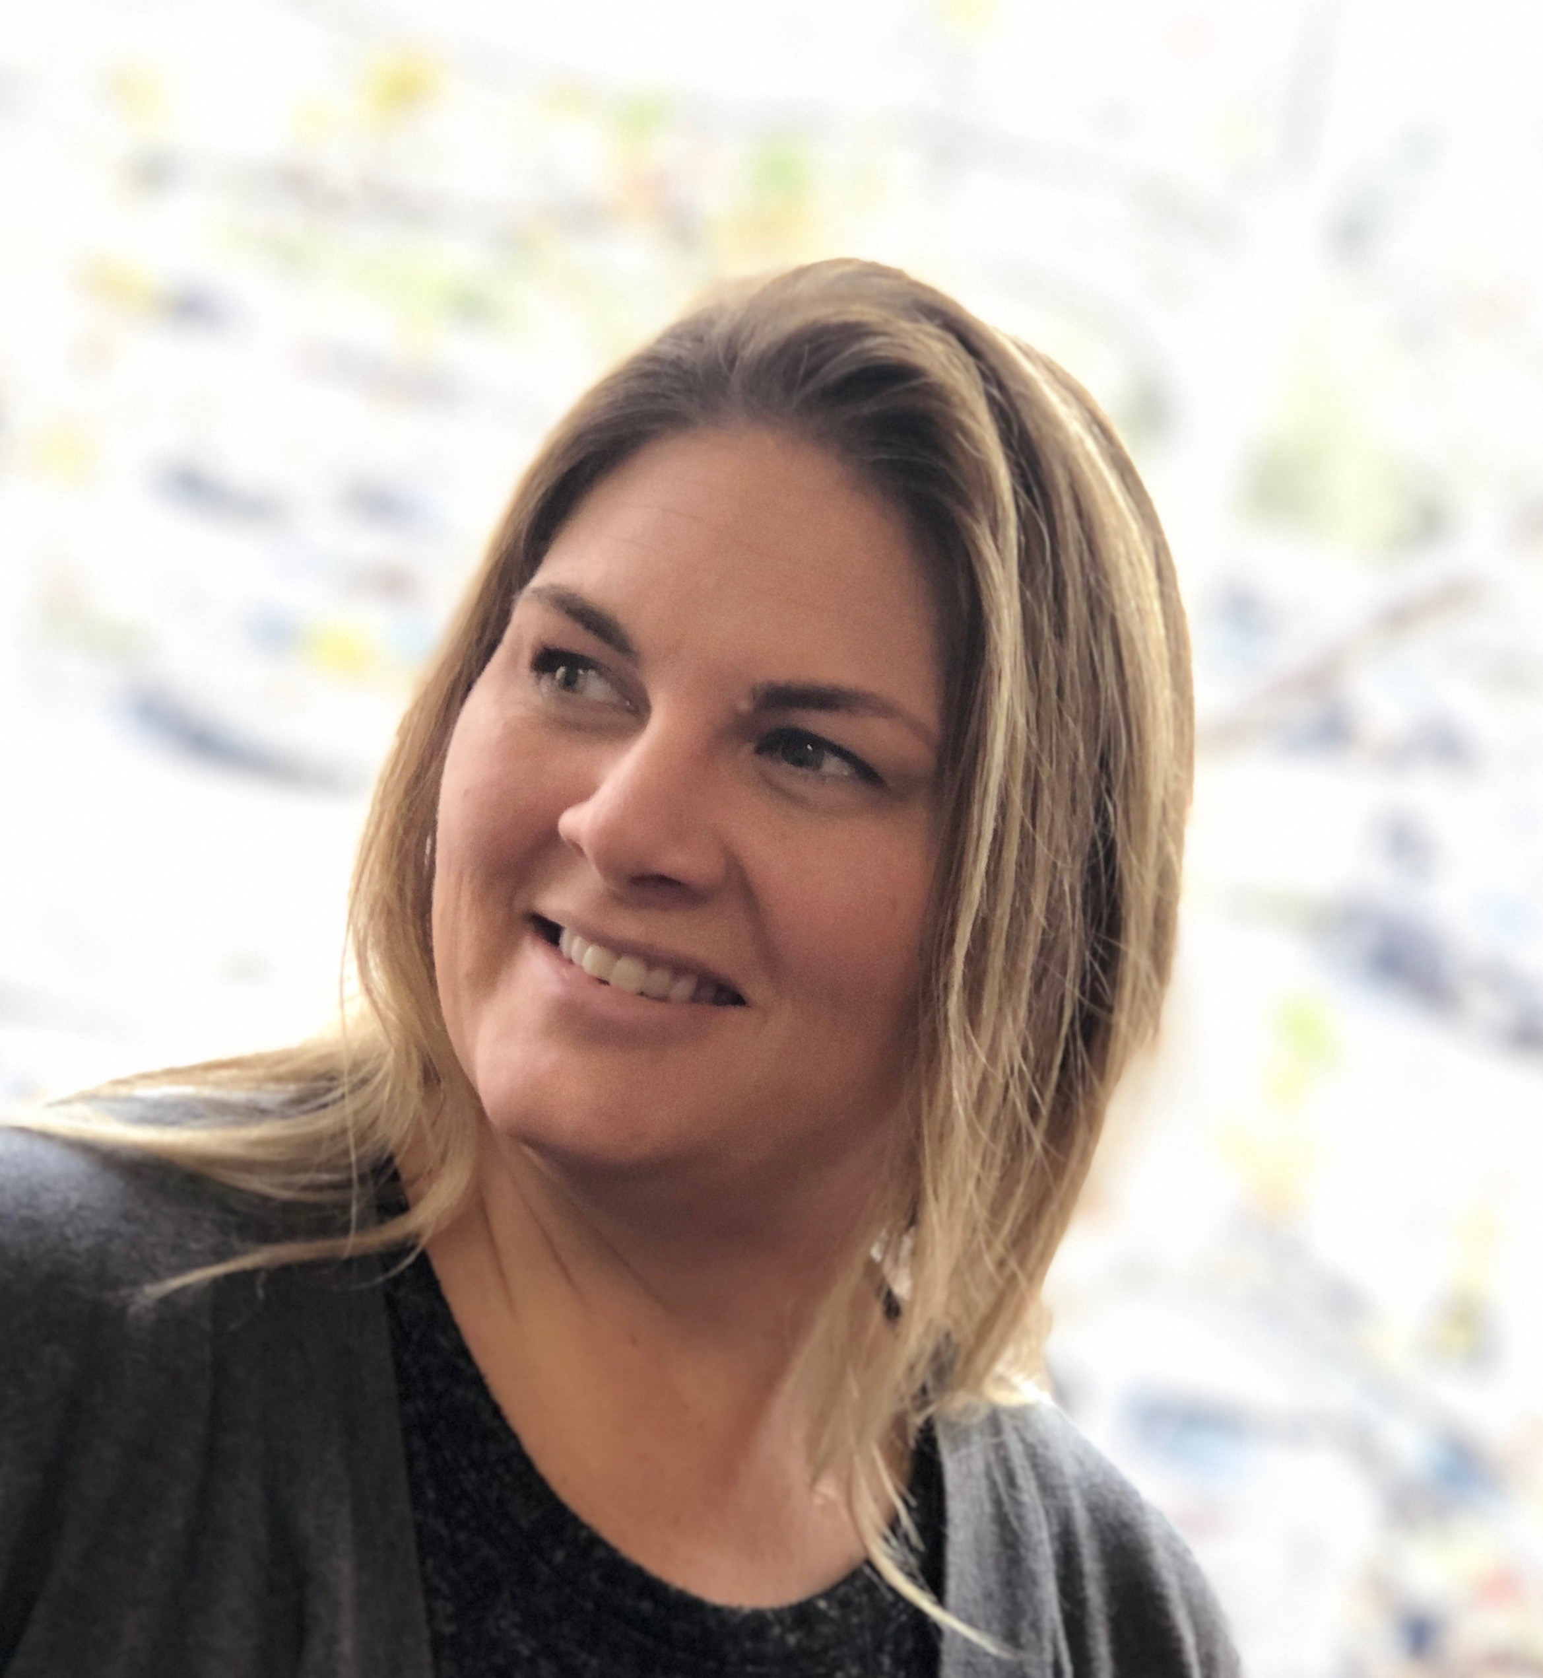
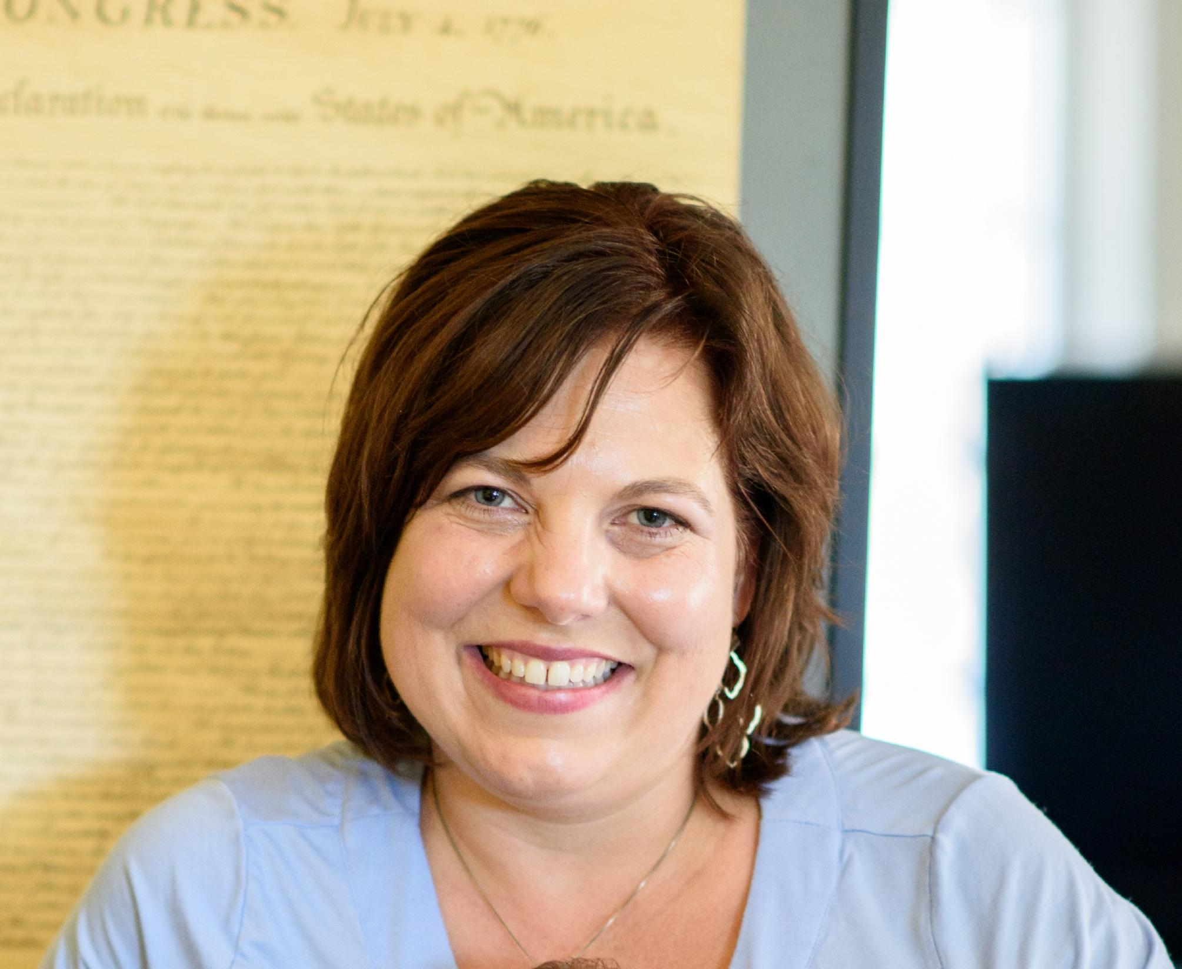
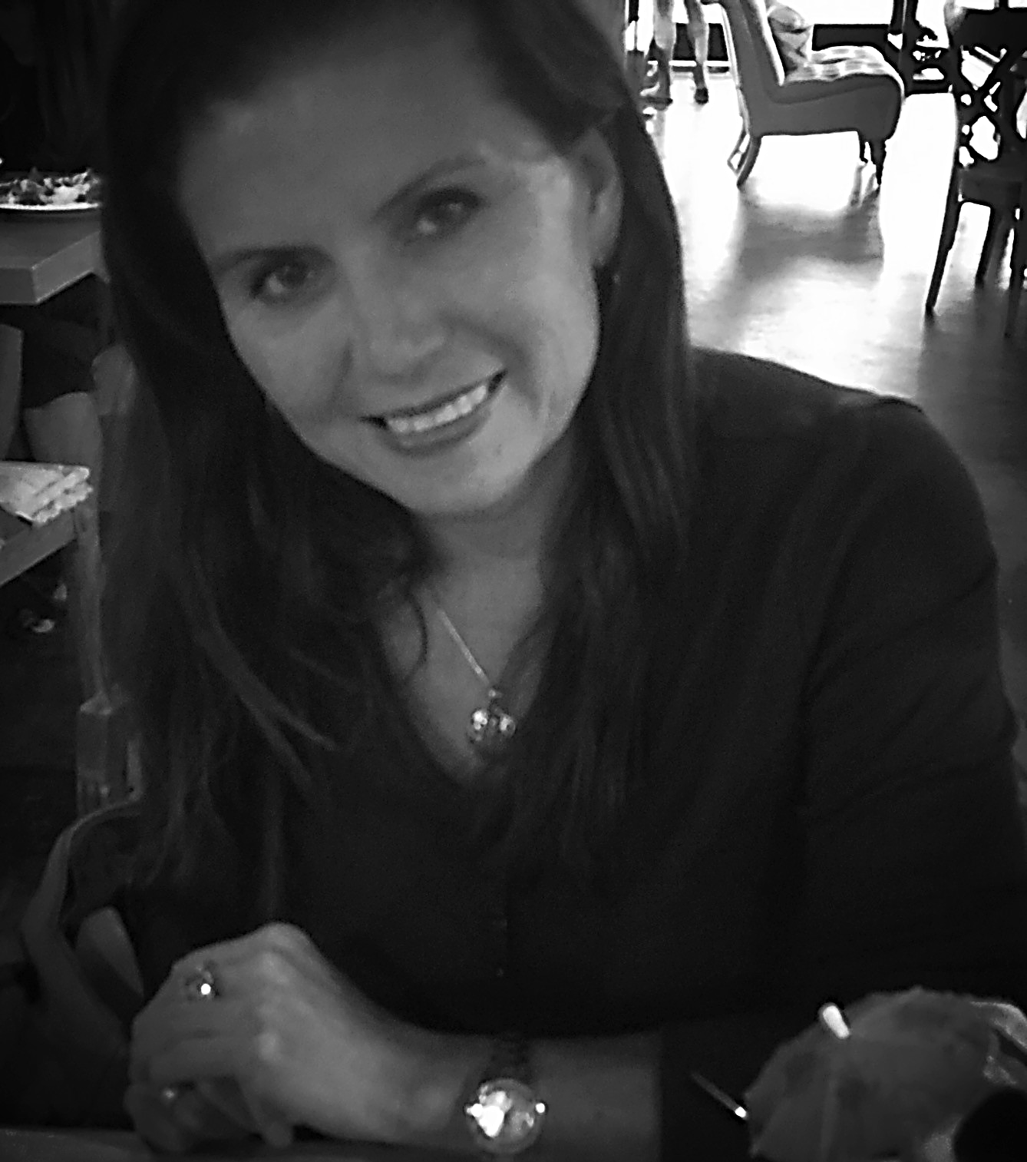
Design Leads
Access Management
Bill McCarroll
Accounts Receivable,
Cash and Banking
Susselys Virgil
Asset Management
Jamie Wheat
Budget and Planning
Amanda Buss
Common Chart of Accounts
Jamie Nickel
Controls and Compliance
Arlynn Renslow
Disbursements and Travel
Kevin Wong
General Ledger
Melissa Navarro
PPM (Post Award)
and Project
Marissa Prough
Notes:
Cheryl (~3 minutes)

Slide 10
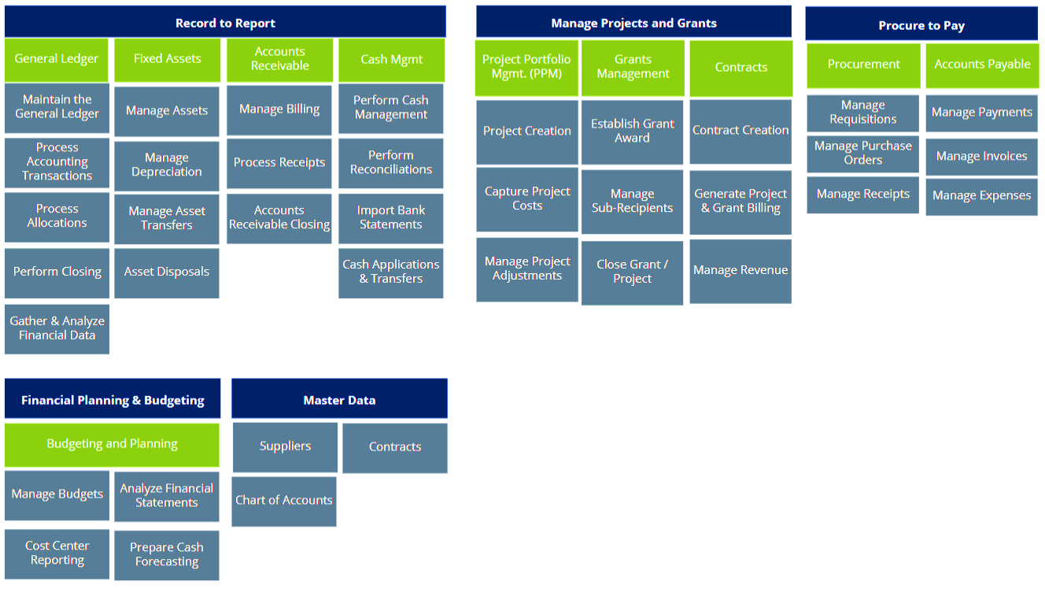
Design Process and Module Scope
Notes:
Bill (~4 minutes)

Slide 11


Design and Iterate
Design Teams
Observe
Analyze
Develop Solution
Listen &
Feedback
Configure or
Deploy
Stakeholder Vetting
Notes:
Bill (~2 minutes)

Slide 12
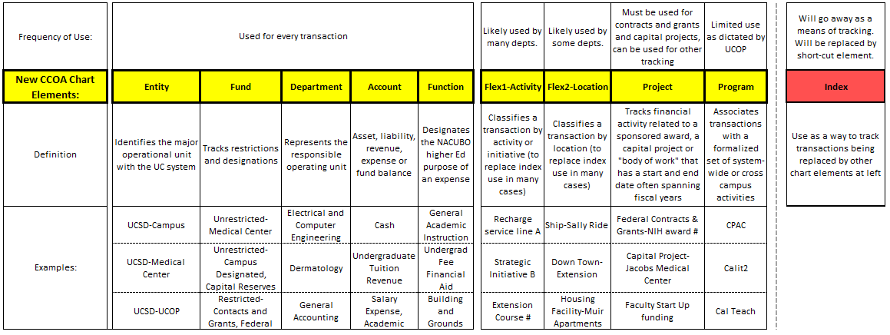
New Common Chart of Accounts Structure
HOW?
Visit Redesigned CCoA to review final drafts of new chart elements.
Notes:
Bill (~7 minutes)

Slide 13
IFIS Chart of Accounts Clean Up
Clean-up and inactivations have been ongoing. Comparing last June 2018 to this December 2018 we have:
1,767 reduction (11%) in # of active funds—should be more to come
2,535 reduction (39%) in # of active orgs
2,055 reduction (36%) in # of active accounts
4,717 reduction (87%) in # of active program codes
25,932 reduction (28%) in # of active indexes
Visit CoA clean up to review reports to assist you in your clean up.
HOW?
Notes:
Bill (~2 minutes)

Slide 14



Oracle Launch
January 2020
Oracle Enterprise Planning and Budgeting Cloud Service Module
July 2020
All remaining Oracle ERP Cloud Modules
Post Launch Enhancement
Oracle Fusion Advanced Financial Controls Cloud Service Module
Notes:
Bill (~3 minutes)

Slide 15
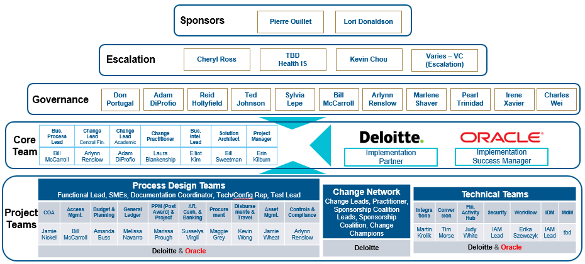
Project Structure
Notes:
Erin (~2 minutes)

Slide 16
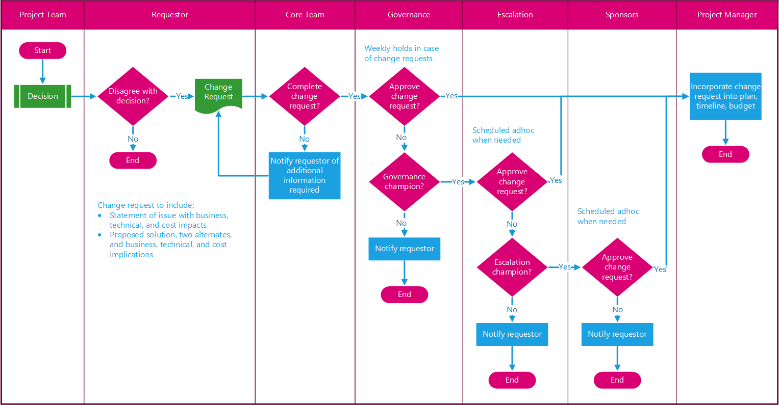
Decision and Escalation Process
Reqs & Process Landscape
Design Lead
Design Team
Testing
Training
How are decisions made and feedback incorporated?
Notes:
Erin (~1 minute)

Slide 17
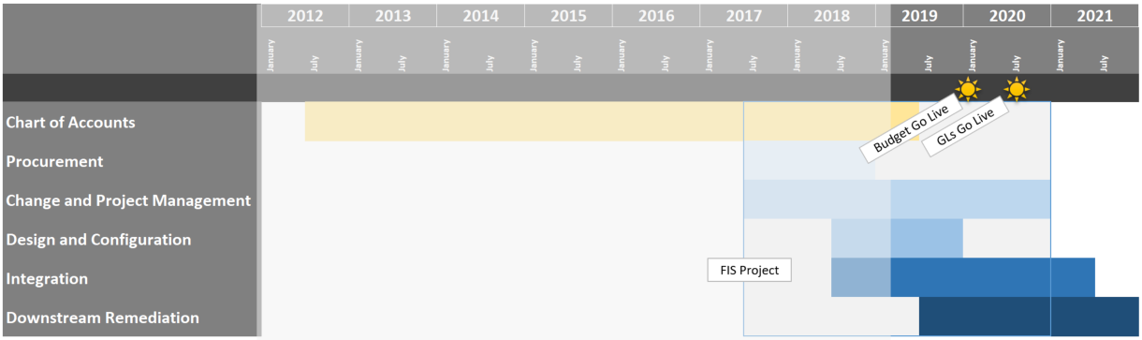
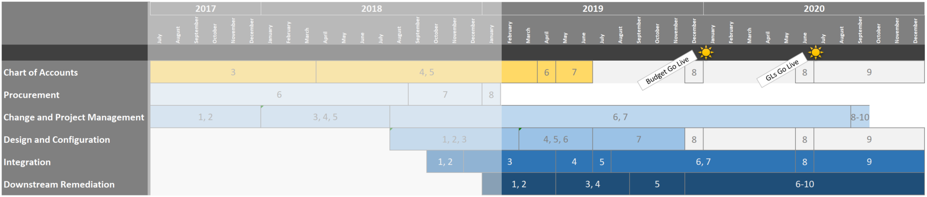
Phases
We Are Here
1. Identification and Initiation
2. Concept and Business Case
3. Requirements and Analysis
4. Preliminary Design
5. Detailed Design
6. Implementation and Configuration
7. Validation and Test
8. Transition
9. Operations and Maintenance
10. Decommission
Notes:
Erin (~1 minute)

Slide 18
90 Day Plan
Project Deliverable | Date
Functional Implementation Certification | February- April 29th
Travel Tool Decision | March 1st
Chart of Accounts Complete | March 31st
Procurement Tool Decision | April 1st
Integration Inventory Decisions (300+ apps, custom data processes!) | April 30th
Training Plan Development | April 30th
Learning Deliverable | Date
Analytics Community of Practice Financial Activity Hub Triton 1 & 2 (TPCS 3rd Floor) | Today@ 1:30-2:30
People Manager Workshops Price Center (West Ballroom A and B) | Feb. 25th
Chart of Accounts Q&A Zoom (campus wide); 2 hour session | April 3rd
Notes:
Erin (~2 minutes)

Slide 19
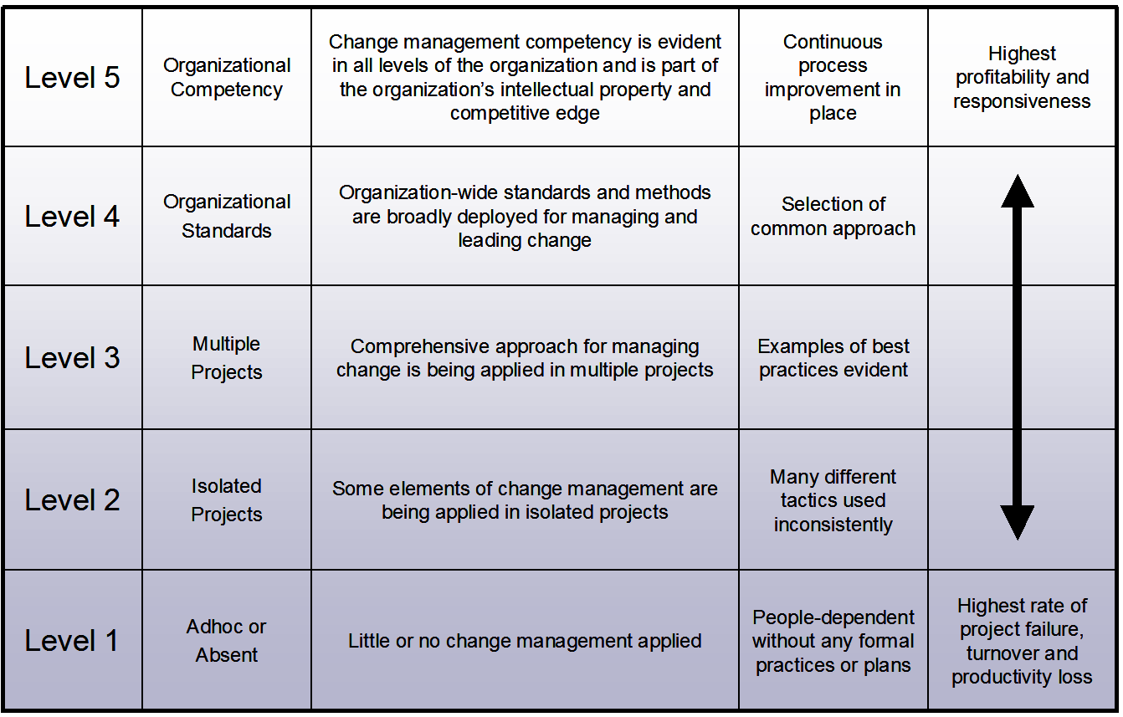
Prosci® Change Management Maturity Model™
ESR Change Management Approach: Strategic and Unified
Notes:
Bernadette (~30 seconds)

Slide 20







Top Contributors to Success
Active and visible
executive sponsorship
Frequent and open communication
Integration and engagement with project management
Dedicated change management resources
Structured change management approach
Engagement with middle managers
Employee engagement and participation
Insights and learnings from variety of organizations across globe 20+ years
Notes:
Bernadette (~3 minutes)

Slide 21
Project Plans Account for the Psychology of Change
Organizational Plans and Community Effort Will Achieve Individual Outcomes
Awareness
Desire
Knowledge
Ability
Reinforcement®
Communications Plan
Sponsor Roadmap
Sponsor Roadmap
Coaching Plan
Resistance
Management
Plan
Training Plan
Set Change Management Plans & Deliverables over time
Notes:
Bernadette (~2 minutes)

Slide 22
ESR Program Structure to Support and Guide Projects
ESR Governance - Enterprise Information Services Committee (EISC)
Laurie Owen - AVC, Research
Daric Brummett - Executive Director, Advancement
Nancy Resnick - Chief HR Officer, Campus
Janet Kamerman - Chief HR Officer, Health
Cheryl Ross - AVC, Controller
Hemlata Jhaveri - Executive Director, Housing Dining Hospitality
Alysson Satterlund- VC, Student Affairs
Gene Hasegawa - COO, Health Sciences
Robert Continetti - Senior AVC, Academic Affairs
Anne Footer - Interim AVC, Scripps Institution of Oceanography
Gary Matthews - VC, Resource Management & Planning
Steve Ross - AVC, Academic Resources
Adele Brumfield - AVC, Enrollment Management
Lori Donaldson - CFO, Medical Center
Kevin Chou - Director, ESR
Pierre Ouillet - VC, Chief Financial Officer
ESR Program Team
Procurement
--------
Ted Johnson - Chief Procurement Officer
Todd Adams - Director, Procurement
Bryan Hurley - Manager, Technology
Mary Chiu - RFx Supervisor
Lynda Ta - RFx Coordinator
Director
--------
Kevin Chou
Architecture & Program Management
--------
Scott Lee - Enterprise Architect, ESR
David Hutches - Data Architect, ESR
Kal Zsamboky - Program Manager, ESR
Expert Sourcing Facilitation
--------
Steve Ross - AVC, AA Resource Administration
Nancy Resnick - CHRO, Campus
Janet Kamerman - CHRO, Health
Strategic OCM
--------
Bernadette Han - Director, Strategic OCM
Mojgan Amini - ITS/IT Community
Lynn Underwood - ITS/IT Community
Marketing & Communications
--------
Mark Hersberger - ESR Communications
Elaine Fleming - ESR Communications
Jade Griffin - Associate Director, University Communications
Notes:
Bernadette (~2 minutes)

Slide 23
We Need Your Help
1
2
Communicate frequently and directly with colleagues and management and serve as a direct source of feedback to the FIS Core Team about any issues and concerns so that we can immediately address, course correct, deploy resources, train and resolve
  Promote the use of new technology and business intelligence for decision making, full utilization of system capabilities as innovation tools to support strategic initiatives, entrepreneurship and career development
4
3
Participate actively and visibly throughout the project – newsletters, emails, events, roadshows, meetings
  Enhance awareness of the university’s efforts in accountability and transparency as a public entity, including our commitment to financial stewardship, data integrity, and efficiency in financial operations
5
  Personally engage and demonstrate why change is necessary, influence and set priorities with your teams
6
  Help address and manage resistance, especially to the Guiding Principles
7
  Participate in reinforcing change by recognizing employees publicly and privately, and call out group and individual contributions
8
  Support continuous care, training and monitoring to ensure full adoption and usage
Notes:
Arylnn and Adam

Slide 24
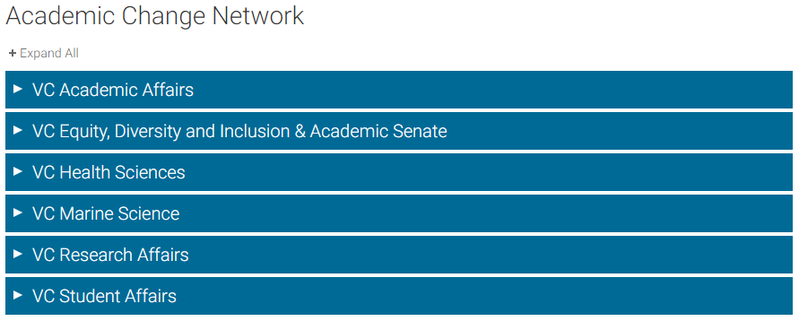
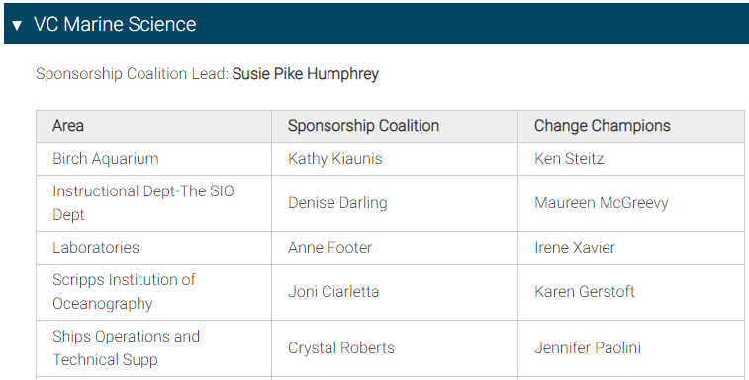
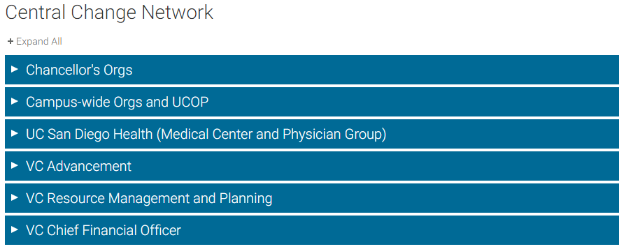
Find Your Change Network
Notes:
Adam (~4 minutes)

Slide 25
Survey Results
Survey Question | Results
I am aware that Oracle financials will replace UC San Diego's current IFIS system (plus additional applications) targeted for July 2020. | 89% Yes 11% No
I understand the objectives of the ESR Financial Information System project. | 59% Yes 14% No 27% Maybe
My biggest concern regarding Oracle implementation involves: | 31% Business Process Changes 13% Change in Chart of Accounts 9% Change Saturation 5% Insufficient Communication 29% Insufficient Training 2% Leadership Transparency 9% Other
Notes:
Adam (~2 minutes)

Slide 26
Survey Q&A
System Integrations
How is UCPath integrating with Oracle financials?
Will the new financial system communicate with ISIS?
How does this project impact Med Center systems?
Notes:
Bill (~2 minutes) Questions 1 and 2
Lori (~2 minutes) Question 3

Slide 27
Survey Q&A
Consultants
How is Deloitte going to help us during implementation?
Notes:
Kevin (~1 minute)

Slide 28
Survey Q&A
Training
What type of training will be available?
When can we expect training?
Notes:
Adam (~3 minute)

Slide 29
Survey Q&A
Timeline
Is it feasible to launch in July 2020?
Will IFIS and Oracle systems run in parallel?
Notes:
Erin (~1 minute)

Slide 30
Survey Q&A
Reporting & Data
What happens to legacy data?
What reports will we have at go-live?
How does Activity Hub replace QueryLink?
Notes:
Kevin (~6 minutes for next 5 slides)

Slide 31
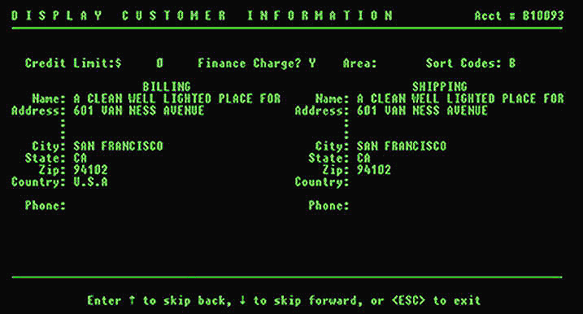
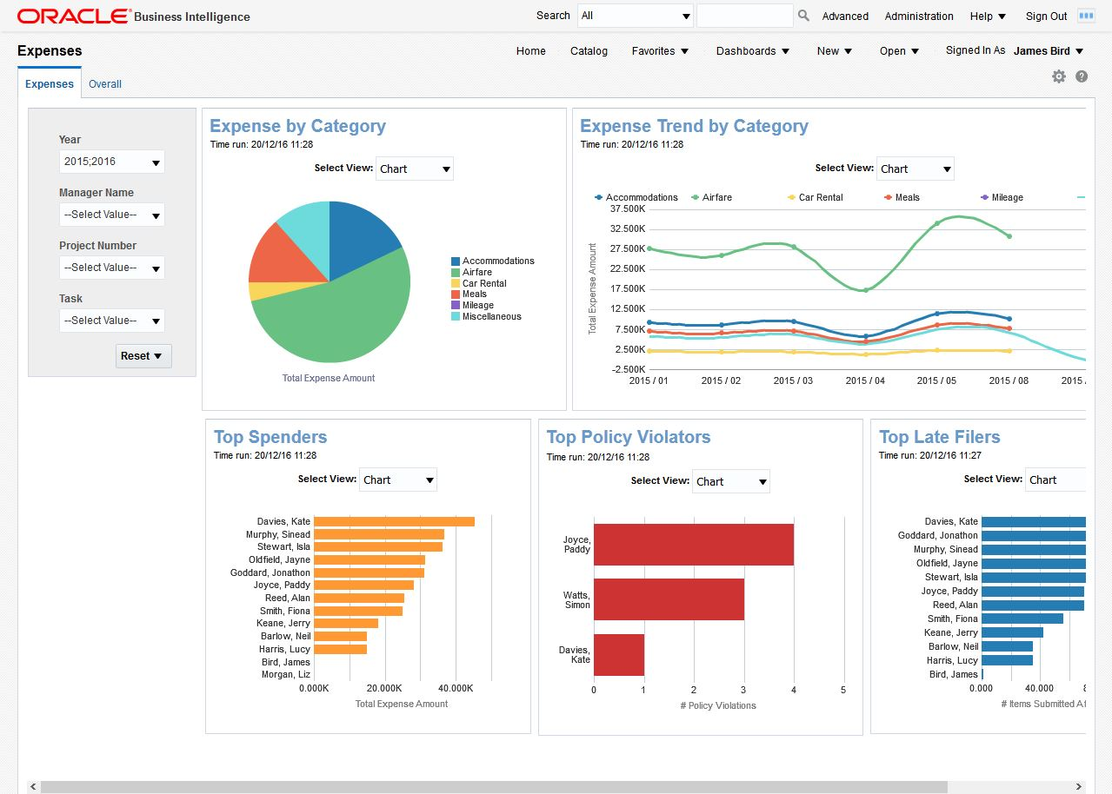
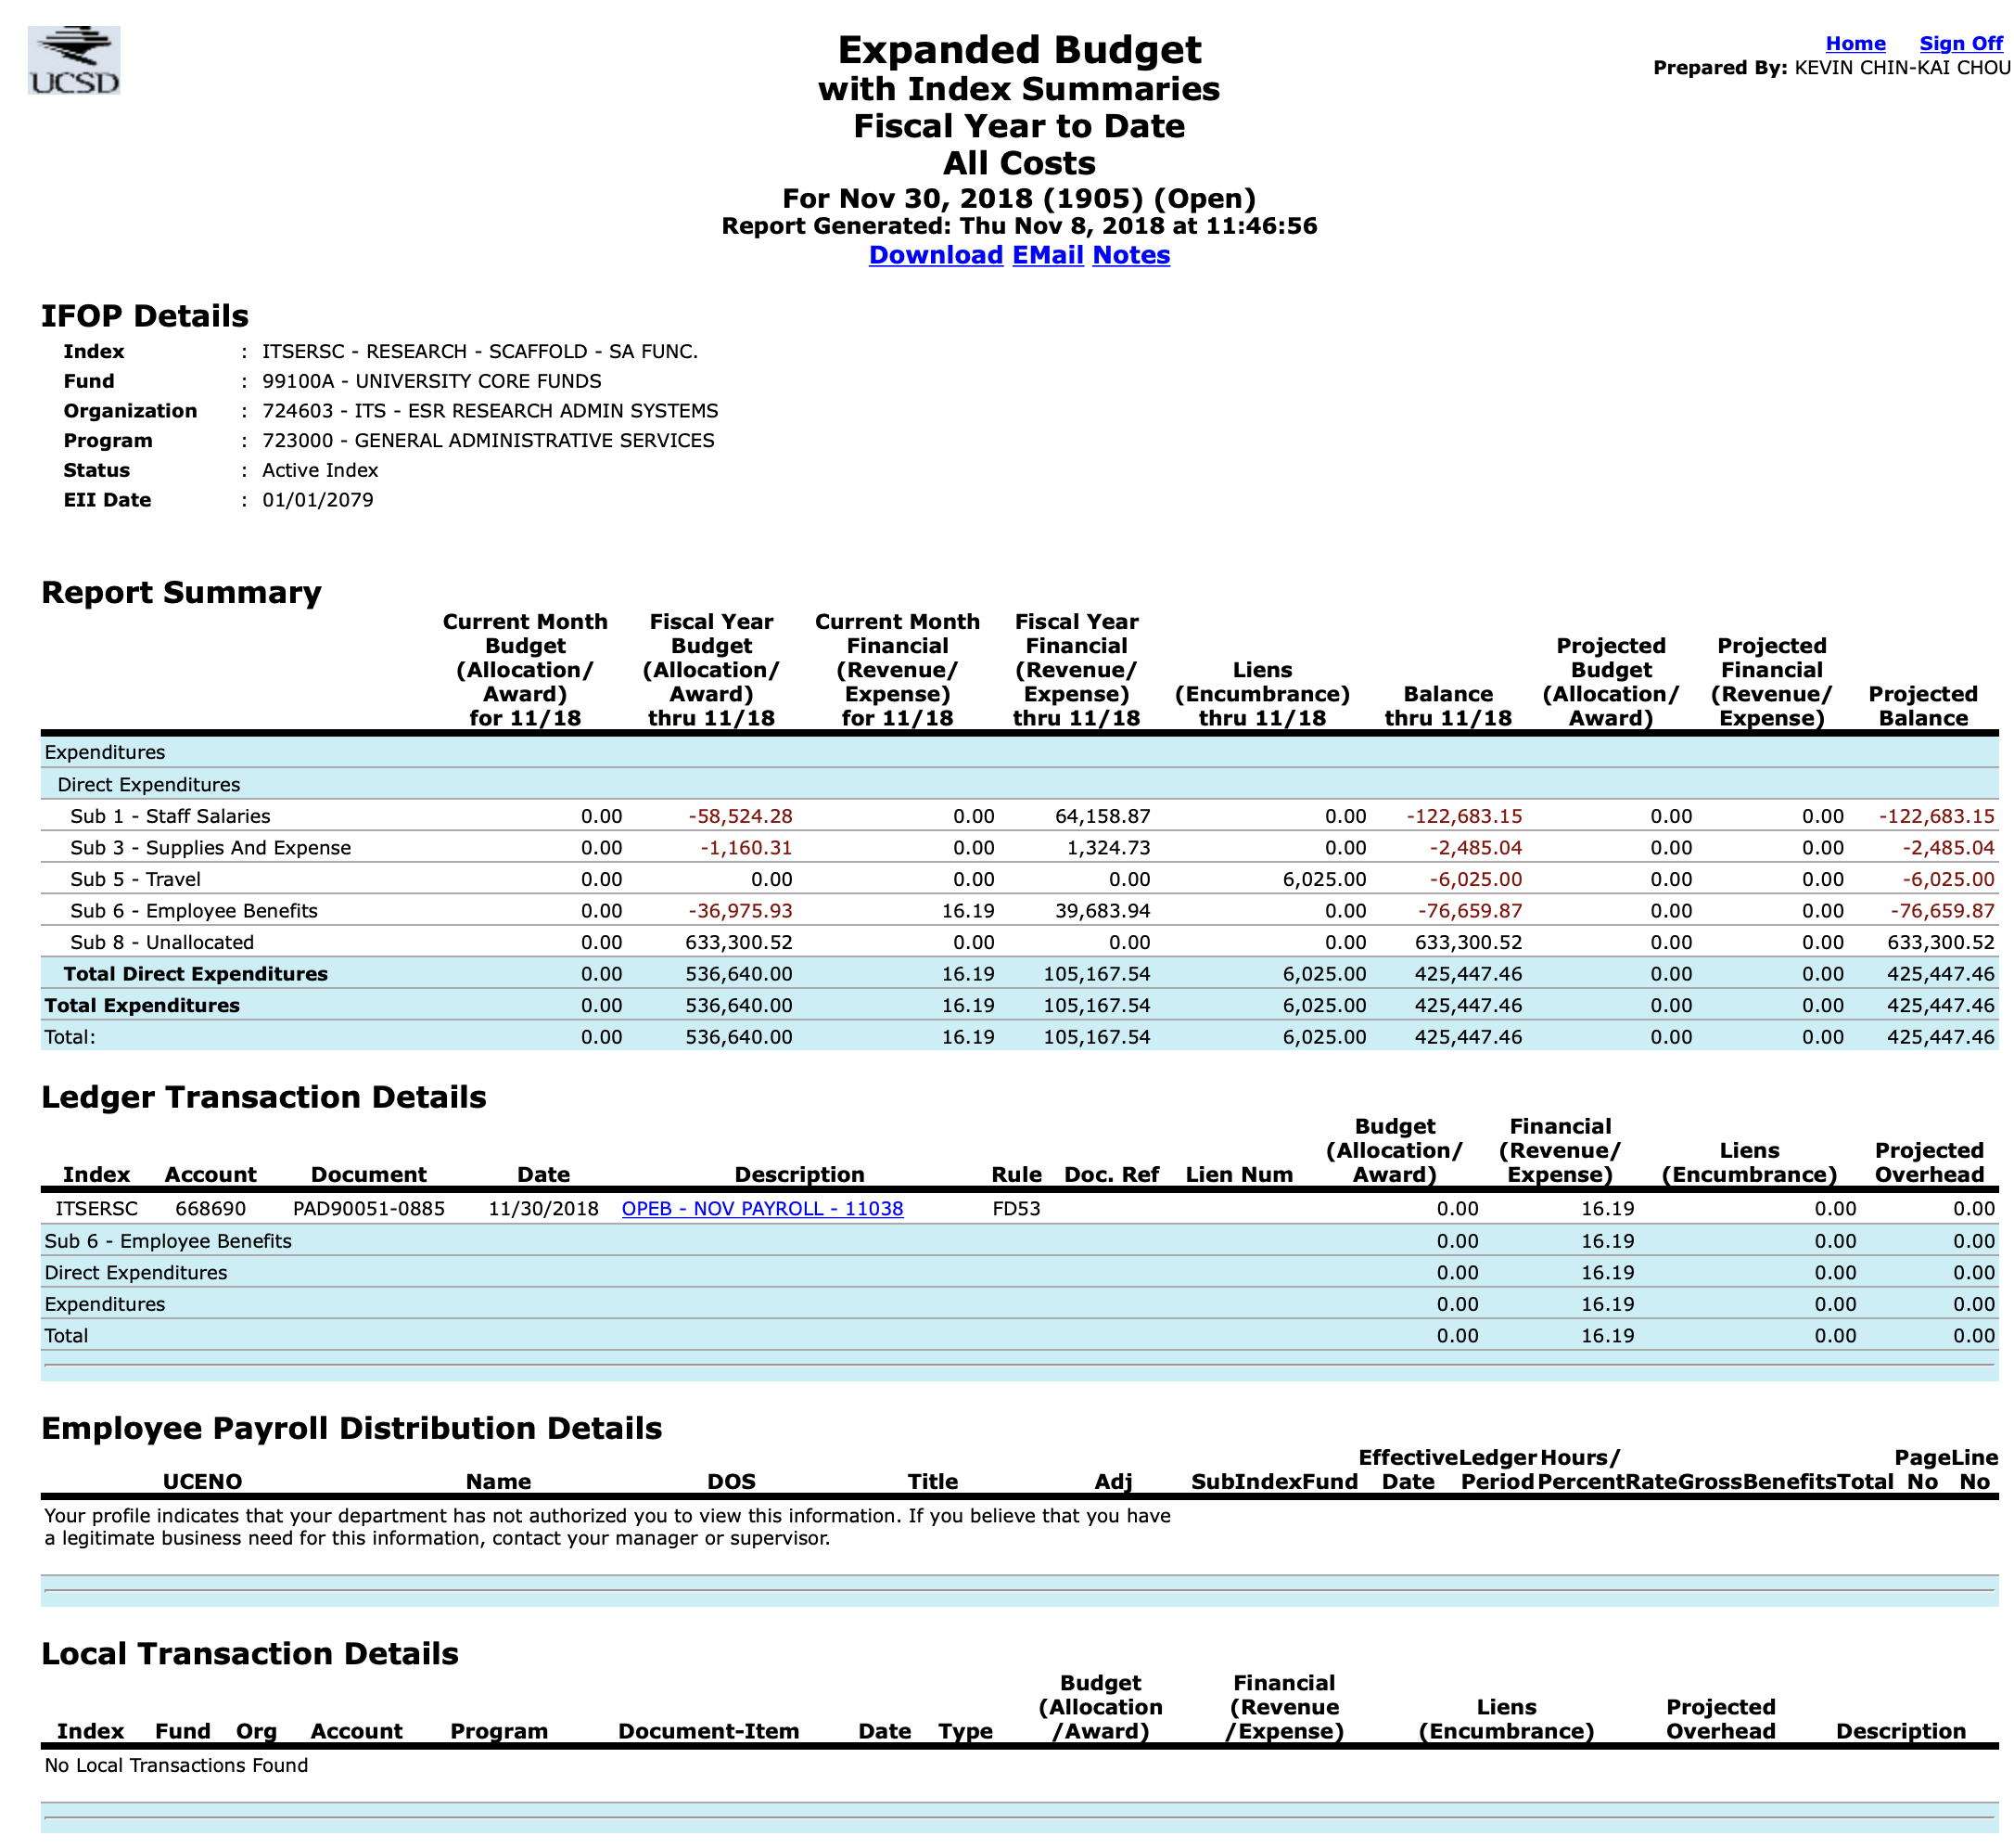
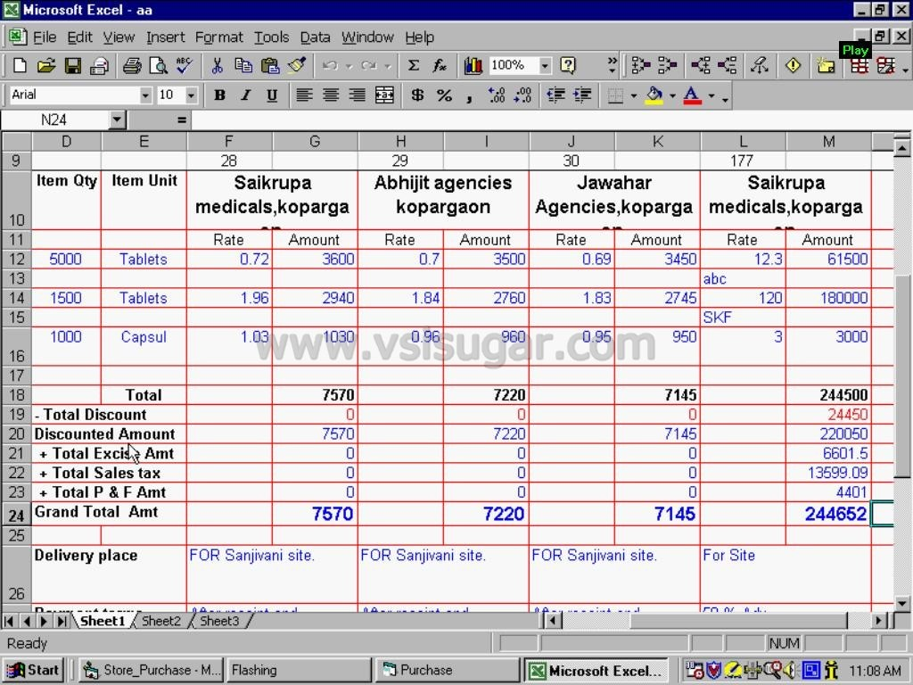
Why are we changing how you get data?
Now
Future
  Multiple Ways to Get Data
  A variety of Enterprise System screens and
  reports
  In-System Reports
  Reports from single Enterprise Systems
FinLink/IFIS
Excel Spreadsheet
Notes:
Kevin

Slide 32
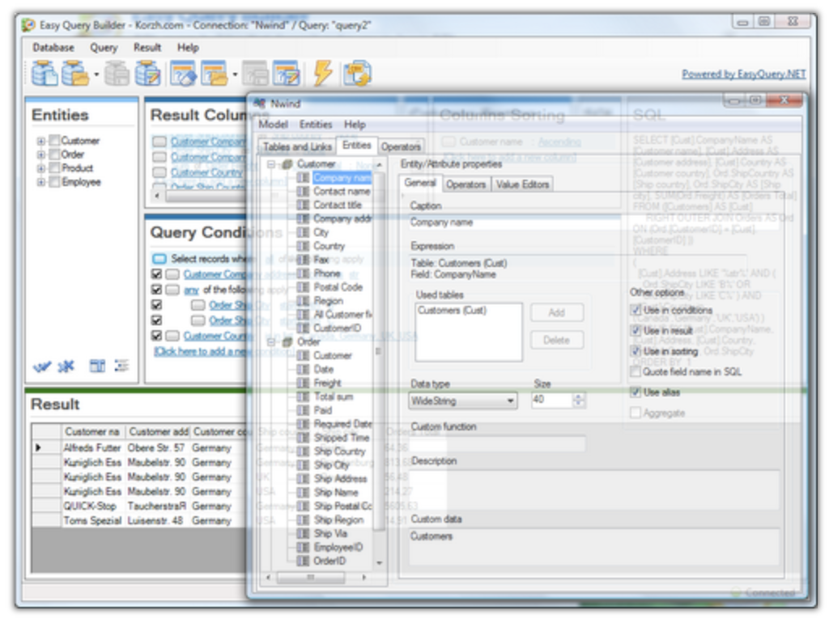
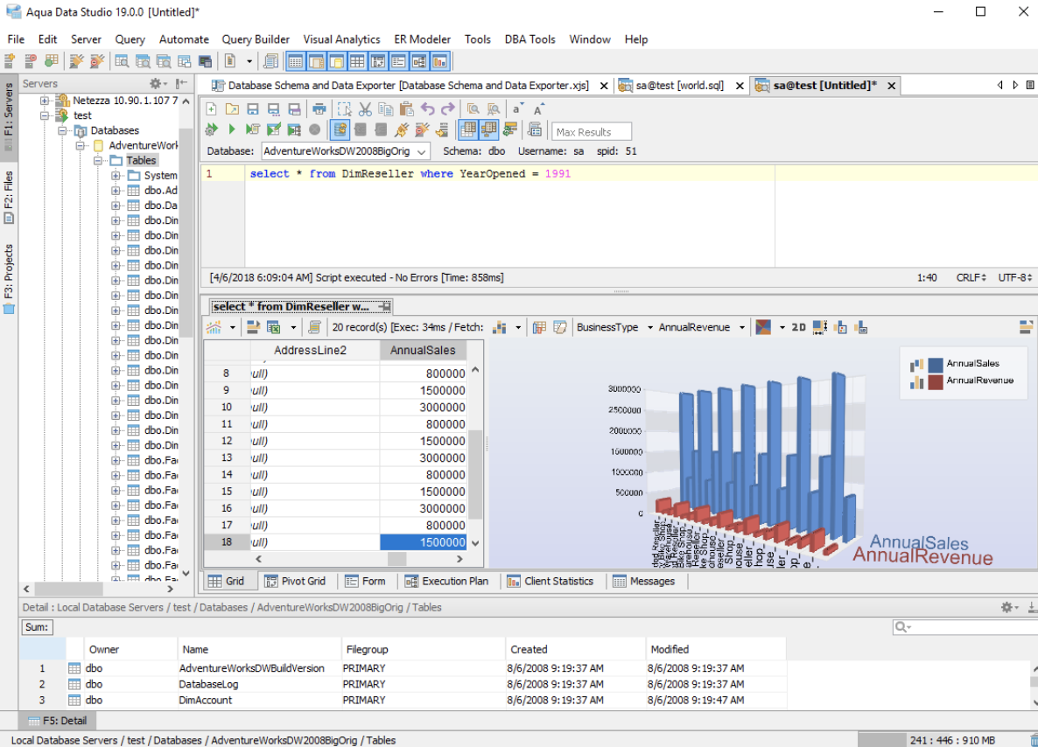
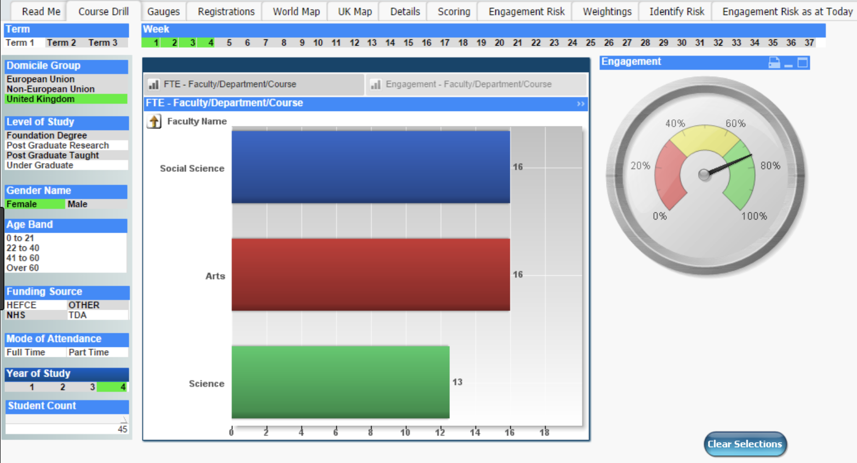
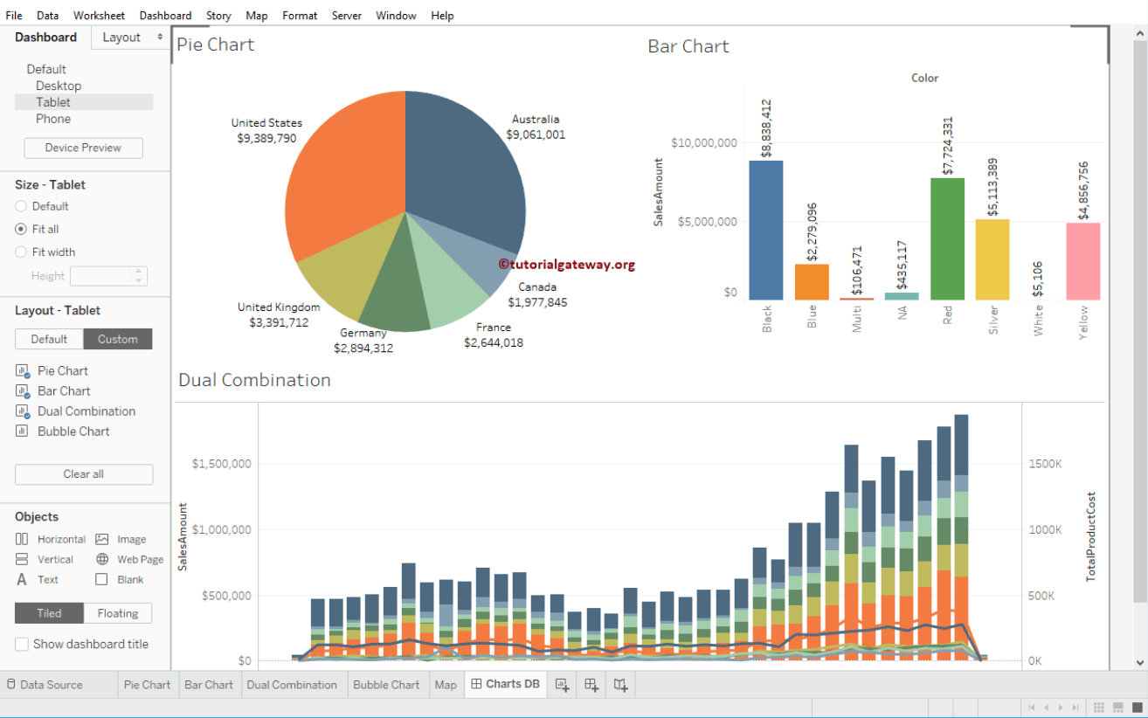
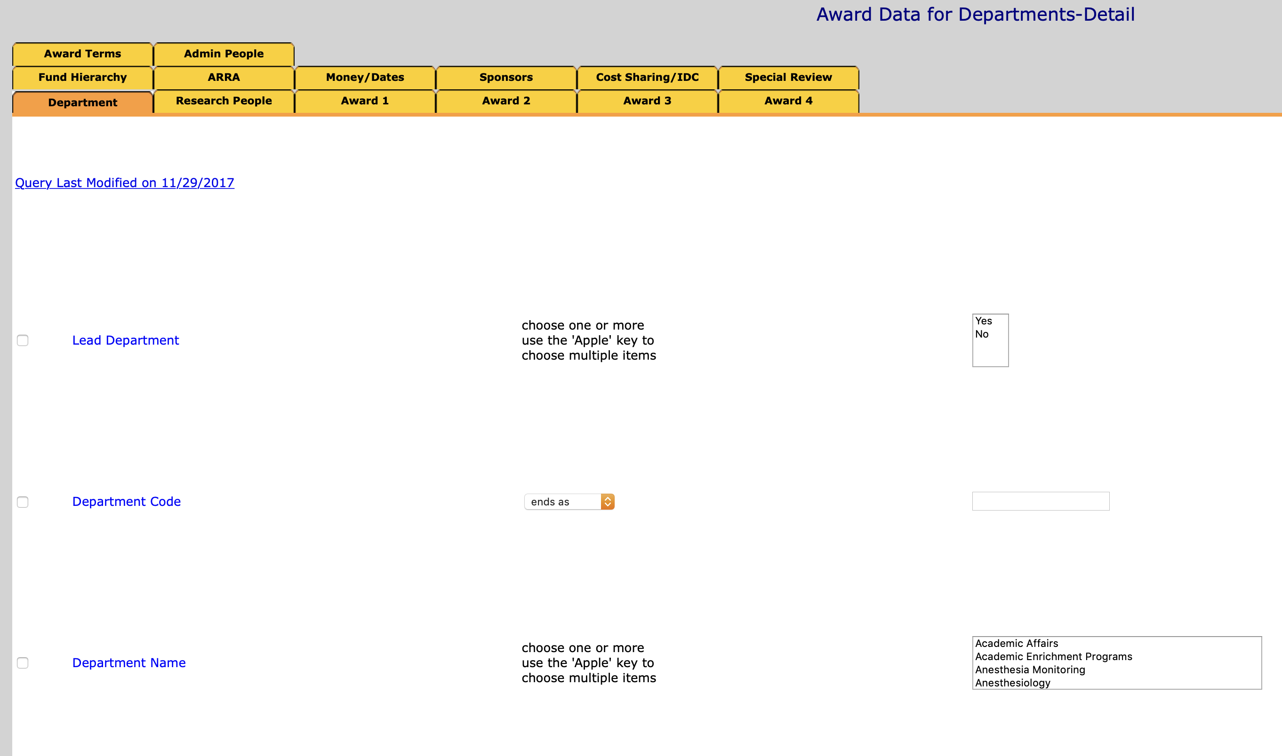
Data from Query/Reporting Tools
Now
Future
Custom Tools and Multiple Sources
A variety of tools, some custom-created,
pull data from multiple sources such as the
Data Warehouse
  Cognos/Tableau Reporting Tools
  Build & Run Custom Reports
  Blend Data from Multiple Systems
  Analyze Historical Data
Run, develop and save new reports using Cognos or Tableau pulling from Activity Hubs
Easy Query Builder
Aqua Data Studio
.
Blended
Custom
Historical
Reports
Adv/Alumni
Data
Employee
Data
Financial
Data
Research
Data
Student
Data
QueryLink/EasyQuery
Activity Hubs Data
Notes:
Kevin

Slide 33
How you will get data in the future
Query & Reporting Tools
Downstream Processes and Systems
Enterprise Systems
Systems of Record
In-system reporting
Activity Hubs
Cognos and Tableau tools
  Build & run
  custom reports
  Blend data from
  multiple sources
  Analyze historical data
iPaaS Integration Platform
Data connection for downstream applications
Notes:
Kevin

Slide 34

THANK YOU!
Email
esrfisp@ucsd.edu
Notes:
Kevin

