Slide 1
About Kuali Research
Here’s what you need to know

Slide 2
Kuali Research Sponsored Programs Modules
The scope of the modules under the purview of the Kuali Research project

Slide 3
Kuali Research (KR) Project Scope
ENTERPRISE SYSTEMS RENEWAL PROJECTS
Kuali Projects
Data and Analytics
Sponsored Programs Modules
Pre-Award
Proposal Development
Institutional Proposal
Negotiations *new*
Facilities Information Management
Financial Information Systems
Post-Award
Awards
Subawards *new*
Human Resources and Payroll
Research Administration Systems
Conflict of Interest (COI)
Student and Faculty Information Systems
Protocols Module
Supporting Technology Infrastructure
Institutional Review Board (IRB)

Slide 4
Kuali Initiatives at UC San Diego
ESR Kuali project updates
Kuali Research
Sponsored Programs Modules
(replacing EPD, Coeus IP, Coeus Award)
Pre-Award
Proposal Development* *(includes the KR Dashboard)
Institutional Proposal
Negotiations
Post-Award
Award
Subaward
Kuali COI
Facilitates Electronic Disclosures
(replacing paper/PDF process)
Covers the following forms:
PHS
700U
9510
Kuali Protocols
Human Subjects Protocols
(replacing legacy system)
PIs prepare and submit
New Studies
Modifications
Renewals
Reports
For review by
IRBs
SCRO
HRPP
Project Sponsor: Sandra A. Brown
Project Sponsor: Sandra A. Brown
Project Sponsor: Gary Firestein

Slide 5
Kuali Initiatives at UC San Diego
ESR Kuali project updates
Kuali Research
Sponsored Programs Modules
(replacing EPD, Coeus IP, Coeus Award)
Pre-Award
Proposal Development* *(includes the KR Dashboard)
Institutional Proposal
Negotiations
Post-Award
Award
Subaward
Kuali COI
Facilitates Electronic Disclosures
(replacing paper/PDF process)
Covers the following forms:
PHS
700U
9510
Kuali Protocols
Human Subjects Protocols
(replacing legacy system)
PIs prepare and submit
New Studies
Modifications
Renewals
Reports
For review by
IRBs
SCRO
HRPP
Project Sponsor: Sandra A. Brown
Project Sponsor: Sandra A. Brown
Project Sponsor: Gary Firestein

Slide 6
Kuali Research Project Update
Initiate
Design
Plan
Validate
Transition
Go Live
Realization
Stabilization
Configure
Initiate
Design
Plan
Validate
Transition
Go Live
Realization
Stabilization
Configure
General status update regarding progress since last quarter, activities for next quarter, risks/issues and project timeline.
Oct – Dec 2017
Jan – Mar 2018
Apr 2018 – Apr 2019
Aug 2018 – May 2019
May – Nov 2019
Dec 2019 – Jan 2020
Jan 21, 2020
Jan – Mar 2020
Apr – Jun 2020
We are here

Slide 7
Initiate
Initiate
Design
Plan
Validate
Transition
Go Live
Realization
Stabilization
Configure
Discuss resourcing needs; Finalize statements of work and discuss prioritization of domain implementation.
Oct – Dec 2017

Slide 8
Kuali Research Project
Business Case
Implement an integrated Electronic Research Administration solution that increases Faculty/Researcher productivity, improves financial/research compliance to mitigate risk, is closely aligned with lean/streamlined business operations, takes advantage of existing system functionality as appropriate and is integrated with current/future systems for the transfer of data between enterprise systems. The impact of this modernization and alignment effort will affect more than 800 end users, over $4B in submitted proposals and over $1B in annual expenditures.

Slide 9
Kuali Research Project
Objectives
Guiding Principles
Benefits
Transition from Coeus platform to Kuali Research SaaS solution
Implement electronic research administration modules
Review and improve current business processes using Lean Six Sigma methodology
Train impacted users on new business processes and system
Document and retire legacy business processes, systems and data as appropriate
Architect, document and implement data integration services
Cost savings by optimizing business processes
Leverage web-based SaaS to improve user experience with modern web and user interfaces
Improved compliance
Availability of new functionalities that support essential research administration business processes, and ensures effective management of risk
Greater security
Modernization and sustainability
Be open to change
Continue process improvement
Support a culture of quality
Encourage feedback and critique
Follow industry best practices

Slide 10
Kuali Research Project Scope
KR is web based so you can access on the go!

Slide 11
Plan
Initiate
Design
Plan
Validate
Transition
Go Live
Realization
Stabilization
Configure
Project team engages vendor partners in planning, including business process design teams.
Jan – Mar 2018

Slide 12
KR Project Structure
Sponsor
Sandra A. Brown
Escalation
Laurie Owen
Gene Hasegawa
Anne Footer
Governance
Linda
Collins
Erika
Wilson
Anne
Footer
Marissa Prough
Carolyn Sheehan
Maryam Attari
Eric
Mah
Angela McMahill
Ross Dammann
Bill
Decker
Core Team
Project Manager | Change Lead | Change Practitioner | Change Practitioner | Bus. Proc. Lead | Config. Lead | Solutions Architect | Testing Lead | Reporting Lead
Susan Oswalt | Nicole Joyce | Nicole Joyce | Francisco Mejia | Jason DeFay | Jason DeFay | Robert Dias | David Edmonson | Marisol Christinson
Kuali | Project Lead
Kaci Foster
Kuali | Functional Lead
Kat Szulc
Kuali | Technical Lead
Terry Durkin
Business Process Review Teams Lean Bench, SMEs, Bus Proc/Config Lead, Testing Lead, Reporting Lead
Determine Agreement Types 1.3.1 | Route for Review & Approval 1.3.2 | Develop & Finalize Budget 1.2.1 | Negotiate Award & Agreement 1.5 | Complete Compliance Requests 1.2.3 | PI Exception Complete Compliance 1.2.3 | Complete Questionnaires 1.2.4 | Final Review & Submit to Sponsor 1.3.3 | Send NOA to Unit 1.6.2 | Revise Budget 1.4.4 | Other Documents for Package 1.2.5
Reconcile & Finalize Record 1.3.4 | Complete Compliance/Protocol Approval 1.4.1 | Submit Advanced Spending Requests 1.4.5 | Create Award 2.1.2 | Request Fund Set Up 2.1.3 | Award Budget (Allocations) 2.1.5 | Issuing & Managing Subawards (outgoing) 2.2.3 | Manage Changes & Prior Approvals 2.2.6 | Manages Cost Sharing 2.3.3 | Submit Reports to Sponsor/Agency 2.5.4 | Finalize Sponsor/Agency Reporting 2.6.3
Kuali Support
Change Network Change Lead, Practitioners, Sponsorship Coalition Lead, Sponsorship Coalition, Change Champions
Kuali Support
Technical Teams Solutions Architect, Testing Lead, Reporting Lead
Integrations | Conversion | Res Activity Hub | Security | Workflow | IDM | MdM
Kuali Support
Project Teams

Slide 13
Change Structure
Our goal is to organize leaders, at all levels of the University, to coordinate communication, so end users hear the right messages from the right people. Change Network members are local sponsors and serve as an extension of the project Change Leads. Learn more about Change Network roles and responsibilities.
Executive Team
Change Network
Primary Sponsor
and KR Governance
Sponsor Coalition Lead
Sponsorship
Coalition
Change
Champions
Launches change
and actively sponsors among the research community
Serves as org. sponsor, and primary contact for the Change Lead and Sponsorship Coalition
Serves as the leader, executor, and communicator for their Division and/or Department.
Disseminates and advocates for positive change among impacted units and teams
Active and visible participation; communicates key messages from the Core Team
Support communications from Change Leads
Track readiness and provide two-way communication
Share communications and set priority

Slide 14
Design
Initiate
Design
Plan
Validate
Transition
Go Live
Realization
Stabilization
Configure
Business process review (SME involvement begins)
Apr 2018 – Apr 2019

Slide 15
Project Timeline
Initiate
Design
Plan
Validate
Transition
Go Live
Realization
Stabilization
Configure
This list is not exhaustive and is subject to change
Celebrating Success
We are here
Oct – Dec 2017
Jan – Mar 2018
Apr 2018 – Apr 2019
Aug 2018 – Apr 2019
May – Nov 2019
Dec 2019 – Jan 2020
Jan 21, 2020
Jan – Mar 2020
Apr – Jun 2020
Milestones
80+ SMEs
200+ hours
25 Processes
Over 1 year
Business Process Design
Based on business process design and decisions
Reviewed by SMEs
System Configuration
6 levels of testing and 2 phases per level
Engaging SMEs for various testing
User Acceptance Testing (Nov 2019)
Testing
Technology
Workflow/Process
Mindset
Leverage SME Trainers
Change Management: Communications and Training
Deployment Plan
Hyper Care
User Support Plan
Transition

Slide 16
Design
Business Process Review Goals
Streamline
Adopt single institutional best practice
Identify process inefficiencies and apply Lean Six Sigma proven process improvement methodology to streamline and realize cost and time savings
Reduce variation in processes and determine a unified best practices to be adopted institutionally
Leverage system capabilities and process improvements to gain efficiencies that are configured for consistent and singular implementation and utilization
Reduce Variation

Slide 17
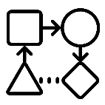
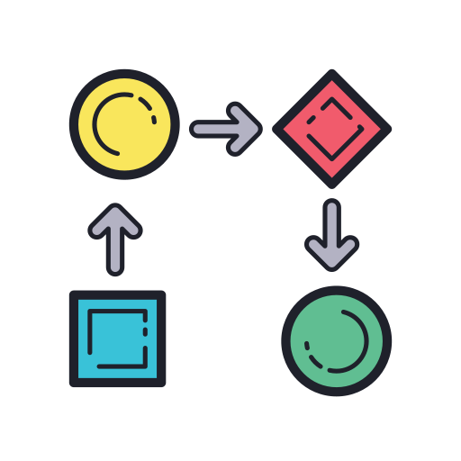
Business Process Review
This is oversimplified!
Coming up with a proposed future state
1)
2)
3)
4)
Project Governance provides the Project Team with names of SMEs for designated business process reviews
Project Team meets with groups of SMEs to conduct current state mapping
SMEs Business Process Design Teams applies Lean Six Sigma methodology and works with Project Team to consult with the vendor and come up with and vote on an improved proposed future state
Project Team presents the proposed future state to the Project Governance for review and final approval before passing the proposed future state on for configuration

Slide 18
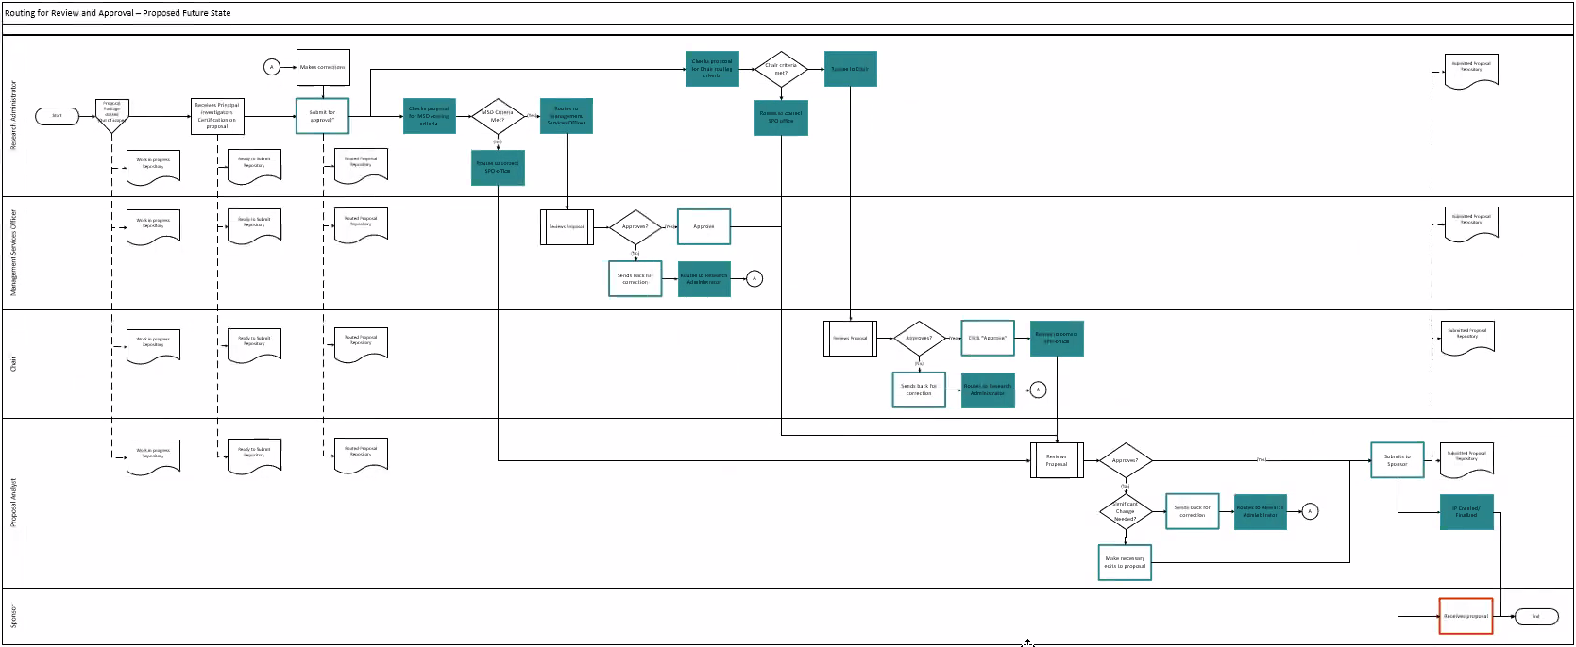
Understanding Business Process Review Levels
EXAMPLE
Level 1 Function
A function is a discreet set of activities focused on achieving an outcome. Foundation for a Level 2 process.
Level 2 Activity
Breakdown of project-wide functions into major activities necessary to complete and maintain each function. Foundation for Level 3 process.
Level 3 Task
Breakdown of major activities into high level process steps called tasks required to complete activities. Foundation for Level 4 process.
Level 4 Subtask
Breakdown of tasks into sub tasks that provide detail including organizational responsibility and role interactions
Level 4

Slide 19
Research Administration – Process Landscape
Level 1

Slide 20
Research Administration – Process Landscape
Completed
In Progress
Not Yet Started
Message meeting w/ SMEs
Visit the Business Process Webpage for updates and to see who is involved
http://esr.ucsd.edu/projects/kuali-research/process/index.html

Slide 21
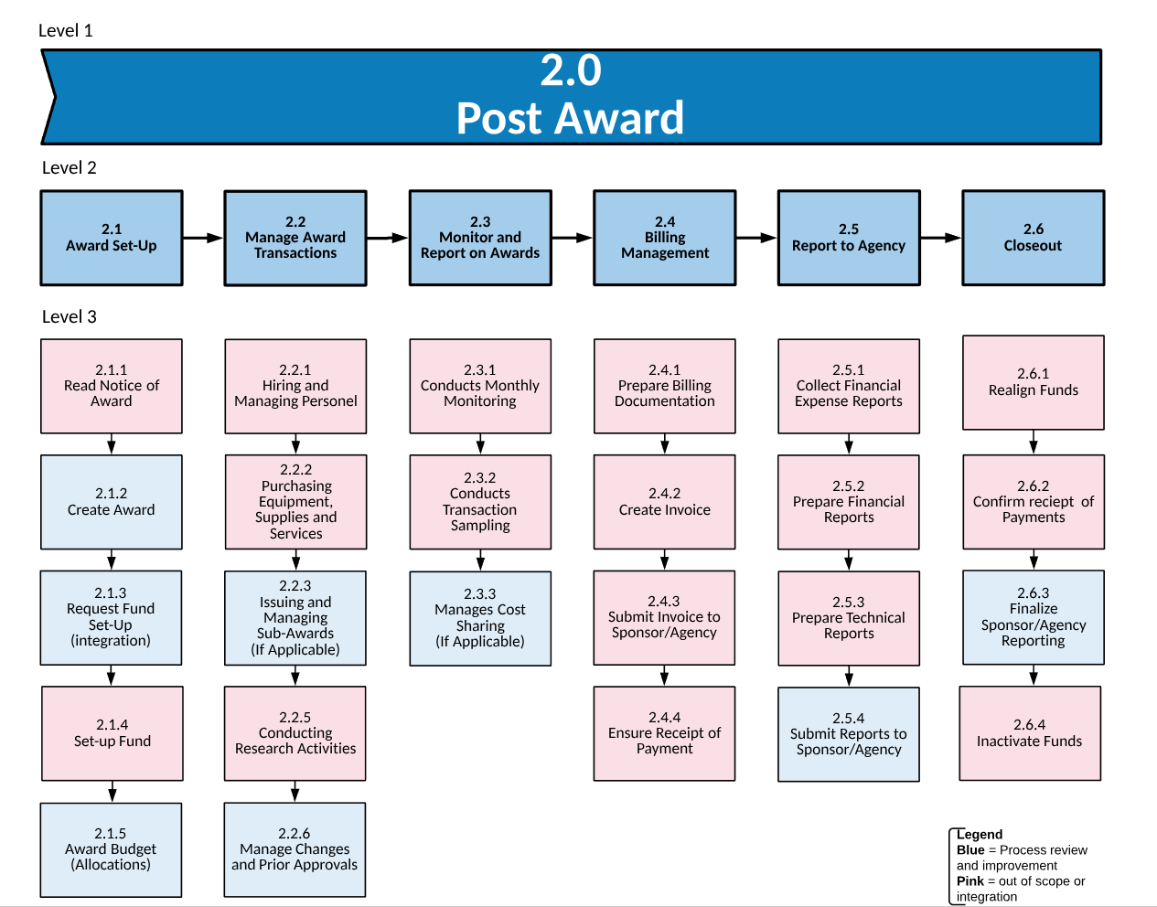
Research Administration – Process Landscape
Completed
In Progress
Not Yet Started
Message meeting w/ SMEs
Visit the Business Process Webpage for updates and to see who is involved
http://esr.ucsd.edu/projects/kuali-research/process/index.html

Slide 22
Business Process Messaging
Articulating impacts of business process changes
1)
2)
3)
4)
Change Lead meets with group of SMEs who conducted business process review and conducts any additional follow up needed
SMEs develop key messages regarding changes, impact, benefits and other items to consider for employees, managers and executives
Project Governance reviews SME messages and also conduct additional organizational impact analysis
Change Network distributes messaging accordingly

Slide 23
Configure & Prototype
Initiate
Design
Plan
Validate
Transition
Go Live
Realization
Stabilization
Configure
Developing and configuring the system and processes
Aug 2018 – May 2019

Slide 24
Configuration & Prototype
Configuration Lead works with the Solutions Architect, Testing Lead and Vendor to configure the system and develop testing requirements
SMEs are engaged in configuration feedback sessions
Proposed Future State Business Process is passed on for configuration
Configuration is tested internally by selected project team members and SMEs
As the system becomes more configured there will be more opportunities for users and stakeholders to see the system via demos, open offices and forums.

Slide 25
Validate
Initiate
Design
Plan
Validate
Transition
Go Live
Realization
Stabilization
Configure
Iterative system testing cycles; Validating and testing the system and processes
May – Nov 2019

Slide 26
Validate
Testing, Testing and More Testing
If test case “fails” the issue is worked on and retested until it passes
If test case “passes” then it is ready for production
Testing for technical AND functional business requirements
Technical and User Acceptance Testing (UAT)

Slide 27
Validate
Data
Migration
Testing
User
Acceptance
Testing
Testing new business processes and work procedures
Scheduled: October - December
Transferring Coeus Data to Kuali
Scheduled: May - June
Testing
Strategy
Functional
Testing
Performance
Testing
Ensure system will perform to acceptable standards
Scheduled: August
Technical configuration of Kuali
Scheduled: May - June
Business
Process Testing
System
Integration
Testing
End-to-end test of new business process flows determined in Business Process Improvement phase
Scheduled: July - August
Data pushed in and pulled out of Kuali from other enterprise systems (e.g. Financial, HR, Sponsor, etc.)
Scheduled: June - July

Slide 28
Preparing for Change
BUSINESS PROCESS IMPROVEMENTS
ASSESSING TRAINING NEEDS
DEVELOP & DELIVER TRAINING
REINFORCEMENT
MEASURING SUCCESS
COMMUNICATE
Changes resulting from business process improvements
AUDIENCES
Identify trainees
CONTENT
Designed to address Technology, Process/Knowledge and Mindset
REQUIRED DRIVERS
Processes and systems that reinforce, monitor, encourage, and reward performance or critical behaviors on the job
REACTION
How satisfied are trainees
CRITICAL BEHAVIORS
Identify actions that if done have the biggest impact on success
CONFIGURE SYSTEM
To support business requirements
SME ROLES
Contribute as Content Providers, Content Reviewers, Trainer, Co-Trainers, Coaches, Mentors
LEARNING
Were knowledge and skills increased
REINFORCEMENT GAPS
Knowledge
Skill
Motivation
Environment
Communication
LEARNING GOALS & OBJECTIVES
Inform content design and delivery
TEST
To ensure a production ready system that supports business processes
BEHAVIOR
Are trainees utilizing what was learned when on the job
OUTCOMES
Identify the need Knowledge, Skills & Abilities, Attitude, Commitment, Confidence
DELIVERY METHODS
Train-the-Trainer
In Person Instructor Led Virtual Instructor Led Recorded Presentations
Learning Lab/Open Offices
Digital Adoption Platform
On-the-Job Coaching
ORGANIZATIONAL PERFORMANCE
Were organizational goals achieved
EXPERTISE
Novice, Competent, Proficient, Expert

Slide 29
Preparing for Change
WHY
WHAT
HOW
APPLY
It is important to master new knowledge and skills
Do I need to know, do and believe
To change behavior and do things
Work on behavior change by using new knowledge and skills

Slide 30
Transition
Initiate
Design
Plan
Validate
Transition
Go Live
Realization
Stabilization
Configure
Robust end user training
Dec 2019 – Jan 2020

Slide 31
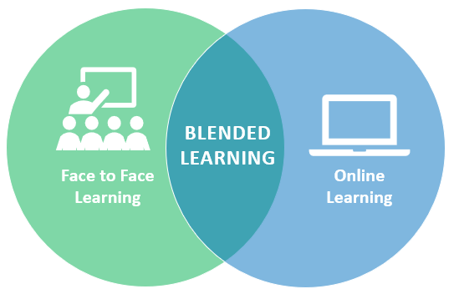
Transition
Training, Training & More Training
Robust end user training will occur once the system has passed UAT, using a blended learning approach.

Slide 32
Training Landscape
Learning vs. Behavior
Learning – the degree to which participants acquire the intended knowledge, skills and attitudes based on their participation in the learning event.
Behavior – the degree to which participants apply what they learned during training when they are back on the job

Slide 33
Training for Outcomes
Knowledge: the degree to which participants know certain information | Skills & Abilities: the degree to which they know how to do something or perform a certain task | Attitude: the degree to which training participants believe it will be worthwhile to implement what is learned during training on the job | Commitment: the degree to which learners intend to apply the knowledge and skills learned during training to their jobs, relates to learner motivation by acknowledging that even if the learner masters the knowledge and skills, they must still put forth effort to use the information or perform the skills daily. | Confidence: the degree to which training participants thing they will be able to do what they learned during training on the job. Addressing confidence during training brings learners close to the desired on-the-job performance. It can proactively surface potential on-the-job application barriers so they can be resolved.
“I know it.” | “I can do it right now.” | “I believe it will be worthwhile to do this in my work.” | “I intend to do it on the job.” | “I think I can do it on the job.”
Training for Expertise
Level of Expertise* | Beginner/Novice: Follows simple directions Performs using memory of facts and simple rules | Competent: Makes simple judgments for typical tasks May need help with complex or unusual tasks May lack speed and flexibility | Proficient: Performance guided by deeper experience Able to figure out the most critical aspects of a situation Sees nuances missed by less skilled performers Flexible performance | Expert: Performance guided by extensive practice and easily retrievable knowledge and skills Notices nuances, connections, and patterns Intuitive understanding based on extensive practice Able to solve difficult problems, learn fast, find needed resources
*Association for Talent Development (ATD) Training for Expertise Job Aid by Patti Shank, PhD

Slide 34
Training Requirements
Make sure ALL needs are assessed and addressed!
What are you training for?
Dealing with transition
Personally dealing with change
Succeeding in a changing environment
Managing resistance (supervisors and sponsors)
Big picture overview of the new environment
Basic or requisite skills/knowledge
Temporary work processes
Handling exceptions
Process skills/knowledge
System skills/knowledge
Technical skill/knowledge
Organizational skills/ knowledge
Problem resolution
People Manager Training
Town halls, roadshows, meetings, etc.
Ad hoc, incorporated as needed
Town halls, roadshows, meetings, etc.
KR Modules:
Dashboard
Proposal Development
Institutional Proposal
Negotiations
Award
Subaward
Kuali Protocols
Kuali COI
Other integrations?
Reporting tools
Hands on learning for end users
Hands on learning for system administrators
Ad hoc, incorporated as needed
Post-go live

Slide 35
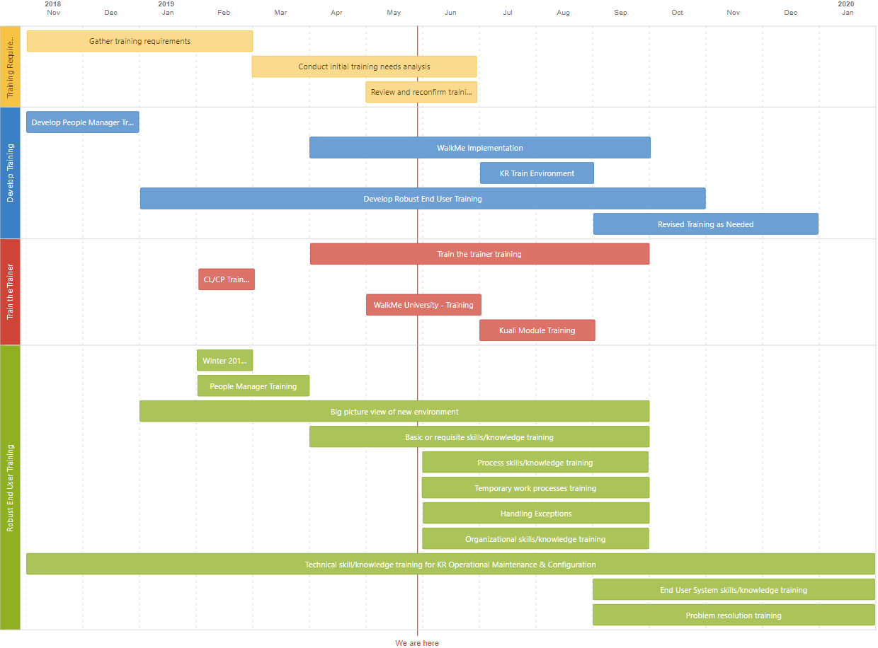
Training Roadmap Draft
This outlines the high level strategy and is subject to change
Rev 5.29.2019

Slide 36
Transition Strategy
Deployment Plan
Proposals & Awards In Coeus
Hyper Care Plan
Expedient support to Users during deployment AND after Kuali go live
User Support Plan
What does support look like after the stabilization period?

Slide 37
Go Live
Initiate
Design
Plan
Validate
Transition
Go Live
Realization
Stabilization
Configure
New system is launched!
Jan 21, 2020

Slide 38
Go Live
“Flip the Switch” & Celebrate!

Slide 39
Realization
Initiate
Design
Plan
Validate
Transition
Go Live
Realization
Stabilization
Configure
Deploying and monitoring the system and processes with vendor support
Jan – Mar 2020

Slide 40
Realization
How is it going?
Is the system working?
Are people using the system and business processes?
Is there anything else we need to do?

Slide 41
Stabilization
Initiate
Design
Plan
Validate
Transition
Go Live
Realization
Stabilization
Configure
After go-live, the stabilization period is typically three-nine months
Apr – Jun 2020

Slide 42
Stabilization
Smooth sailing? or Rough Seas?
How do we need to adjust post-implementation to maintain operations long term?

Slide 43
Kuali Research
Initiate
Design
Plan
Validate
Transition
Go Live
Realization
Stabilization
Configure
Stay up to date by…
We are here
Oct – Dec 2017
Jan – Mar 2018
Apr 2018 – Apr 2019
Aug 2018 – May 2019
May – Nov 2019
Dec 2019 – Jan 2020
Jan 21, 2020
Jan – Mar 2020
Apr – Jun 2020
Visiting the Kuali Research Website
esr.ucsd.edu/kuali-research
Connecting with members of the Change Network
Subscribing to the KR Newsletter

Slide 44
Kuali Initiatives at UC San Diego
ESR Kuali project updates
Kuali Research
Sponsored Programs Modules
(replacing EPD, Coeus IP, Coeus Award)
Pre-Award
Proposal Development* *(includes the KR Dashboard)
Institutional Proposal
Negotiations
Post-Award
Award
Subaward
Kuali COI
Facilitates Electronic Disclosures
(replacing paper/PDF process)
Covers the following forms:
PHS
700U
9510
Kuali Protocols
Human Subjects Protocols
(replacing legacy system)
PIs prepare and submit
New Studies
Modifications
Renewals
Reports
For review by
IRBs
SCRO
HRPP
Project Sponsor: Sandra A. Brown
Project Sponsor: Sandra A. Brown
Project Sponsor: Gary Firestein

Slide 45
Kuali IRB
Initiate
Design
Plan
Validate
Transition
Go Live
Realization
Stabilization
Configure
Project Time Line
We are here
Nov – Dec 2018
Jan – Mar 2019
Apr – Jun 2019
Jul – Sept 2019
Oct – Nov 2019
Sept – Nov 2019
Dec 2019/ Jan 2020
Jan – Mar 2020
Apr – Jun 2020

Slide 46
Kuali Initiatives at UC San Diego
ESR Kuali project updates
Kuali Research
Sponsored Programs Modules
(replacing EPD, Coeus IP, Coeus Award)
Pre-Award
Proposal Development* *(includes the KR Dashboard)
Institutional Proposal
Negotiations
Post-Award
Award
Subaward
Kuali COI
Facilitates Electronic Disclosures
(replacing paper/PDF process)
Covers the following forms:
PHS
700U
9510
Kuali Protocols *new*
Human Subjects Protocols
(replacing legacy system)
PIs prepare and submit
New Studies
Modifications
Renewals
Reports
For review by
IRBs
SCRO
HRPP
Project Sponsor: Sandra A. Brown
Project Sponsor: Sandra A. Brown
Project Sponsor: Gary Firestein

Slide 47
Kuali COI
Initiate
Design
Plan
Validate
Transition
Go Live
Realization
Stabilization
Configure
Project Time Line and Updates
We are here
Nov – Dec 2018
Jan – Mar 2019
Apr – Jun 2019
Jul – Sept 2019
Oct – Nov 2019
Sept – Nov 2019
Jan 2020
Jan – Mar 2020
Apr – Jun 2020
Standing Meetings
Project Highlights
Upcoming Milestones
Kuali Project Manager
Weekly: Business Process
Kuali Compliance Product Manager
Weekly: Featured Enhancements
ITS Project Manager
Weekly: Progress and risks
Change Practitioner (SOCM)
Bimonthly
Governance
Monthly
Sponsor
Monthly
Integrative approach
Business Process Analysis and Featured Enhancement
Configuration: Proof of Concept
Obtaining access to sandbox
Developing combined Training Plan with KR and Kuali IRB
ESR Training as Change Practitioner (organizational change management)
March 1, 2019: Document Form Specification for Current Functionality
March 30, 2019: Delivery of March feature enhancements (C7, C8, C9) for testing
April 1, 2019: Assess project schedule with the ESR Kuali Sponsored project

Slide 48
For questions about Kuali Research contact Nicole Joyce at njoyce@ucsd.edu or 858-534-9112
For questions about Kuali COI contact Jennifer Ford at jjford@ucsd.edu or 858-534-3335
For questions about Kuali IRB contact Kip Kantelo at kkantelo@ucsd.edu or 858-822-1870

