Slide 1
About Kuali Research
Here’s what you need to know

Slide 2
Kuali Research Sponsored Programs Modules
The scope of the modules under the purview of the Kuali Research project

Slide 3
Kuali Research (KR) Project Scope
ENTERPRISE SYSTEMS RENEWAL PROJECTS
Kuali Research Project
Data and Analytics
Sponsored Programs Modules
Facilities Information Management
Pre-Award
Proposal Development
Institutional Proposal
Negotiations *new*
Financial Information Systems
Human Resources and Payroll
Post-Award
Awards
Subawards *new*
Research Administration Systems
Student and Faculty Information Systems
Supporting Technology Infrastructure
Note: Kuali IRB and Kuali COI will be handled as separate projects, but will be coordinated with the KR team

Slide 4
Kuali Research Project Update
Initiate
Design
Plan
Validate
Transition
Go Live
Realization
Stabilization
Configure
Initiate
Design
Plan
Validate
Transition
Go Live
Realization
Stabilization
Configure
General status update regarding progress since last quarter, activities for next quarter, risks/issues and project timeline.
We are here

Slide 5
Initiate
Initiate
Design
Plan
Validate
Transition
Go Live
Realization
Stabilization
Configure
Discuss resourcing needs; Finalize statements of work and discuss prioritization of domain implementation.

Slide 6
Kuali Research Project
Business Case
Implement an integrated Electronic Research Administration solution that increases Faculty/Researcher productivity, improves financial/research compliance to mitigate risk, is closely aligned with lean/streamlined business operations, takes advantage of existing system functionality as appropriate and is integrated with current/future systems for the transfer of data between enterprise systems. The impact of this modernization and alignment effort will affect more than 800 end users, over $4B in submitted proposals and over $1B in annual expenditures.

Slide 7
Kuali Research Project
Objectives
Guiding Principles
Benefits
Transition from Coeus platform to Kuali Research SaaS solution
Implement electronic research administration modules
Review and improve current business processes using Lean Six Sigma methodology
Train impacted users on new business processes and system
Document and retire legacy business processes, systems and data as appropriate
Architect, document and implement data integration services
Cost savings by optimizing business processes
Leverage web-based SaaS to and improved user experience with modern web and user interfaces
Improved compliance
Availability of new functionalities that support essential research administration business processes, and ensures effective management of risk
Greater security
Modernization and sustainability
Be open to change
Continue process improvement
Support a culture of quality
Encourage feedback and critique
Follow industry best practices

Slide 8
Kuali Research Project Scope
KR is web based so you can access on the go!

Slide 9
Plan
Initiate
Design
Plan
Validate
Transition
Go Live
Realization
Stabilization
Configure
Project team engages vendor partners in planning, including for design teams.

Slide 10
KR Project Structure
Sponsor
Sandra A. Brown
Escalation
Laurie Owen
Gene Hasegawa
Anne Footer
Governance
Linda
Collins
Erika
Wilson
Anne
Footer
Marissa Prough
Carolyn Sheehan
Maryam Attari
Eric
Mah
Angela McMahill
Ross Dammann
Bill
Decker
Core Team
Project Manager | Change Lead | Change Practitioner | Change Practitioner | Bus. Proc. Lead | Config. Lead | Solutions Architect | Testing Lead | Reporting Lead
Susan Oswalt | Nicole Joyce | Nicole Joyce | Francisco Mejia | Jason DeFay | Jason DeFay | Robert Dias | David Edmonson | Marisol Christinson
Kuali | Project Lead
Kaci Foster
Kuali | Functional Lead
Kat Szulc
Kuali | Technical Lead
Terry Durkin
Business Process Review Teams Lean Bench, SMEs, Bus Proc/Config Lead, Testing Lead, Reporting Lead
Determine Agreement Types 1.3.1 | Route for Review & Approval 1.3.2 | Develop & Finalize Budget 1.2.1 | Negotiate Award & Agreement 1.5 | Complete Compliance Requests 1.2.3 | PI Exception Complete Compliance 1.2.3 | Complete Questionnaires 1.2.4 | Final Review & Submit to Sponsor 1.3.3 | Send NOA to Unit 1.6.2 | Revise Budget 1.4.4 | Other Documents for Package 1.2.5
Reconcile & Finalize Record 1.3.4 | Complete Compliance/Protocol Approval 1.4.1 | Submit Advanced Spending Requests 1.4.5 | Create Award 2.1.2 | Request Fund Set Up 2.1.3 | Award Budget (Allocations) 2.1.5 | Issuing & Managing Subawards (outgoing) 2.2.3 | Manage Changes & Prior Approvals 2.2.6 | Manages Cost Sharing 2.3.3 | Submit Reports to Sponsor/Agency 2.5.4 | Finalize Sponsor/Agency Reporting 2.6.3
Kuali Support
Change Network Change Lead, Practitioners, Sponsorship Coalition Lead, Sponsorship Coalition, Change Champions
Kuali Support
Technical Teams Solutions Architect, Testing Lead, Reporting Lead
Integrations | Conversion | Res Activity Hub | Security | Workflow | IDM | MdM
Kuali Support
Project Teams

Slide 11
Change Structure
Our goal is to organize leaders, at all levels of the University, to coordinate communication, so end users hear the right messages from the right people. Change Network members are local sponsors and serve as an extension of the project Change Leads. Learn more about Change Network roles and responsibilities.
Executive Team
Change Network
Primary Sponsor
and KR Governance
Sponsor Coalition Lead
Sponsorship
Coalition
Change
Champions
Launches change
and actively sponsors among the research community
Serves as org. sponsor, and primary contact for the Change Lead and Sponsorship Coalition
Serves as the leader, executor, and communicator for their Division and/or Department.
Disseminates and advocates for positive change among impacted units and teams
Active and visible participation; communicates key messages from the Core Team
Support communications from Change Leads
Track readiness and provide two-way communication
Share communications and set priority

Slide 12
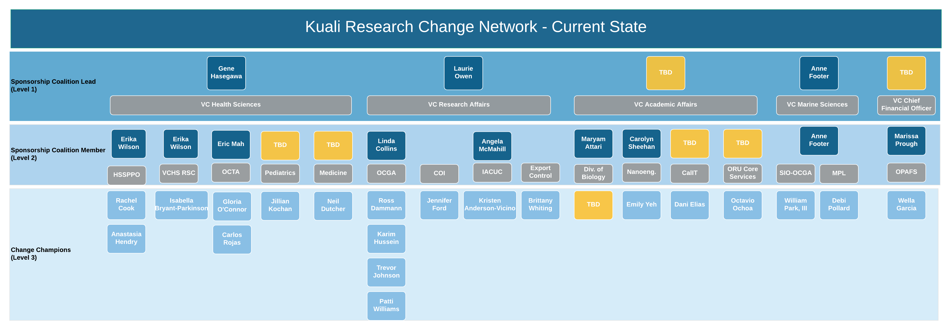
Change Network – Currently Under Review
Notes:
Sponsors, as a general term, refers to anyone who is supportive of the change. Sponsors promote the change with their actions, behaviors and conversations. According to Prosci, Middle managers and supervisors are sometimes the most powerful sponsors of change.
Change Network serves as an extension of the primary sponsor, governance, and project team
Objectives:
1. Ensure all areas have coverage where at least one contact will pass along information via meetings, road shows and other inter-personal activities.
2. Allow for department users to have one local representative where they can pass along their thoughts and concerns, and receive information.

Slide 13
Design
Initiate
Design
Plan
Validate
Transition
Go Live
Realization
Stabilization
Configure
Business process review (SME involvement begins)

Slide 14
Kuali Research
Initiate
Design
Plan
Validate
Transition
Go Live
Realization
Stabilization
Configure
Project Time Line
We are here
Oct – Dec 2017
Jan – Mar 2018
Apr 2018 – Mar 2019
Aug 2018 – Apr 2019
Apr – Sept 2019
Sept – Nov 2019
Dec 2019/ Jan 2020
Jan – Mar 2020
Apr – Jun 2020
The project team is working with subject matter experts (SMEs) from across the campus who were recommended by project governance (the Research Information Services (RIS) Advisory Group). The SMEs are reviewing Pre and Post Award business processes by documenting current state and working with the vendor and project team to establish a proposed future state using Lean Six Sigma methodology. The proposed future states are then submitted for review and approve to the RIS. If additional guidance, decision and/or support is needed at a higher level, the process is escalated as needed for future review and approval.
Once a proposed future state process has been approved, it is handed off to the Configuration Lead and the Solutions Architect for configuration into the Kuali Research System and integration evaluation. Once configured it will be slated for validation and user acceptance testing.

Slide 15
Design
Business Process Review Goals
Streamline
Adopt single institutional best practice
Identify process inefficiencies and apply Lean Six Sigma proven process improvement methodology to streamline and realize cost and time savings
Reduce variation in processes and determine a unified best practices to be adopted institutionally
Leverage system capabilities and process improvements to gain efficiencies that are configured for consistent and singular implementation and utilization
Reduce Variation

Slide 16
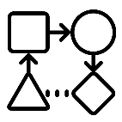
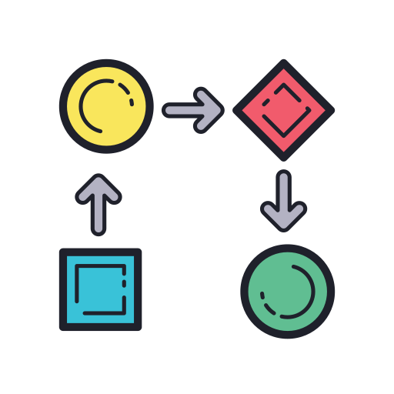
Business Process Review
This is oversimplified!
Coming up with a proposed future state
1)
2)
3)
4)
Project Governance provides the Project Team with names of SMEs for designated business process reviews
Project Team meets with groups of SMEs to conduct current state mapping
SMEs Business Process Design Teams applies Lean Six Sigma methodology and works with Project Team to consult with the vendor and come up with and vote on an improved proposed future state
Project Team presents the proposed future state to the Project Governance for review and final approval before passing the proposed future state on for configuration

Slide 17
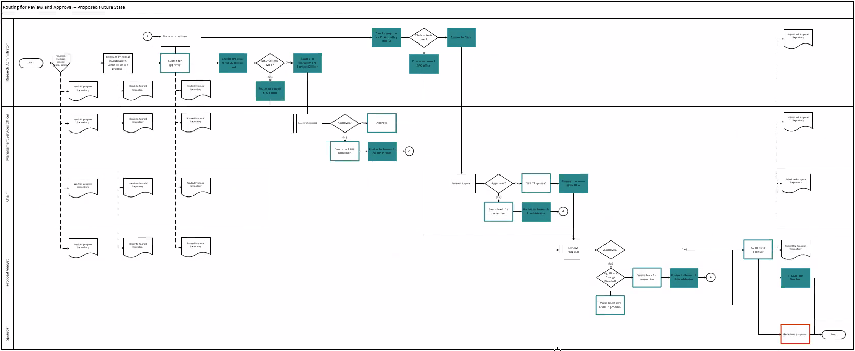
Understanding Business Process Review Levels
EXAMPLE
Level 1 Function
A function is a discreet set of activities focused on achieving an outcome. Foundation for a Level 2 process.
Level 2 Activity
Breakdown of project-wide functions into major activities necessary to complete and maintain each function. Foundation for Level 3 process.
Level 3 Task
Breakdown of major activities into high level process steps called tasks required to complete activities. Foundation for Level 4 process.
Level 4 Subtask
Breakdown of tasks into sub tasks that provide detail including organizational responsibility and role interactions
Level 4

Slide 18
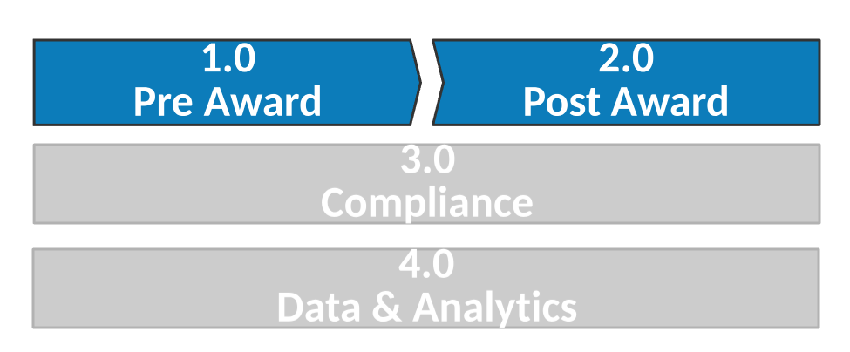
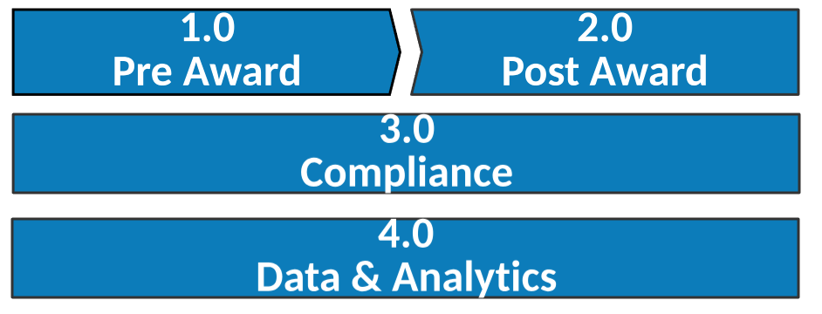
Research Administration – Process Landscape
Level 1

Slide 19
Research Administration – Process Landscape

Slide 20
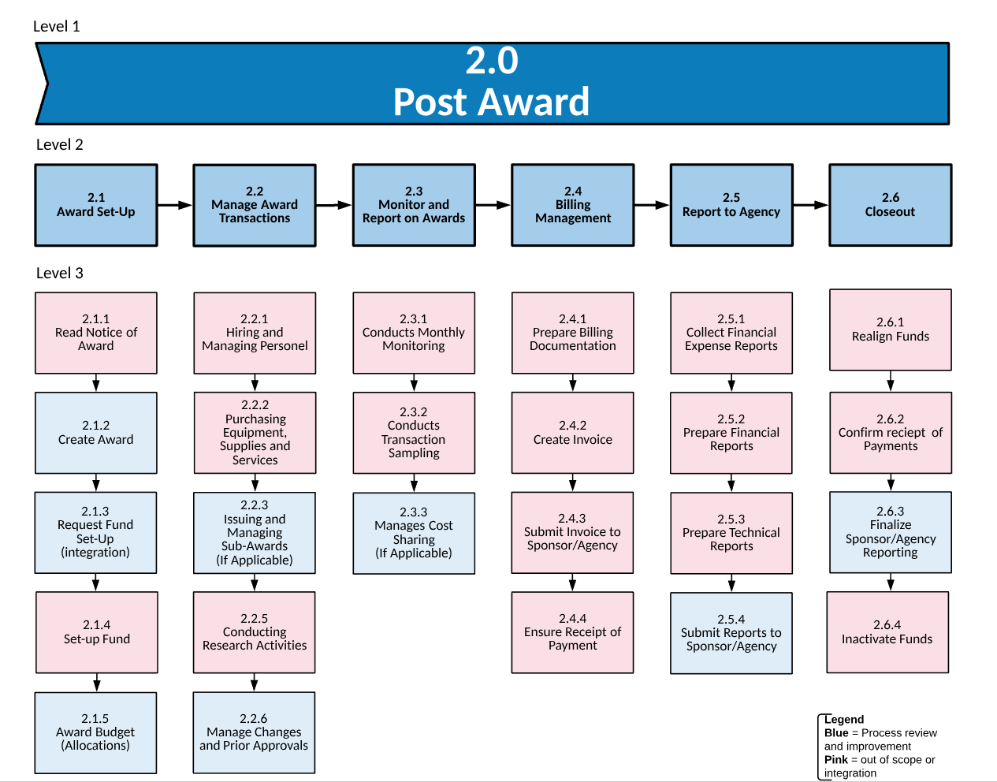
Research Administration – Process Landscape

Slide 21
Configure & Prototype
Initiate
Design
Plan
Validate
Transition
Go Live
Realization
Stabilization
Configure
Developing and configuring the system and processes

Slide 22
Configuration & Prototype
Configuration Lead works with the Solutions Architect, Testing Lead and Vendor to configure the system and develop testing requirements
SMEs are engaged in testing and/or additional conversation (if needed)
Proposed Future State Business Process is passed on for configuration
Configuration is tested internally by selected project team members and SMEs
As the system becomes more configured there will be more opportunities for users and stakeholders to see the system via demos, open offices and forums.

Slide 23
Validate
Initiate
Design
Plan
Validate
Transition
Go Live
Realization
Stabilization
Configure
Iterative system testing cycles; Validating and testing the system and processes

Slide 24
Validate
The testing plan is currently being developed and will include robust user acceptance testing (UAT) and will involve various subject matter experts and stakeholders.
Testing, Testing and More Testing
If test case “fails” the issue is worked on and retested until it passes
If test case “passes” then it is ready for production
Testing for technical AND functional business requirements
Technical and User Acceptance Testing (UAT)

Slide 25
Validate
Communicate, Develop Training & Train the Trainers
&
We hope to leverage the Change Network, Subject Matter Experts and Central Offices for not only communications and change management, but also for training.

Slide 26
Transition
Initiate
Design
Plan
Validate
Transition
Go Live
Realization
Stabilization
Configure
Robust end user training

Slide 27
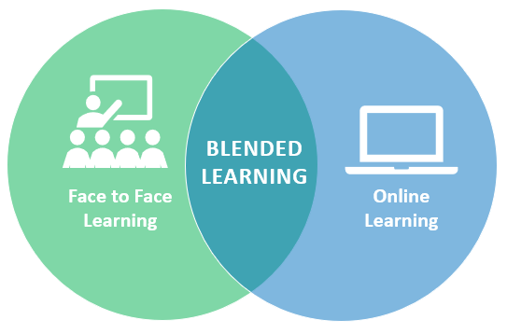
Transition
Training, Training & More Training
Robust end user training will occur once the system has passed UAT, using a blended learning approach.

Slide 28
Training Landscape
Learning vs. Behavior
Learning – the degree to which participants acquire the intended knowledge, skills and attitudes based on their participation in the learning event.
Behavior – the degree to which participants apply what they learned during training when they are back on the job

Slide 29
Training for Outcomes
Knowledge: the degree to which participants know certain information | Skills & Abilities: the degree to which they know how to do something or perform a certain task | Attitude: the degree to which training participants believe it will be worthwhile to implement what is learned during training on the job | Commitment: the degree to which learners intend to apply the knowledge and skills learned during training to their jobs, relates to learner motivation by acknowledging that even if the learner masters the knowledge and skills, they must still put forth effort to use the information or perform the skills daily. | Confidence: the degree to which training participants thing they will be able to do what they learned during training on the job. Addressing confidence during training brings learners close to the desired on-the-job performance. It can proactively surface potential on-the-job application barriers so they can be resolved.
“I know it.” | “I can do it right now.” | “I believe it will be worthwhile to do this in my work.” | “I intend to do it on the job.” | “I think I can do it on the job.”
Training for Expertise
Level of Expertise* | Beginner/Novice: Follows simple directions Performs using memory of facts and simple rules | Competent: Makes simple judgments for typical tasks May need help with complex or unusual tasks May lack speed and flexibility | Proficient: Performance guided by deeper experience Able to figure out the most critical aspects of a situation Sees nuances missed by less skilled performers Flexible performance | Expert: Performance guided by extensive practice and easily retrievable knowledge and skills Notices nuances, connections, and patterns Intuitive understanding based on extensive practice Able to solve difficult problems, learn fast, find needed resources
*Association for Talent Development (ATD) Training for Expertise Job Aid by Patti Shank, PhD

Slide 30
Training Requirements
Make sure ALL needs are assessed and addressed!
What are you training for?
Dealing with transition
Personally dealing with change
Succeeding in a changing environment
Managing resistance (supervisors and sponsors)
Big picture overview of the new environment
Basic or requisite skills/knowledge
Temporary work processes
Handling exceptions
Process skills/knowledge
System skills/knowledge
Technical skill/knowledge
Organizational skills/ knowledge
Problem resolution
People Manager Training
Town halls, roadshows, meetings, etc.
Ad hoc, incorporated as needed
Town halls, roadshows, meetings, etc.
KR Modules:
Dashboard
Proposal Development
Institutional Proposal
Negotiations
Award
Subaward
Other integrations?
Kuali IRB
Kuali COI
Reporting tools
Hands on learning for end users
Hands on learning for system administrators
Ad hoc, incorporated as needed
Post-go live

Slide 31
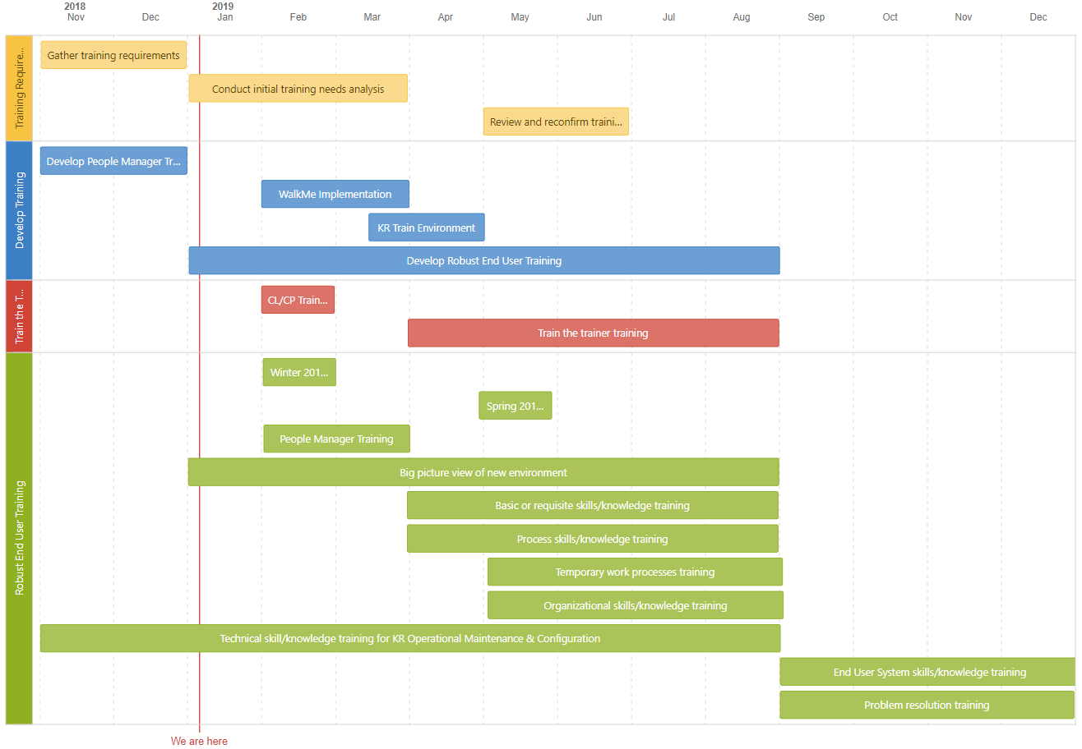
Training Roadmap Draft
This outlines the high level strategy and is subject to change
Rev 1.28.2018

Slide 32
Go Live
Initiate
Design
Plan
Validate
Transition
Go Live
Realization
Stabilization
Configure
New system is launched!

Slide 33
Go Live
“Flip the Switch” & Celebrate!

Slide 34
Realization
Initiate
Design
Plan
Validate
Transition
Go Live
Realization
Stabilization
Configure
Deploying and monitoring the system and processes with vendor support

Slide 35
Realization
How is it going?
Is the system working?
Are people using the system and business processes?
Is there anything else we need to do?

Slide 36
Stabilization
Initiate
Design
Plan
Validate
Transition
Go Live
Realization
Stabilization
Configure
After go-live, the stabilization period is typically three-nine months

Slide 37
Stabilization
Smooth sailing? or Rough Seas?
How do we need to adjust post-implementation to maintain operations long term?

Slide 38
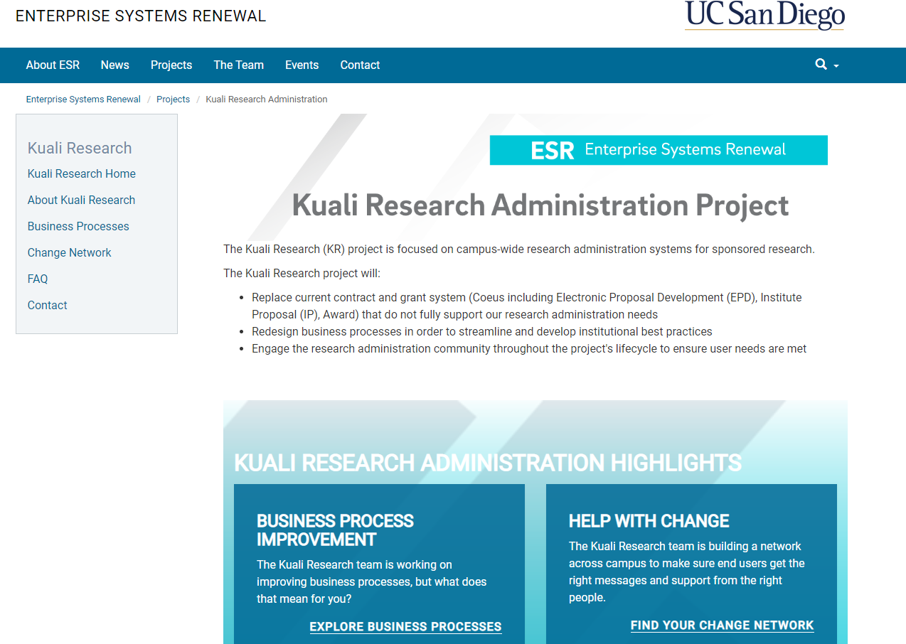
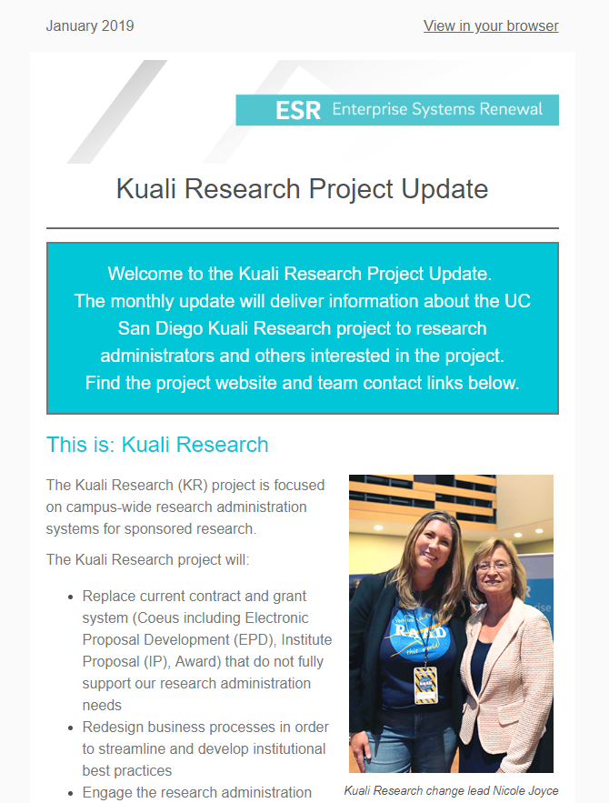
Kuali Research
Initiate
Design
Plan
Validate
Transition
Go Live
Realization
Stabilization
Configure
Stay up to date by…
We are here
Oct – Dec 2017
Jan – Mar 2018
Apr 2018 – Mar 2019
Aug 2018 – Apr 2019
Apr – Sept 2019
Sept – Nov 2019
Dec 2019/ Jan 2020
Jan – Mar 2020
Apr – Jun 2020
Visiting the Kuali Research Website
esr.ucsd.edu/kuali-research
Connecting with members of the Change Network
Subscribing to the KR Newsletter

Slide 39
For questions contact Nicole Joyce at njoyce@ucsd.edu or 858-534-9112.

Slide 40
Description | Related KR Module | Team | Status
No business process review needed because these typically occurs outside of the system
Return to Pre Award Process Landscape

Slide 41
Description | Related KR Module | Team | Status
The detailed budgeting process involves creating a detailed project budget that breaks down anticipated costs into categories for a given research project and includes S2S or "System to System“ submissions. | KR Proposal Development | Isabella Bryant-Parkinson, Wella Garcia, Octavio Ochoa, Debi Pollard; Jillian Kochan, Jennifer Louie, Ji Song, Crystal Liu, Jasmyn Hornbuckle, Chelsea Van Pelt, Brianne Decker, Sussy Virgil, Lenore Eyer, Hailey Tipton McDaniels, Kimberly Aguilar | Completed - In Configuration
No business process review needed because this typically occurs outside of the system
When the Research Administrator or Principal Investigator indicates a proposed research project involves or has attributes that may require review and approval by one of UCSD's compliance offices. | KR Proposal Development | Ross Dammann, Trevor Johnson, Rachel Cook, Thanhdieu Rich, William Park III, Jennifer Ford, Brittany Whiting, Han Nguyen, Kip Kantelo, Kristen Anderson-Vicino, Jonathan Joyce, Jennifer Oh, Erika Wilson, Liz Brenner, Christin McDonald, Dani Elias, Emily Yeh, Jillian Kochan, Jennifer Louie | Completed - In Configuration
Researcher and Research Administrator must answer questions about the project to provide information about the activities being proposed. Some questions are required by the sponsor and others are required by University of California. | KR Proposal Development | Ross Dammann, Dani Elias, Rachel Cook, William Gentz, Debi Pollard, Lisa Meredith, Sanaz Masha, Sunny Kochhar, William Park III | In Progress – On Schedule (Jan 2019)
When all required and optional sponsor/internal forms have been added to the proposal package. | KR Proposal Development | Well Garcia, Rachel Cook, Ross Dammann, Trevor Johnson, William Park III, Marissa Yessis-Prough, Thanhdieu Rich | In Progress – On Schedule (Jan 2019)
Return to Pre Award Process Landscape

Slide 42
Description | Related KR Module | Team | Status
List of agreement types to be handled through KR. The only agreement type out of scope were purchase orders as KR is not a procurement system. | KR Proposal Development | Emily Yeh, Octavio Ochoa, Dani Elias, Isabella Bryant-Parkinson, Debi Pollard, Karim Hussein, Patti Williams, Ross Damman, Trevor Johnson, Rachel Cook, Anastasia Hendry, William Park III, Well Garcia, Gloria O’Connor, Carlos Rojas, Jennifer Ford, Brittany Whiting, Kristen Anderson-Vicino, Jillian Kochan | Completed - In Configuration
Begins when proposal package is complete and ready for the department approvers and sponsored projects office (SPO) to review and submit the package to the sponsor. | KR Proposal Development | Emily Yeh, Octavio Ochoa, Dani Elias, Isabella Bryant-Parkinson, Debi Pollard, Karim Hussein, Patti Williams, Ross Dammann, Trevor Johnson, Rachel Cook, Anastasia Hendry, William Park III, Well Garcia, Gloria O’Connor, Carlos Rojas, Jennifer Ford, Brittany Whiting, Kristen Anderson-Vicino, Jillian Kochan, Marissa Yessis-Prough, Neil Dutcher | Completed - In Configuration
The process generally involves a review by a Proposal Analyst in one of UCSD's sponsored projects offices (SPOs) to make sure the proposal package meets UCSD and sponsor requirements. | KR Proposal Development | Jeff Warner, Ross Dammann, Trevor Johnson, William Park III, Evelyn Oles, Rachel Cook, Gloria O’Connor, Carlos Rojas, Debi Pollard, Jeff Woods, Judy De Los Santos | In Progress – At Risk of Meeting Deadline (Feb 2019)
Involves updating the proposal record with any final changes or data elements so that UCSD's system of record has the latest/final proposal materials that were submitted to the sponsor. | KR Proposal Development | Well Garcia, Rachel Cook, Ross Dammann, Trevor Johnson, William Park III, Marissa Yessis-Prough, Thanhdieu Rich | In Progress – On Schedule (Jan 2019)
Return to Pre Award Process Landscape

Slide 43
Description | Related KR Module | Team | Status
Monitor and maintain the compliance approval status in order to insure that an award is not created when a required compliance review and approval process has not taken place. | KR Proposal Development | Rachel Cook, Ross Dammann, Trevor Johnson, William Park III, Thanhdieu Rich, Dani Elias, Jennifer Ford, Jennifer Louie, Erika Wilson, Jonathan Joyce, Emily Yeh, Brittany Whiting, Kristen Anderson-Vicino, Jillian Kochan, Jan Nguyen, Kip Kantelo, Liz Brenner, Christian McDonald, Jennifer Oh | Completed - In Configuration
No business process review needed because this typically occurs outside of the system
No business process review needed because this typically occurs outside of the system
When the sponsor requests a budget revision and is completed when a revised budget has been submitted to the sponsor. | KR Proposal Development | Well Garcia, Rachel Cook, Ross Dammann, Trevor Johnson, William Park III, Marissa Yessis-Prough, Thanhdieu Rich | In Progress – On Schedule (Jan 2019)
This process might happen when the sponsor is considering making an award to UCSD, wants to conduct a site visit and the PI needs to expend funds to cover the costs. | KR Proposal Development | Well Garcia, Rachel Cook, Ross Dammann, Trevor Johnson, William Park III, Marissa Yessis-Prough, Thanhdieu Rich | In Progress – On Schedule (Jan 2019)
Return to Pre Award Process Landscape

Slide 44
Description | Related KR Module | Team | Status
This process is contained within the pre-award function of research administration. The process begins when the award document is received from or requested by the sponsor and ends with the full execution of the agreement. Negotiations are the series of steps to take the initial agreement from proposal/original document through discussion/negotiation of the language with the other party to a final signed agreement. | KR Negotiations | Lisa Meredith, Stella Sung, Mary Mansfield, Karim Hussein, Andrea Lupu, Lauren Sanfilippo, Lindsay Wholey, Sanaz Masha, Gloria O’Connor | Completed - In Configuration
Return to Pre Award Process Landscape

Slide 45
Description | Related KR Module | Team | Status
No business process review needed because this typically occurs outside of the system
Upon receipt of the NOA, the Sponsored Projects Office (SPO) will create an award record in UCSD's research agreement management system and update the record with all necessary information. | KR Institutional Proposal | Ross Dammann, Trevor Johnson, William Park III, Patti Williams | In Progress – On Schedule (Jan 2019)
No business process review needed because this typically occurs outside of the system
No business process review needed because this typically occurs outside of the system
Return to Pre Award Process Landscape

Slide 46
Description | Related KR Module | Team | Status
No business process review needed because this typically occurs outside of the system
After the Notice of Award (NOA) is received, the Sponsored Project Office (SPO) creates an award so Principal Investigators can begin their research and spend money. | KR Award | William Park III, Wella Garcia, Rachel Cook, Marissa Yessis-Prough, Ernesto Donate, William Gentz, Marisol Christinson, Patty Pace | Completed - In Configuration
Involves creating a unique account number in UCSD's chart of accounts and associating that account number with the award. | KR Award | William Park III, Wella Garcia, Rachel Cook, Marissa Yessis-Prough, Ernesto Donate, William Gentz, Marisol Christinson, Patty Pace, Trevor Johnson, Isabella Byrant-Parkinson, Minerva Nelson | In Progress – On Schedule (Feb 2019)
No business process review needed because this typically occurs outside of the system
Taking a copy of the submitted budget, modifying/updating the costs based on new information that is different from what was proposed. | KR Institutional Proposal | Wella Garcia, Marissa Yessis-Prough, Ernesto Donate, Isabella Byrant-Parkinson, Minerva Nelson, Debi Pollard, Jeff Woods | In Progress – At Risk of Meeting Deadline (Feb 2019)
Return to Post Award Process Landscape

Slide 47
Description | Related KR Module | Team | Status
No business process review needed because this typically occurs outside of the system
No business process review needed because this typically occurs outside of the system
Reviewing the sub-award proposed by the PI and lead unit responsible for managing the research project, working with sub-awardee, UCSD's procurements department and any compliance departments to negotiate and execute the sub. | KR Award | Dani Elias, Jennifer Ford, Tara Cameron, Evans Owalla, Jennifer Louie, Erika Wilson, Jonathan Joyce | In Progress – On Schedule (Jan 2019)
No business process review needed because this typically occurs outside of the system
Description In Progress | KR Institutional Proposal | William Park III, Trevor Johnson, Wella Garcia, Marissa Yessis-Prough, Patty Pace, Ernesto Donate | Not Started
Return to Post Award Process Landscape

Slide 48
Description | Related KR Module | Team | Status
No business process review needed because this typically occurs outside of the system
No business process review needed because this typically occurs outside of the system
Description In Progress | KR Award | William Park III, Trevor Johnson, Wella Garcia, Marissa Yessis-Prough, Patty Pace, Ernesto Donate | Not Started
Return to Post Award Process Landscape

Slide 49
Description | Related KR Module | Team | Status
No business process review needed because these typically occurs outside of the system
Return to Post Award Process Landscape

Slide 50
Description | Related KR Module | Team | Status
No business process review needed because this typically occurs outside of the system
No business process review needed because this typically occurs outside of the system
No business process review needed because this typically occurs outside of the system
Description In Progress | KR Award | William Park III, Trevor Johnson, Wella Garcia, Marissa Yessis-Prough, Patty Pace, Ross Dammann | Not Started
Return to Post Award Process Landscape

Slide 51
Description | Related KR Module | Team | Status
No business process review needed because this typically occurs outside of the system
No business process review needed because this typically occurs outside of the system
Description In Progress | KR Award | William Park III, Trevor Johnson, Wella Garcia, Marissa Yessis-Prough, Patty Pace, Ross Dammann | Not Started
No business process review needed because this typically occurs outside of the system
Return to Post Award Process Landscape

