Slide 1
Kuali Research Business Process Reviews
Here’s what you need to know

Slide 2
Project Structure
Sponsor
Sandra A. Brown
Escalation
Laurie Owen
Gene Hasegawa
Anne Footer
Governance
Linda
Collins
Erika
Wilson
Anne
Footer
Marissa Prough
Carolyn Sheehan
Maryam Attari
Eric
Mah
Angela McMahill
Core Team
Project Manager | Change Lead | Change Practitioner | Change Practitioner | Bus. Proc. Lead | Config. Lead | Solutions Architect | Testing Lead | Reporting Lead
Susan Oswalt | Nicole Joyce | Nicole Joyce | Francisco Mejia | Jason DeFay | Jason DeFay | Robert Dias | David Edmonson | Marisol Christinson
Kuali | Project Lead
Kaci Foster
Kuali | Functional Lead
Kat Szulc
Kuali | Technical Lead
Terry Durkin
Business Process Review Teams Lean Bench, SMEs, Bus Proc/Config Lead, Testing Lead, Reporting Lead
Create Proposal Package 1.2 | Develop and Submit Proposal 1.3 | Post Submission Actions 1.4 | Negotiate Award 1.5 | Accept Award 1.6
Award Set-Up 2.1 | Manage Award Transactions 2.2 | Monitor and Report on Awards 2.3 | Report to Agency 2.5 | Closeout 2.6
Kuali Support
Change Network Change Lead, Practitioners, Sponsorship Coalition Lead, Sponsorship Coalition, Change Champions
Kuali Support
Technical Teams Solutions Architect, Testing Lead, Reporting Lead
Integrations | Conversion | Res Activity Hub | Security | Workflow | IDM | MdM
Kuali Support
Project Teams

Slide 3
Kuali Research
Initiate
Design
Plan
Validate
Transition
Go Live
Realization
Stabilization
Configure
Project Time Line
We are here
Oct – Dec 2017
Jan – Mar 2018
Apr 2018 – Mar 2019
Aug 2018 – Apr 2019
Apr – Sept 2019
Sept – Nov 2019
Dec 2019/ Jan 2020
Jan – Mar 2020
Apr – Jun 2020
The project team is working with subject matter experts (SMEs) from across the campus who were recommended by project governance (the Research Information Services (RIS) Advisory Group). The SMEs are reviewing Pre and Post Award business processes by documenting current state and working with the vendor and project team to establish a proposed future state using Lean Six Sigma methodology. The proposed future states are then submitted for review and approve to the RIS. If additional guidance, decision and/or support is needed at a higher level, the process is escalated as needed for future review and approval.
Once a proposed future state process has been approved, it is handed off to the Configuration Lead and the Solutions Architect for configuration into the Kuali Research System and integration evaluation. Once configured it will be slated for validation and user acceptance testing.

Slide 4
Design
Business Process Review Goals
Streamline
Adopt single institutional best practice
Identify process inefficiencies and apply Lean Six Sigma proven process improvement methodology to streamline and realize cost and time savings
Reduce variation in processes and determine a unified best practices to be adopted institutionally
Leverage system capabilities and process improvements to gain efficiencies that are configured for consistent and singular implementation and utilization
Reduce Variation

Slide 5
Business Process Review
This is oversimplified!
Coming up with a proposed future state
1)
2)
3)
4)
Project Governance provides the Project Team and Lean Bench with names of SMEs for designated business process reviews
Lean Bench meets with groups of SMEs to conduct current state mapping
SMEs Business Process Design Teams work with Lean Bench to apply Lean Six Sigma methodology and consult with the vendor to come up with and vote on an improved proposed future state
Project Team presents the proposed future state to the Project Governance for review and final approval before passing the proposed future state on for configuration

Slide 6
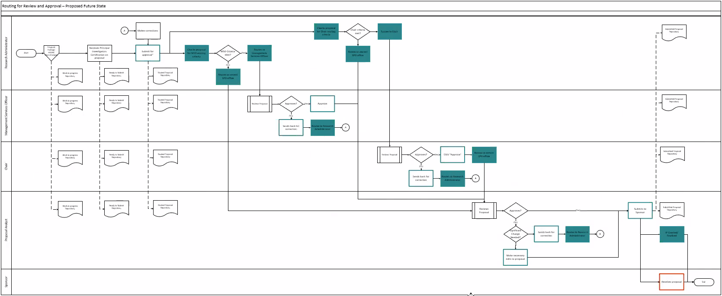
Understanding Business Process Review Levels
Level 1 Function
A function is a discreet set of activities focused on achieving an outcome. Foundation for a Level 2 process.
Level 2 Activity
Breakdown of project-wide functions into major activities necessary to complete and maintain each function. Foundation for Level 3 process.
Level 3 Task
Breakdown of major activities into high level process steps called tasks required to complete activities. Foundation for Level 4 process.
Level 4 Subtask
Breakdown of tasks into sub tasks that provide detail including organizational responsibility and role interactions
Level 4

Slide 7
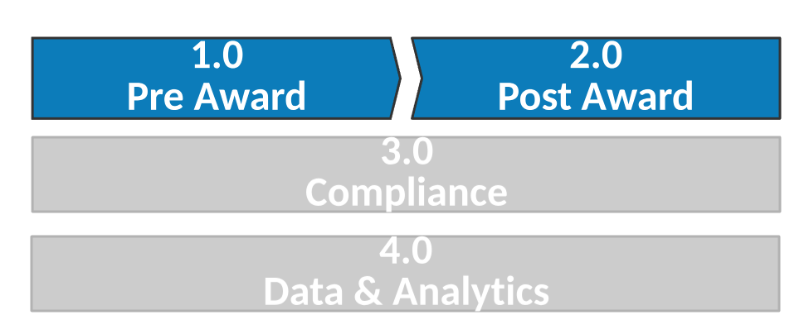
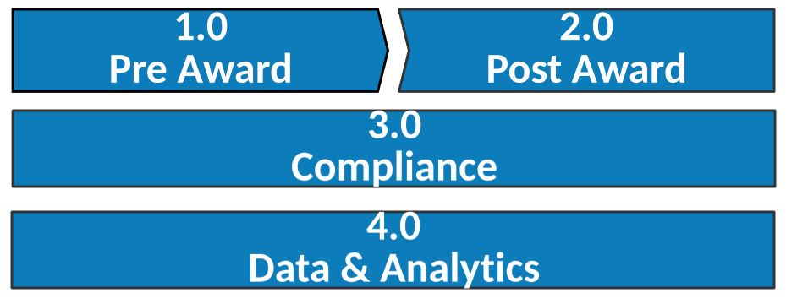
Research Administration – Process Landscape
Level 1

Slide 8
Research Administration – Process Landscape

Slide 9
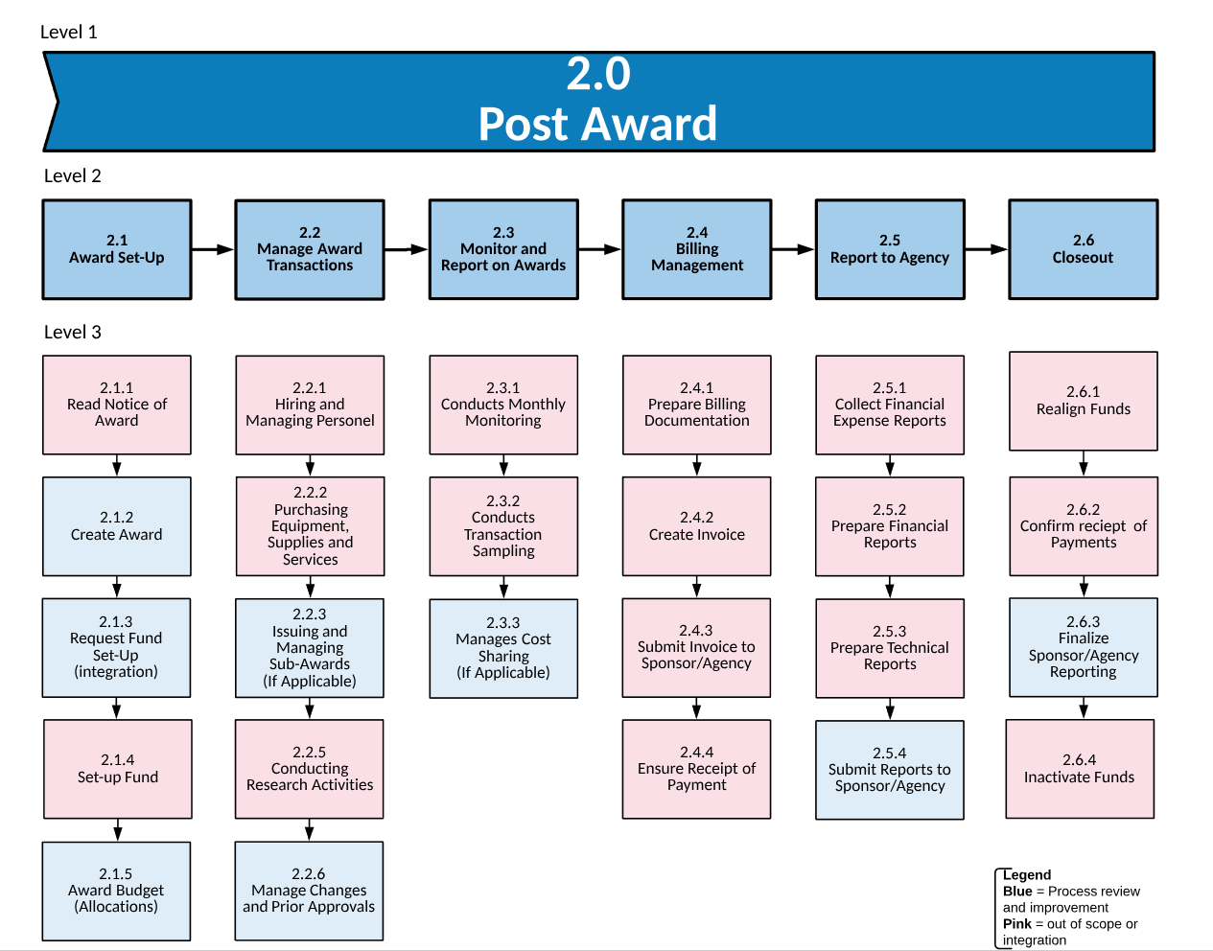
Research Administration – Process Landscape

Slide 10
Research Administration – Process Landscape

Slide 11
Description | Related KR Module | Team | Status
No business process review needed because these typically occurs outside of the system
Return to Project Structure
Return to Pre Award Process Landscape

Slide 12
Description | Related KR Module | Team | Status
The detailed budgeting process involves creating a detailed project budget that breaks down anticipated costs into categories for a given research project and includes S2S or "System to System“ submissions. | KR Proposal Development | Isabella Bryant-Parkinson, Wella Garcia, Octavio Ochoa, Debi Pollard; Jillian Kochan, Jennifer Louie, Ji Song, Crystal Liu, Jasmyn Hornbuckle, Chelsea Van Pelt, Brianne Decker, Sussy Virgil, Lenore Eyer, Hailey Tipton McDaniels, Kimberly Aguilar | Completed - In Configuration
No business process review needed because this typically occurs outside of the system
When the Research Administrator or Principal Investigator indicates a proposed research project involves or has attributes that may require review and approval by one of UCSD's compliance offices. | KR Proposal Development | Ross Dammann, Trevor Johnson, Rachel Cook, Thanhdieu Rich, William Park III, Jennifer Ford, Brittany Whiting, Han Nguyen, Kip Kantelo, Kristen Anderson-Vicino, Jonathan Joyce, Jennifer Oh, Erika Wilson, Liz Brenner, Christin McDonald, Dani Elias, Emily Yeh, Jillian Kochan, Jennifer Louie | Completed - In Configuration
Researcher and Research Administrator must answer questions about the project to provide information about the activities being proposed. Some questions are required by the sponsor and others are required by University of California. | KR Proposal Development | Ross Dammann, Dani Elias, Rachel Cook, William Gentz, Debi Pollard, Lisa Meredith, Sanaz Masha, Sunny Kochhar, William Park III | In Progress – On Schedule (Jan 2019)
When all required and optional sponsor/internal forms have been added to the proposal package. | KR Proposal Development | Well Garcia, Rachel Cook, Ross Dammann, Trevor Johnson, William Park III, Marissa Yessis-Prough, Thanhdieu Rich | In Progress – On Schedule (Jan 2019)
Return to Project Structure
Return to Pre Award Process Landscape

Slide 13
Description | Related KR Module | Team | Status
List of agreement types to be handled through KR. The only agreement type out of scope were purchase orders as KR is not a procurement system. | KR Proposal Development | Emily Yeh, Octavio Ochoa, Dani Elias, Isabella Bryant-Parkinson, Debi Pollard, Karim Hussein, Patti Williams, Ross Damman, Trevor Johnson, Rachel Cook, Anastasia Hendry, William Park III, Well Garcia, Gloria O’Connor, Carlos Rojas, Jennifer Ford, Brittany Whiting, Kristen Anderson-Vicino, Jillian Kochan | Completed - In Configuration
Begins when proposal package is complete and ready for the department approvers and sponsored projects office (SPO) to review and submit the package to the sponsor. | KR Proposal Development | Emily Yeh, Octavio Ochoa, Dani Elias, Isabella Bryant-Parkinson, Debi Pollard, Karim Hussein, Patti Williams, Ross Dammann, Trevor Johnson, Rachel Cook, Anastasia Hendry, William Park III, Well Garcia, Gloria O’Connor, Carlos Rojas, Jennifer Ford, Brittany Whiting, Kristen Anderson-Vicino, Jillian Kochan, Marissa Yessis-Prough, Neil Dutcher | Completed - In Configuration
The process generally involves a review by a Proposal Analyst in one of UCSD's sponsored projects offices (SPOs) to make sure the proposal package meets UCSD and sponsor requirements. | KR Proposal Development | Jeff Warner, Ross Dammann, Trevor Johnson, William Park III, Evelyn Oles, Rachel Cook, Gloria O’Connor, Carlos Rojas, Debi Pollard, Jeff Woods, Judy De Los Santos | In Progress – At Risk of Meeting Deadline (Feb 2019)
Involves updating the proposal record with any final changes or data elements so that UCSD's system of record has the latest/final proposal materials that were submitted to the sponsor. | KR Proposal Development | Well Garcia, Rachel Cook, Ross Dammann, Trevor Johnson, William Park III, Marissa Yessis-Prough, Thanhdieu Rich | In Progress – On Schedule (Jan 2019)
Return to Project Structure
Return to Pre Award Process Landscape

Slide 14
Description | Related KR Module | Team | Status
Monitor and maintain the compliance approval status in order to insure that an award is not created when a required compliance review and approval process has not taken place. | KR Proposal Development | Rachel Cook, Ross Dammann, Trevor Johnson, William Park III, Thanhdieu Rich, Dani Elias, Jennifer Ford, Jennifer Louie, Erika Wilson, Jonathan Joyce, Emily Yeh, Brittany Whiting, Kristen Anderson-Vicino, Jillian Kochan, Jan Nguyen, Kip Kantelo, Liz Brenner, Christian McDonald, Jennifer Oh | Completed - In Configuration
No business process review needed because this typically occurs outside of the system
No business process review needed because this typically occurs outside of the system
When the sponsor requests a budget revision and is completed when a revised budget has been submitted to the sponsor. | KR Proposal Development | Well Garcia, Rachel Cook, Ross Dammann, Trevor Johnson, William Park III, Marissa Yessis-Prough, Thanhdieu Rich | In Progress – On Schedule (Jan 2019)
This process might happen when the sponsor is considering making an award to UCSD, wants to conduct a site visit and the PI needs to expend funds to cover the costs. | KR Proposal Development | Well Garcia, Rachel Cook, Ross Dammann, Trevor Johnson, William Park III, Marissa Yessis-Prough, Thanhdieu Rich | In Progress – On Schedule (Jan 2019)
Return to Project Structure
Return to Pre Award Process Landscape

Slide 15
Description | Related KR Module | Team | Status
This process is contained within the pre-award function of research administration. The process begins when the award document is received from or requested by the sponsor and ends with the full execution of the agreement. Negotiations are the series of steps to take the initial agreement from proposal/original document through discussion/negotiation of the language with the other party to a final signed agreement. | KR Negotiations | Lisa Meredith, Stella Sung, Mary Mansfield, Karim Hussein, Andrea Lupu, Lauren Sanfilippo, Lindsay Wholey, Sanaz Masha, Gloria O’Connor | Completed - In Configuration
Return to Project Structure
Return to Pre Award Process Landscape

Slide 16
Description | Related KR Module | Team | Status
No business process review needed because this typically occurs outside of the system
Upon receipt of the NOA, the Sponsored Projects Office (SPO) will create an award record in UCSD's research agreement management system and update the record with all necessary information. | KR Institutional Proposal | Ross Dammann, Trevor Johnson, William Park III, Patti Williams | In Progress – On Schedule (Jan 2019)
No business process review needed because this typically occurs outside of the system
No business process review needed because this typically occurs outside of the system
Return to Project Structure
Return to Pre Award Process Landscape

Slide 17
Research Administration – Process Landscape

Slide 18
Description | Related KR Module | Team | Status
No business process review needed because this typically occurs outside of the system
After the Notice of Award (NOA) is received, the Sponsored Project Office (SPO) creates an award so Principal Investigators can begin their research and spend money. | KR Award | William Park III, Wella Garcia, Rachel Cook, Marissa Yessis-Prough, Ernesto Donate, William Gentz, Marisol Christinson, Patty Pace | Completed - In Configuration
Involves creating a unique account number in UCSD's chart of accounts and associating that account number with the award. | KR Award | William Park III, Wella Garcia, Rachel Cook, Marissa Yessis-Prough, Ernesto Donate, William Gentz, Marisol Christinson, Patty Pace, Trevor Johnson, Isabella Byrant-Parkinson, Minerva Nelson | In Progress – On Schedule (Feb 2019)
No business process review needed because this typically occurs outside of the system
Taking a copy of the submitted budget, modifying/updating the costs based on new information that is different from what was proposed. | KR Institutional Proposal | Wella Garcia, Marissa Yessis-Prough, Ernesto Donate, Isabella Byrant-Parkinson, Minerva Nelson, Debi Pollard, Jeff Woods | In Progress – At Risk of Meeting Deadline (Feb 2019)
Return to Project Structure
Return to Post Award Process Landscape

Slide 19
Description | Related KR Module | Team | Status
No business process review needed because this typically occurs outside of the system
No business process review needed because this typically occurs outside of the system
Reviewing the sub-award proposed by the PI and lead unit responsible for managing the research project, working with sub-awardee, UCSD's procurements department and any compliance departments to negotiate and execute the sub. | KR Award | Dani Elias, Jennifer Ford, Tara Cameron, Evans Owalla, Jennifer Louie, Erika Wilson, Jonathan Joyce | In Progress – On Schedule (Jan 2019)
No business process review needed because this typically occurs outside of the system
Description In Progress | KR Institutional Proposal | William Park III, Trevor Johnson, Wella Garcia, Marissa Yessis-Prough, Patty Pace, Ernesto Donate | Not Started
Return to Project Structure
Return to Post Award Process Landscape

Slide 20
Description | Related KR Module | Team | Status
No business process review needed because this typically occurs outside of the system
No business process review needed because this typically occurs outside of the system
Description In Progress | KR Award | William Park III, Trevor Johnson, Wella Garcia, Marissa Yessis-Prough, Patty Pace, Ernesto Donate | Not Started
Return to Project Structure
Return to Post Award Process Landscape

Slide 21
Description | Related KR Module | Team | Status
No business process review needed because these typically occurs outside of the system
Return to Project Structure
Return to Post Award Process Landscape

Slide 22
Description | Related KR Module | Team | Status
No business process review needed because this typically occurs outside of the system
No business process review needed because this typically occurs outside of the system
No business process review needed because this typically occurs outside of the system
Description In Progress | KR Award | William Park III, Trevor Johnson, Wella Garcia, Marissa Yessis-Prough, Patty Pace, Ross Dammann | Not Started
Return to Project Structure
Return to Post Award Process Landscape

Slide 23
Description | Related KR Module | Team | Status
No business process review needed because this typically occurs outside of the system
No business process review needed because this typically occurs outside of the system
Description In Progress | KR Award | William Park III, Trevor Johnson, Wella Garcia, Marissa Yessis-Prough, Patty Pace, Ross Dammann | Not Started
No business process review needed because this typically occurs outside of the system
Return to Project Structure
Return to Post Award Process Landscape

Slide 24
For questions email esr-researchadmin@ucsd.edu

