Slide 1
Kuali Research Change Network
Information about the change network roles, responsibilities and resources

Slide 2
Change Network Topics
Change Network Overview
Sponsorship Resources and Updates
Next Steps and Action Items

Slide 3
Project Structure
Sponsor
Sandra A. Brown
Escalation
Laurie Owen
Gene Hasegawa
Anne Footer
Governance
Linda
Collins
Erika
Wilson
Anne
Footer
Marissa Prough
Carolyn Sheehan
Maryam Attari
Eric
Mah
Angela McMahill
Core Team
Project Manager | Change Lead | Change Practitioner | Change Practitioner | Bus. Proc. Lead | Config. Lead | Solutions Architect | Testing Lead | Reporting Lead
Susan Oswalt | Nicole Joyce | Nicole Joyce | Francisco Mejia | Jason DeFay | Jason DeFay | Robert Dias | David Edmonson | Marisol Christinson
Kuali | Project Lead
Kaci Foster
Kuali | Functional Lead
Kat Szulc
Kuali | Technical Lead
Terry Durkin
Business Process Review Teams Lean Bench, SMEs, Bus Proc/Config Lead, Testing Lead, Reporting Lead
Determine Agreement Types 1.3.1 | Route for Review & Approval 1.3.2 | Develop & Finalize Budget 1.2.1 | Negotiate Award & Agreement 1.5 | Complete Compliance Requests 1.2.3 | PI Exception Complete Compliance 1.2.3 | Complete Questionnaires 1.2.4 | Final Review & Submit to Sponsor 1.3.3 | Send NOA to Unit 1.6.2 | Revise Budget 1.4.4 | Other Documents for Package 1.2.5
Reconcile & Finalize Record 1.3.4 | Complete Compliance/Protocol Approval 1.4.1 | Submit Advanced Spending Requests 1.4.5 | Create Award 2.1.2 | Request Fund Set Up 2.1.3 | Award Budget (Allocations) 2.1.5 | Issuing & Managing Subawards (outgoing) 2.2.3 | Manage Changes & Prior Approvals 2.2.6 | Manages Cost Sharing 2.3.3 | Submit Reports to Sponsor/Agency 2.5.4 | Finalize Sponsor/Agency Reporting 2.6.3
Kuali Support
Change Network Change Lead, Practitioners, Sponsorship Coalition Lead, Sponsorship Coalition, Change Champions
Kuali Support
Technical Teams Solutions Architect, Testing Lead, Reporting Lead
Integrations | Conversion | Res Activity Hub | Security | Workflow | IDM | MdM
Kuali Support
Project Teams

Slide 4
Change Structure
Our goal is to organize leaders, at all levels of the University, to coordinate communication, so end users hear the right messages from the right people. Change Network members are local sponsors and serve as an extension of the project Change Leads. Learn more about Change Network roles and responsibilities.
Executive Team
Change Network
Primary Sponsor
and KR Governance
Sponsor Coalition Lead
Sponsorship
Coalition
Change
Champions
Launches change
and actively sponsors among the research community
Serves as org. sponsor, and primary contact for the Change Lead and Sponsorship Coalition
Serves as the leader, executor, and communicator for their Division and/or Department.
Disseminates and advocates for positive change among impacted units and teams
Active and visible participation; communicates key messages from the Core Team
Support communications from Change Leads
Track readiness and provide two-way communication
Share communications and set priority

Slide 5
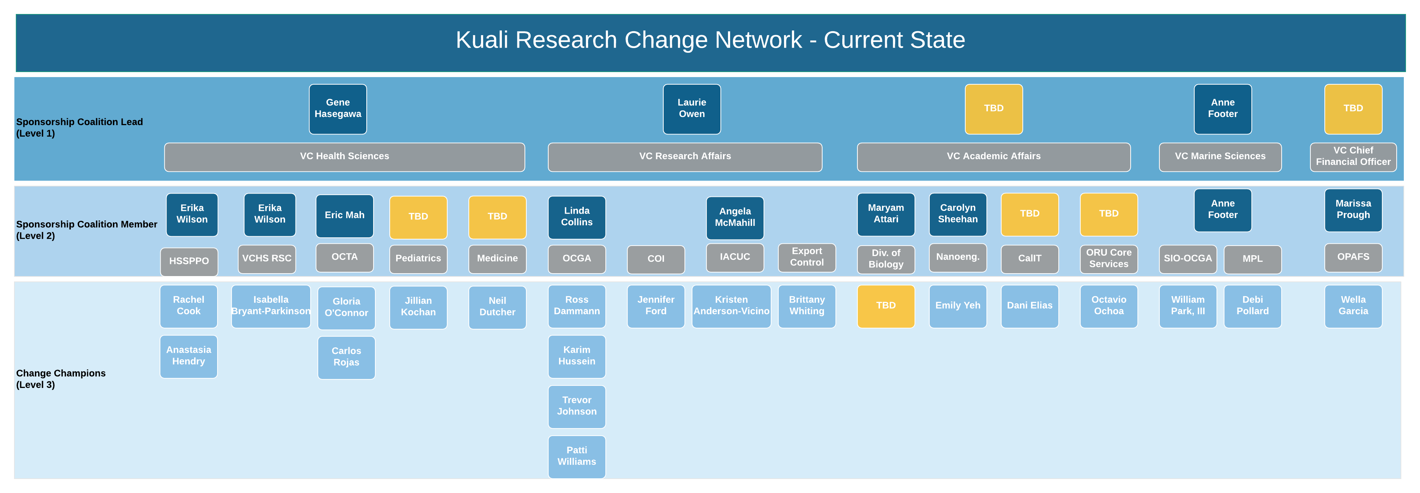
Change Network
Notes:
Sponsors, as a general term, refers to anyone who is supportive of the change. Sponsors promote the change with their actions, behaviors and conversations. According to Prosci, Middle managers and supervisors are sometimes the most powerful sponsors of change.
Change Network serves as an extension of the primary sponsor, governance, and project team
Objectives:
1. Ensure all areas have coverage where at least one contact will pass along information via meetings, road shows and other inter-personal activities.
2. Allow for department users to have one local representative where they can pass along their thoughts and concerns, and receive information.

Slide 6
Sponsorship Activities
5%
Estimated effort required by Sponsorship Coalition
Primary Sponsors
Help address and manage resistance, especially to the Guiding Principles, and step in for critical decisions
Stay current with key milestones achieved and project schedule/scope updates
Attend/participate in the Town Hall event and Training Expos
Publicly recognize individuals and teams
Maintain regular (at least quarterly) contact with Change Lead and Sponsorship Coalition Members
Communicate core team updates through local Change Network channels
Stay current on key milestones achieved and project schedule/scope updates
Complete People Manager training
Sponsorship Coalition Lead
Attend Change Network meetings
Maintain regular contact with Sponsorship Coalition Lead regarding KR project
Encourage staff to read KR newsletters, attend trainings, and visit KR web pages
Embrace CLARC + ADKAR
Coach and manage resistance within teams
Sponsorship Coalition & Change Champions
Notes:
Expectations: Effort should be less than 5% for now. We are estimating one meeting per month with Change Leads, one meeting per month to share with their group, and then a few more hours to deal with individual ad-hoc discussions, resistance management, etc.
Sponsorship Guidance from Prosci Best Practices
#1 – The number one obstacle to success for major change initiatives is ineffective sponsorship
#2 – Project teams ranked 50% of their sponsors as having only a moderate to low understanding of their role managing the people side of change and graded them a “average to poor” in terms of sponsorship activities
Mistakes or “ineffective sponsorship”:
1. Failed to remain active and visible throughout the life of the project
2. Underestimated or misunderstood the people side of change
3. Failed to communicate messages about the need for change
4. Delegated the sponsorship role and responsibilities

Slide 7
Sponsorship Resources
As part of the Change Network your role is to serve as your unit’s “CLARC.”
To support you in your role, the project team will provide you with training, tips and tricks, and the following tools throughout the change:
A Distribution List with all Change Network members in your area to facilitate communication, provide feedback loops, and manage unit readiness
Communicator
Liaison
Email communications and readiness activities to set KR as your unit’s priority and ensure preparedness
Advocate
Resistance Manager
Presentations and talking points to spark discussion at your departmental meetings
Coach
Kuali Research System webpages to keep your unit in sync with updates, communications, and change network resources.

Slide 8
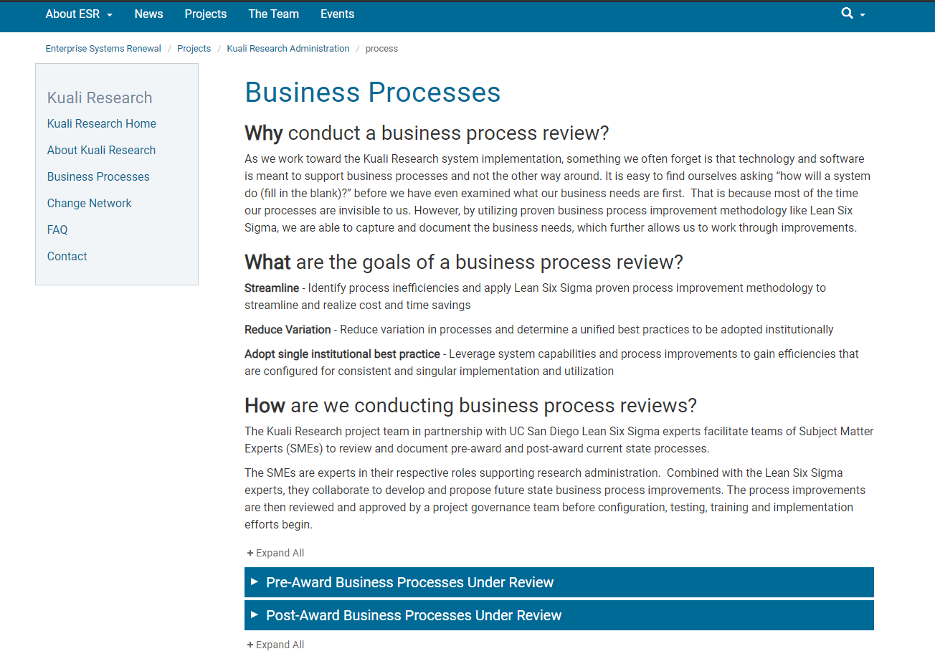
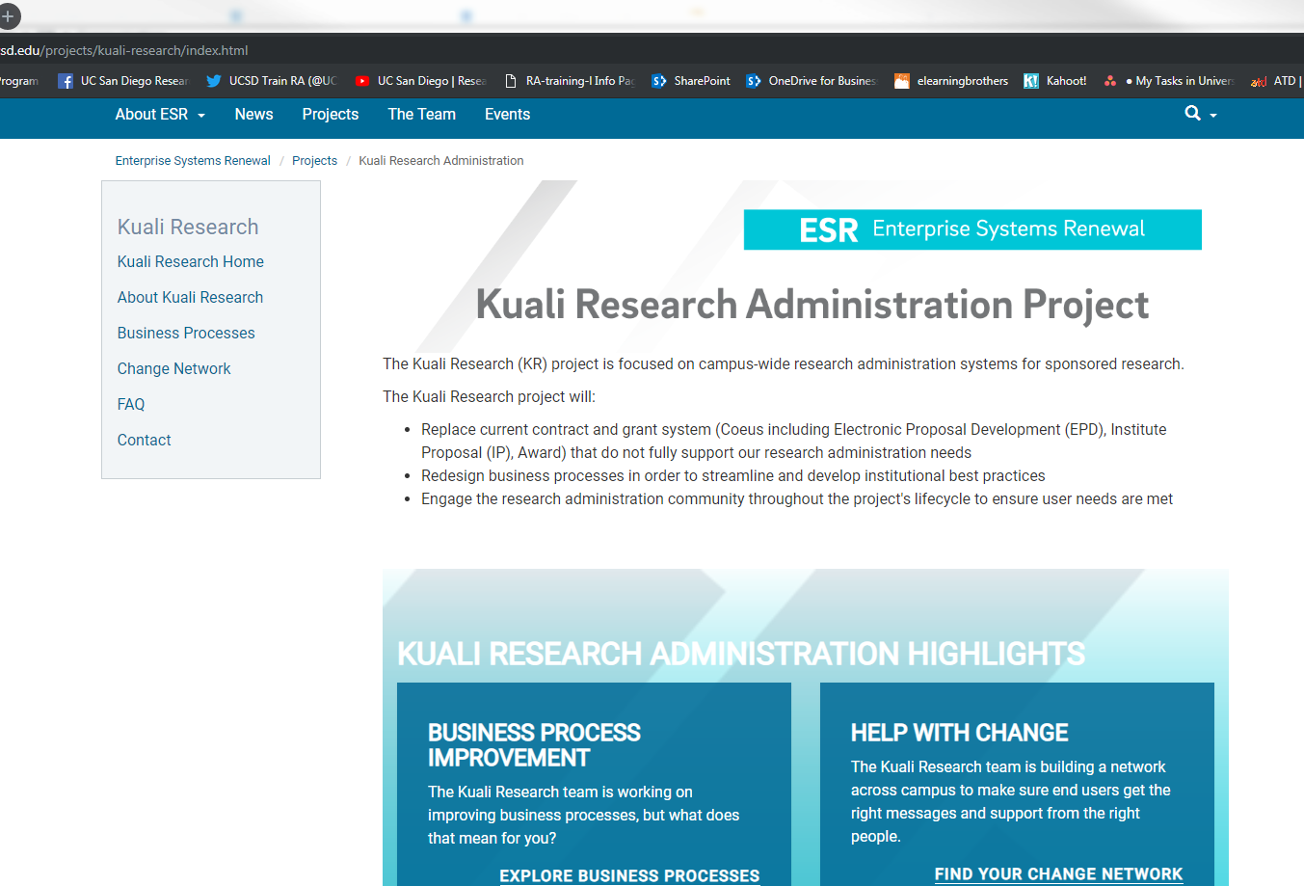
Sponsorship Resources
Visit our redesigned Kuali Research System web pages for updates, project communications, and change network representatives: http://esr.ucsd.edu/projects/kuali-research/index.html

Slide 9
Next Steps
Initiate
Design
Plan
Validate
Transition
Go Live
Realization
Stabilization
Configure
Project Time Line
We are here
Oct – Dec 2017
Jan – Mar 2018
Apr 2018 – Mar 2019
Aug 2018 – Apr 2019
Apr – Sept 2019
Sept – Nov 2019
Dec 2019/ Jan 2020
Jan – Mar 2020
Apr – Jun 2020
The project team is working with subject matter experts (SMEs) from across the campus who were recommended by project governance (the Research Information Services (RIS) Advisory Group). The SMEs are reviewing Pre and Post Award business processes by documenting current state and working with the vendor and project team to establish a proposed future state using Lean Six Sigma methodology. The proposed future states are then submitted for review and approve to the RIS. If additional guidance, decision and/or support is needed at a higher level, the process is escalated as needed for future review and approval.
Once a proposed future state process has been approved, it is handed off to the Configuration Lead and the Solutions Architect for configuration into the Kuali Research System and integration evaluation. Once configured it will be slated for validation and user acceptance testing.

Slide 10
Next Steps
Business Process Improvements
Support department subject matter experts (SMEs) business process improvement efforts (target December 2018)
Finalize proposed future state design
Proposed future state design will be integrated into Configuration for future User Acceptance Testing (UAT)
Functional Teams
Recommend SMEs to serve as end users and testers on process design teams
Participate in the business process reviews and share the information with your areas
Provide feedback to the project team on how we can continue to improve
Change Management
Introduce yourself- your role on the KR Change Network Direct staff to project resources, including newsletters, and demo the website at staff meetings
Share KR information at department meetings and encourage your staff to share their viewpoints and be willing to take a leap and envision the change
= Change Network support

