Slide 1
KR Training Strategy
An introduction into learning and performance

Slide 2
Defining Change
What is changing and why do people need to be trained?
The implementation of a new research administration system (Kuali Research) along with various process changes in the way sponsored projects are handled from proposal development to award closeout.

Slide 3
Training Landscape
Learning vs. Behavior
Learning – the degree to which participants acquire the intended knowledge, skills and attitudes based on their participation in the learning event.
Behavior – the degree to which participants apply what they learned during training when they are back on the job

Slide 4
Training for Outcomes
Knowledge: the degree to which participants know certain information | Skills & Abilities: the degree to which they know how to do something or perform a certain task | Attitude: the degree to which training participants believe it will be worthwhile to implement what is learned during training on the job | Commitment: the degree to which learners intend to apply the knowledge and skills learned during training to their jobs, relates to learner motivation by acknowledging that even if the learner masters the knowledge and skills, they must still put forth effort to use the information or perform the skills daily. | Confidence: the degree to which training participants thing they will be able to do what they learned during training on the job. Addressing confidence during training brings learners close to the desired on-the-job performance. It can proactively surface potential on-the-job application barriers so they can be resolved.
“I know it.” | “I can do it right now.” | “I believe it will be worthwhile to do this in my work.” | “I intend to do it on the job.” | “I think I can do it on the job.”
Training for Expertise
Level of Expertise* | Beginner/Novice: Follows simple directions Performs using memory of facts and simple rules | Competent: Makes simple judgments for typical tasks May need help with complex or unusual tasks May lack speed and flexibility | Proficient: Performance guided by deeper experience Able to figure out the most critical aspects of a situation Sees nuances missed by less skilled performers Flexible performance | Expert: Performance guided by extensive practice and easily retrievable knowledge and skills Notices nuances, connections, and patterns Intuitive understanding based on extensive practice Able to solve difficult problems, learn fast, find needed resources
*Association for Talent Development (ATD) Training for Expertise Job Aid by Patti Shank, PhD

Slide 5
Training Requirements
Make sure ALL needs are assessed and addressed!
What are you training for?
Dealing with transition
Personally dealing with change
Succeeding in a changing environment
Managing resistance (supervisors and sponsors)
Big picture overview of the new environment
Basic or requisite skills/knowledge
Temporary work processes
Handling exceptions
Process skills/knowledge
System skills/knowledge
Technical skill/knowledge
Organizational skills/ knowledge
Problem resolution
People Manager Training
Town halls, roadshows, meetings, etc.
Ad hoc, incorporated as needed
Town halls, roadshows, meetings, etc.
KR Modules:
Dashboard
Proposal Development
Institutional Proposal
Negotiations
Award
Subaward
Other integrations?
Kuali IRB
Kuali COI
Reporting tools
Hands on learning for end users
Hands on learning for system administrators
Ad hoc, incorporated as needed
Post-go live

Slide 6
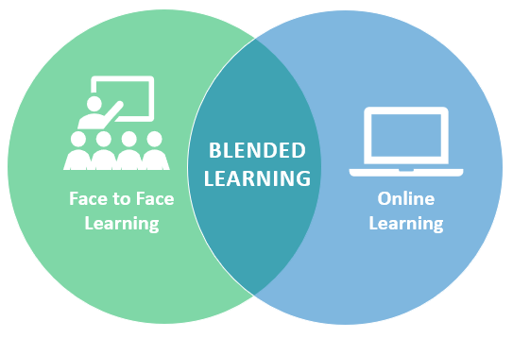
Training Landscape
How do you address all of these?
Blended Learning – what is it?
An approach to education that combines online educational materials and opportunities for interaction online with traditional place-based classroom methods.

Slide 7
Training Requirements Assessment
Executive Asst.
Who do you need to train?
PIs
SRAs
Identifying Audiences
Fund Managers
Aggregators
Dept. Research Administrators
Dept. Managers
Clinical Care Coord.
Chairs
MSOs/DBOs
Lab Mgs.
SPOs
Trainers
People Mgs.

Slide 8
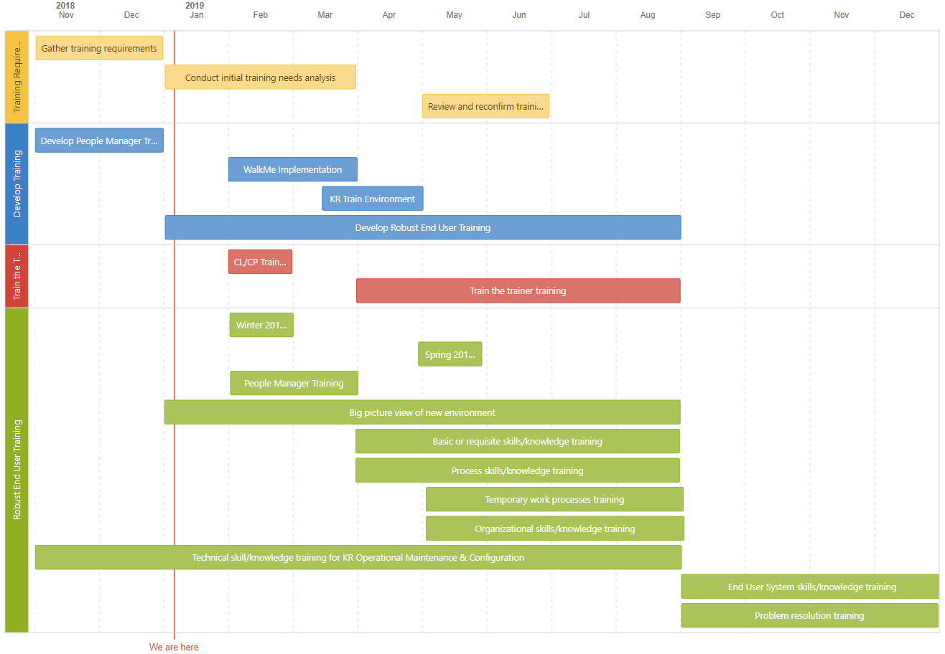
Training Roadmap Draft
This outlines the high level strategy and is subject to change
Rev 1.28.2018

Slide 9
Critical Dependencies & Things to Consider
Impacts on Training Strategy
Will we leverage internal expert sourcing or external resources?
When will the system be “stable” enough to start designing the training content?
When will the final business process decisions be complete?
Do we know who we are training and to what degree? Does everyone have to be an expert?
Will trainers also be expected to provide some level of client support?

Slide 10
Next Steps
Where do we go from here?
Refine reports and work with RIS and others to identify the various audiences
Conduct cost/benefit analysis on the purchase of WalkMe and Live Chat software (if green lighted, purchase, install and train the trainer)
Review a training and communications survey results (use this to inform content and delivery design)
Complete the training requirements assessment
Work with people managers to conduce training needs assessments and analyze gaps (use this to inform content and delivery design)
Kick off people manager training in the beginning of 2019
Kick off roadshows in the beginning of 2019 designed to train to big picture and business process changes
Establish a KR Training Environment at end of CYQ1

Slide 11
For questions contact Nicole Joyce at njoyce@ucsd.edu or 858-534-9112.

