Slide 1
Change Network
November 2019

Slide 2
Index Mapping Results

Slide 3
How much work was this?
18
204
62,300
20
0
Spreadsheets
Tabs
Active Index Numbers
Working Days
Extensions

Slide 4
How did we get this done?
25+
1,175
1
10,125
258
Countless
Newsletters, Web Pages, Webinar, Office Hours, Guideline Documents, Presentations
Video views
Magical Spreadsheet Template
Unique Spreadsheet Sessions
In-spreadsheet Comments
Change Network Hours
Coordinating with Colleagues

Slide 5
Results
13,500
48,800
5,300
43,500
23,200
Consolidated Index Numbers
Unique Chart Strings
Non-Project GL Strings
Tasks
Projects
Thank you!

Slide 6
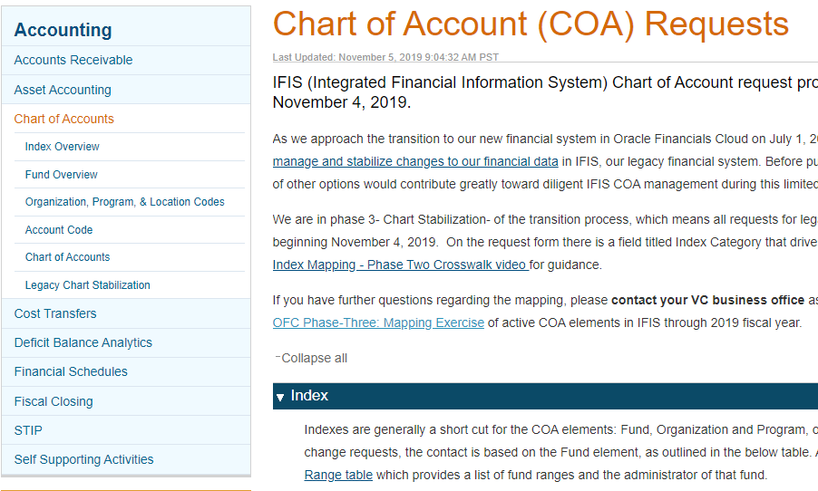
Phase 3- Chart Stabilization
Legacy Chart Stabilization https://blink.ucsd.edu/finance/accounting/chart/chart-stabilization.html
Chart of Accounts Request Instructions https://blink.ucsd.edu/finance/accounting/chart/index.html

Slide 7
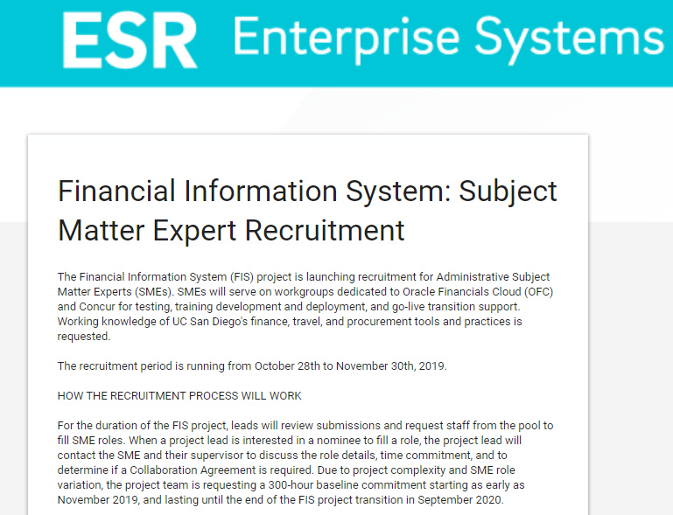
SME Recruitment
• The recruitment period runs from October 28th to November 30th, 2019.
• We need University-wide participation; this is your area’s opportunity to build competency in Oracle and Concur systems before go-live.
• Please nominate staff and encourage supervisors to allow for participation.
• 300 hours is the baseline commitment
SME Recruitment Form

Slide 8
Kuali Project Updates
November 7, 2019
Notes:
Add comments to notes

Slide 9
Agenda
1 | Kuali Research Project Update
2 | Upcoming Trainings
3 | Upcoming Unit and Faculty Engagements

Slide 10
KR Project Timeline
Initiate
Design
Plan
Validate
Transition
Go Live
Realization
Stabilization
Configure
Upcoming Milestones
We are here
Oct – Dec 2017
Jan – Mar 2018
Apr 2018 – Apr 2019
Aug 2018 – Apr 2019
May – Dec 2019
Dec 2019 – Jan 2020
Jan 21, 2020
Jan – Mar 2020
Apr – Jun 2020
Milestones
80+ SMEs
200+ hours
25 Processes
Over 1 year
Business Process Design
Final configurations - Complete
System Configuration
Functional Testing – Complete
Data Migration Testing – In Progress
System Integration Testing – In Progress
Business Process Testing – In Progress
User Acceptance Testing – Scheduled (Dec)
Testing
Chancellor Cabinet and Deans Update - Complete
SME Train-the-Trainer – Complete
Learning Labs – Scheduled (Nov – Jan)
Webinars – To be scheduled
WalkMe Builds – In Progress
Change Management: Communications and Training
Service Transition (project to operational model) – In progress
Hypercare User Support Planning – In progress
Transition

Slide 11
Kuali Research Training
Registration is now open!
Kuali Research Proposal Development Learning Labs (Nov – Jan):
How to build a System-to-System Proposal, Non System-to-System Proposal, a Detailed Budget, and other features of the system
How to associate new business processes for proposal submission
Offerings will have General Campus, Health Sciences or Marine Sciences Focus
Topic specific trainings will also be offered as needed
To register go to Kuali Research Training Opportunities

Slide 12
Upcoming Unit and Faculty Engagements
SPO Leadership Outreach to Submitting Units
SPO Leaders are the process of scheduling meetings with submitting unit heads across, AA, HS and MS to communicate notable changes regarding business processes related to Kuali Research
Units heads be expected to work within their areas to develop and submit an implementation plan

Slide 13
Communication Activity | Kuali Research | Sender(s) | Message(s)
Faculty Communications | Chancellor’s Cabinet & Deans Meeting 9/23 - Complete | VCR and CIO | Notable changes and impacts on campus related to KR rollout (14, 5 and 2 business days); action items for Deans
 | ORU Directors Meeting 10/29 – Complete ORUBA ORU Business Officers 12/6 – Scheduled SDSC and Q1 Director and MSO – To be scheduled | AVC C&G | About KR, importance of changes (14, 5 and 2 business days); action items for Directors
 | AA Deans/Chairs/DBO-MSO: Physical Sciences Department Heads – Scheduling in progress Biological Sciences Department Heads – Complete Social Sciences Department Heads – Scheduled 11/21 Arts and Humanities – Scheduled 11/20 Graduate Division - Scheduling in progress Global Policy and Strategy - Scheduling in progress JSOE – Scheduled 11/15 or 12/16 CaliT, SDSC, Design Lab, HDSI – Scheduling in progress Rady School of Management -Scheduling in progress | AVC C&G | Notable changes and impacts on campus related to KR rollout (14, 5 and 2 business days); lots of change for administrators, be mindful when planning timelines
 | SIO Division/Department Head Meetings for Implementation Plans: SIO 9 meetings for Division Directors and Section Heads – Scheduling in progress | SPO Leaders (SIO Director C&G and SIO Chief Administrative Officer) | Notable changes and impacts on campus related to KR rollout (14, 5 and 2 business days) and (Back up to Back up) ; action items for Chairs, DBOs, Faculty
 | Health Sciences Council of HS Chairs – Target 11/12 Agenda - Scheduling In Progress 22 Meetings with Department Chairs and DBOs Bioinformatics – 10/23 - Complete All Scheduled for November: Anesthesiology, CMM, CTRI, Dermatology, Emergency Medicine, Fmaily Medicine, Medicine, MCC, Neurosciences, Ophiology, Orthopedic Surgery, Pathology, Pediatrics, Pharmacology, Psychiatry, Radiation Medicine, Radiology, ReproMed, Skaggs School of Pharmacy , Surgery, Urology Health Sciences Contacts Meeting | AVC C&G and HS Senior Director Research Service Core | Notable changes and impacts on campus related to KR rollout (14, 5 and 2 business days); lots of change for administrators, be mindful when planning timelines
 | Academic Senate – Representative Assembly 12/10 - Scheduled | VCR | Notable changes and impacts on campus related to KR rollout (14, 5 and 2 business days); ); lots of change for administrators, be mindful when planning timelines
 | EVC – GC/AA Assistant Deans Meeting - TBD | AVC C&G | TBD
 | EVC – GC and SIO Quarterly Chair Meeting - TBD | AVC C&G | TBD
 | Faculty Advisory Committee – TBD | VCR and AVC C&G | Looking for 5-7 representatives to serve on as an academic advisory group to review proposal submittal timeline and provide feedback, offer engagement and support for process changes.

Slide 14
Resources Available to Stay Up to Date!
REGISTER FOR LEARNING LABS
https://esr.ucsd.edu/projects/kuali-research/index.html
CHANGE NETWORK
esr.ucsd.edu/projects/kuali-research/network/
INVITE US TO YOUR MEETING!
njoyce@ucsd.edu
858-534-9112
WEBSITE
esr.ucsd.edu/projects/kuali-research/
NEWSLETTER
esr.ucsd.edu/contact/subscribe.html
DIGITAL FORUM
Last Wednesday of every month
(note holiday schedule will change dates see newsletter and website for updates)
12:00PM – 1:00PM
https://ucsd.zoom.us/s/897430526

Slide 15
For questions about Kuali Research contact Nicole Joyce at njoyce@ucsd.edu or 858-534-9112
For questions about Kuali COI contact Jennifer J. Ford at jjford@ucsd.edu or 858-534-3335
For questions about Kuali IRB contact Kip Kantelo at kkantelo@ucsd.edu or 858-822-1870

Slide 16
Communication Activity | Kuali Research Channel | Frequency | Sender(s) | Message(s)
Enterprise Systems Renewal (ESR) Program Governance Updates | Enterprise Information Services Committee (EISC) Program Meeting | Ad Hoc - Last presentation 10/24 | KR Change Lead | Project update, completed milestone, up coming initiatives (topic tailored as needed)
Project Sponsor Updates | To Sandy Brown via ORA Leadership Meeting | Monthly - Since Sept 2018 | KR Change Lead | Project update, completed milestone, up coming initiatives (topic tailored as needed)
Project Governance Updates | Research Information Services (RIS) Advisory Group Meeting In Person and Executive Summary Email | Bi-Weekly In Person Monthly Email – Since Oct 2017 | KR Project Team | Project status, updates, issues and/or risks, asks of governance
Escalation Committee Updates | Executive Summary Email to Escalation Committee Members | Monthly Email – Since Feb 2019 - on hold | KR Change Lead on behalf of Project Team | Project status, updates, issues and/or risks, asks of committee
Roadshows to Units | Various Unit Meetings | Ad Hoc - Round 1 presented to 11 groups Jan – May 2019 | KR Change Lead – Round 1 | About Kuali Research, business case, why UCSD is changing, project structure, governance and timeline
Kuali Newsletter | Kuali Mailchimp Email | Monthly - Since Jan 2019 | KR Project Team (managed by Change Practitioner) | Messages related to topics based on project activity and upcoming initiatives
ESR Newsletter | ESR Mailchimp Email | Ad Hoc – Since Jul 2018 | KR Project Team (managed by Change Practitioner) | Messages related to topics based on project activity and upcoming initiatives
Digital Forum | Live Webinar via Zoom | Monthly – Since Mar 2019 | KR Change Lead | Messages related to topics based on project activity and upcoming initiatives – transitioning into system demos
Town Halls | In Person Event | Ad Hoc – Last hosted Apr 2019 | KR Project Sponsor, ESR Program and Project Team | About Kuali Research, business case, why UCSD is changing, project structure, governance and timeline and system demo
Business Process/ Change Messaging | Business Process Follow Up Meetings w/ SMEs | Ad Hoc from Jan – Aug 2019 | KR Project Sponsor, Governance, Project Team and Various Business Leaders (Executive and Managers) | Notable business process changes, reason for change, risk of not changing, critical behaviors and key success factors; Reinforcement
Faculty Communications | Various Faculty and Unit Meetings | Ad Hoc - (see next slide) | KR Project Sponsor and Various Business Leaders (Executive and Managers) | Notable business process changes, reason for change, risk of not changing, critical behaviors and key success factors; Reinforcement
Direct Communications | Recorded Videos, Change Network, Various listservs, All Campus Communication | Ad Hoc - Since Feb 2018 | KR Project Sponsor, Project Team, Change Network and Various Business Leaders (Executive and Managers) | Messages related to topics based on project activity and upcoming initiatives
Milestone Celebrations | Ad hoc – Hosted on for Business Process SMEs in Apr 2019 | Hosted on for Business Process SMEs in Apr 2019 | KR Project Sponsor, ESR Program and Project Team | Appreciation to campus subject matter experts and those contributing to the project, business process improvement efforts and engaged in support of change

Slide 17
Training Delivery Method | Kuali Research | Target Audience | Instructor/ Facilitator | Content
Train-the-Trainer (T3 or TTT) – Complete (Dates…) | Trained 83 SMEs (Dept. and SPO) | Select Subject Matter Experts (SMEs) from across campus Dept. Units and Central Offices | Vendor – Kuali | Kuali Research
 | Trainer Kickoff | SME Trainers (Dept. and SPO) | KR Change Lead | Expectations and training plan
 | Training Exercise and Content Review | SME Trainers (Dept. and SPO) | KR Training Team | Modifying content for UC San Diego Units and Offices
 | Training Environment System Access Granted | SME Trainers (Dept. and SPO) | KR Training Team | Access use agreement and environment expectations
Learning Labs/Office Hours – In Progress (Dates…) | Scheduled on site | Central Offices | SME Trainers | Build a proposal and detailed budget and submit for review using; Review a proposal hierarchy; Print and render proposal and budget forms using; Review and return a proposal; Approve and Submit a proposal; Edit and Finalize an Institutional Proposal; Build a Negotiation Record; Create and develop an Award (if applicable); Associate how Kuali Research Proposal Development supports business process changes
 | Scheduled across campus from Nov 2019 – Feb 2020 | Department Research Administrators | SME Trainers | Build a proposal using Kuali Research Proposal Development; Build a detailed budget for a proposal; Create a proposal hierarchy by building and linking parent and children proposals; Copy a proposal; Print and render proposal and budget forms; Submit a proposal for review; Associate how Kuali Research Proposal Development supports business process changes
Digital Adoption Planform (DAP) – In progress | 60+ Walk Thru Build Smart Tips User Interface Configurations - TBD | Users of KR per Audience Segmentation (Proposal Creators and Mangers, Viewers, Approvers, Proposal and Award Analysts) | KR Training Team w/ SMEs | Various content
Microlearning Library – In progress | Utilizing WalkMe to incorporate Blink, HS website, SIO website and Kuali Zendesk and SNOW | Users of KR per Audience Segmentation (Proposal Creators and Mangers, Viewers, Approvers, Proposal and Award Analysts) | KR Training Team | Various content
Virtual Instructor-let Training (VILT) or Webinar – To be scheduled | Ad Hoc | Users of KR per Audience Segmentation (Proposal Creators and Mangers, Viewers, Approvers, Proposal and Award Analysts) | SME Trainers | Various content
On-the-job Coaching | Per UC San Diego’s model of 70-20-10 will establish a community of practice to support on the job coaching | Employees in both Department and Central office Research Administration | SME Trainers | On demand learning as needed
Recorded Presentation | Using existing recorded presentations related to RA, will add these into the onboarding section of WalkMe as it pertains to the KR modules | Users new to Research Administration per Audience Segmentation (Proposal Creators and Mangers, Viewers, Approvers, Proposal and Award Analysts) | SME Trainers | Informational and knowledge based topics
Notes:
Not doing the following for KR (may differ from COI depending on strategy changes per system development)
Instructor-led Classroom (ILT)
Low-level Interaction eLearning
Medium-level Interaction eLearning
High-level Interaction eLearning
Tutorial Videos

