Slide 1
UC San Diego CoA
New Chart of Accounts Q&A Session | 4.18.19

Slide 2
UC Systemwide Common Chart of Accounts (CCoA)
The University of California Common Chart of Accounts (CCoA) Design project was initiated in June of 2012
WHAT
HOW
WHY
The current UCOP chart is outdated, overly complex, and unable to meet the reporting needs of the campuses and UC system
Develop a new CCoA to enhance system-wide reporting, budgeting, and financial management
Foundation for operational
and financial collaboration
Consolidate and standardize financial operations system-wide
Reduce extensive, expensive data reconciliations across locations
Notes:
Bill McCarroll

Slide 3

CCoA Guiding Principles
The CCoA should accommodate for growth and meet ongoing/changing business requirements.
Participants should be open to new, innovative ways of doing business.
The CCoA should serve the needs of stakeholders as the common language used in all financial management processes and IT systems used system-wide by campuses and medical centers.
The CCoA should be simple, intuitive, and easy to comprehend.
Each segment should have a single use with a clear and consistent definition.
Use of the CCoA values should be supported via robust guidelines, communications, and documentation.
The CCoA design should be based on best practices and facilitate comparisons to peer institutions.
Source: Common Chart of Accounts Final Report, University of California, March 26, 2014
Notes:
Bill McCarroll

Slide 4
CCoA Guiding Principles (continued)
The CCoA should capture transactional level data that, when combined with CoA segment attributes and data from subsidiary systems, is sufficient to support campus, medical center, and system-wide financial and budgetary analysis and statutory (i.e., OSHPD), financial, and management reporting needs.
All levels of each CCoA segment hierarchy should be defined and common enough to enable location-wide and system-wide reporting, but remain flexible to meet campus/medical center business requirements (financial and management).
The CCoA should not be designed for a specific financial application, nor should its design be limited by current systems capabilities.
The CCoA structure should focus on long-term needs while accommodating a phased implementation at the system and campus/medical center levels over time.
Source: Common Chart of Accounts Final Report, University of California, March 26, 2014
Notes:
Bill McCarroll

Slide 5

New CoA Project Goals
Goal
Extend the elements of the UC Common Chart of Accounts (CCoA) that services the needs of UC San Diego, including the Medical Center and UC San Diego Foundation.
Approach
Include broad representation of UC San Diego’s units to ensure the new CoA structure and values meet the requirements of external financial reporting, budget, and financial management needs of our diverse organizations, programs, and activities.
PROJECT SUCCESS!

Slide 6
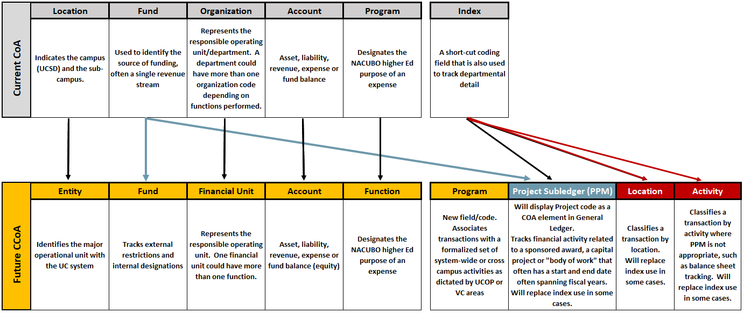
Mapping of Current to New

Slide 7
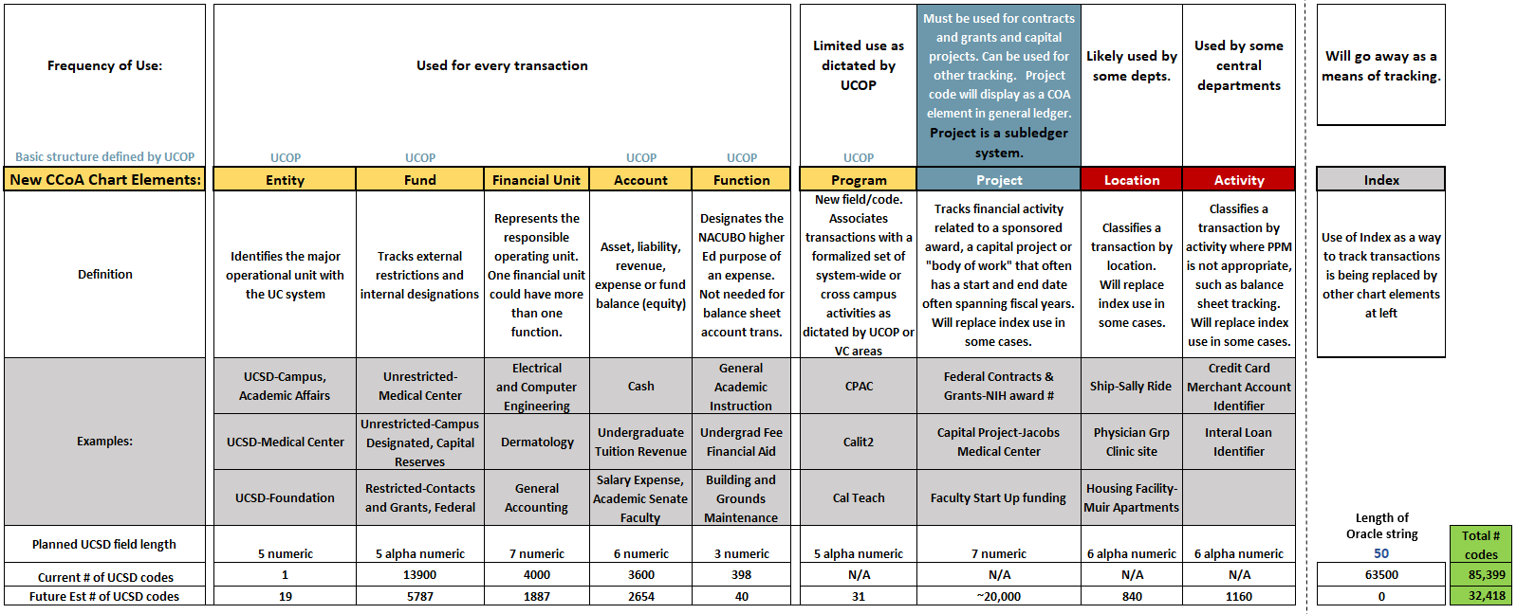
New Common Chart of Accounts

Slide 8

New Chart Segment Overview
The Chart of Accounts (CoA) is the complete set of values used to record financial transactions in the general ledger.
UC San Diego’s new chart string consists of nine segments “chart elements”. This structure assists in the consistent posting and reporting of financial transactions. The diagram below depicts the nine segments of the University’s chart string.
Segment | Definition | Length
Entity | Identifies the major operational unit with the UC system | 5
Fund | Tracks restrictions and designations | 5
Financial Unit | Represents the responsible operating unit | 7
Account | Asset, liability, revenue, expense or fund balance | 6
Function | Designates the NACUBO Higher Ed purpose of expense | 3
Program | Associates transactions with a formalized set of system-wide or cross campus activities | 5
Project* | Tracks financial activity related to a sponsored award, a capital project or “body of work” that may have a start and end date, often spanning fiscal years | 7
Location* | Classifies a transaction by physical location | 6
Activity* | Classifies a transaction by activity where PPM is not appropriate | 6
* To replace index use in many cases for department reporting needs

Slide 9

Entity Structure
Defined: Identifies the major operational unit with the UC system
Field Length and Type: 5-digit alphanumeric
New chart element for UC San Diego
UC San Diego
Campus
Medical Center
UCSD-UCOP
Foundation
Campus →
Major Entities→

Slide 10
Entity Hierarchy
UCOP Required Hierarchy Levels |  |  |  |  |  | UCSD Optional Lower Level
Level A |  | Level B |  | Level C |  | Level D (posting level)
Campus | Grouping | Entity Number | Entity Name
San Diego | 1600A
 |  | 1610B | UC San Diego Campus
 |  |  |  | 1611C | UC San Diego Campus, excluding separately reported blended component units
 |  |  |  |  |  | 16110 | Academic Affairs
 |  |  |  |  |  | 16120 | Marine Science
 |  |  |  |  |  | 16130 | Health Science
 |  |  |  |  |  | 16143 | Health Physician Group
 |  |  |  |  |  | 16144 | Population Health Svc Orgn (PHSO)
 |  |  |  |  |  | 16150 | Chief Financial Officer
 |  |  |  |  |  | 16160 | Student Affairs
 |  |  |  |  |  | 16170 | Resource Management & Planning
 |  |  |  |  |  | 16180 | Research Affairs
 |  |  |  |  |  | 16191 | Academic Senate
 |  |  |  |  |  | 16192 | Office of the President
 |  |  |  |  |  | 16193 | Advancement
 |  |  |  |  |  | 16194 | Equity Diversity Inclusion
 |  |  |  |  |  | 16195 | Chancellor
 |  |  |  |  |  | 16196 | Campuswide Organizations
 |  |  |  | 1612C | Sanford Consortium
 |  |  |  |  |  | 16200 | Sanford Consortium
 |  | 1620B | UC San Diego Medical Center
 |  |  |  | 1621C | UC San Diego Medical Center, excluding separately reported blended component units
 |  |  |  |  |  | 16242 | CEO of Medical Center
 |  | 1640B | UCSD - UCOP
 |  |  |  | 1641C | UCSD - UCOP Current (ALPHA ledger-ALPHA funds)
 |  |  |  |  |  | 16400 | UCSD - UCOP Current (ALPHA ledger-ALPHA funds)
 |  | 1650B | UCSD-Foundation
 |  |  |  | 1651C | UCSD-Foundation
 |  |  |  |  |  | 16510 | UCSD-Foundation
 |  |  |  | Note: Foundation will not map up to UCOP but likely needed since Foundation will be on Oracle.

Slide 11
Fund Structure
Definition: Focus on external fund restrictions and designations for audited financial statement presentation- Unrestricted, Restricted Expendable, Restricted Unexpendable, Net Investment in
Plant, and Agency Funds.
Field Length and Type: 5-digit alphanumeric
Gift & Endowment Funds
    Alphanumeric with leading letter defining restriction level
    Foundation and Campus will share value
Contract and Grant awards will be tracked in the project module in Oracle rather than in individual funds. Contract and Grant projects will roll up to the following funds:
    Federal contracts and grants
    State and Local contracts and grants
    Private contracts and grants
Main fund consolidations
    Contract and Grant funds (7300 down to 3)
    Recharge activities (750 down to 4)- tracked by a unique Department/Financial Unit in Oracle
    Outside work study funds (30 funds down to 1)
    Lease/rental revenue funds (53 funds down to 1)

Slide 12
Fund Hierarchy
1000A | Unrestricted
 |  | 1000B | Unrestricted
 |  | 1993B | UC General Funds
 |  | 1400B | Tuition
 |  | 1500B | Designated
2000A | Restricted Expendable
 |  | 1990B | State General Fund
 |  | 2000B | Contracts and Grants
 |  | 2095B | Federal Appropriations
 |  | 1800B | Special State Appropriations
 |  | 1999B | Specific State Appropriations
 |  | 2100B | State Appropriations, Capital
 |  | 2200B | Restricted Gifts
 |  | 2210B | Split-interest Agreements
 |  | 2400B | Debt Service
 |  | 2600B | Loans
 |  | 2630B | Insurance
3000A | Restricted Unexpendable
 |  | 3000B | Endowment Principal
 |  | 3100B | Split-interest Agreements
 |  | 3200B | Minority Interest
4000A | Net Investment in Capital
 |  | 4000B | Net Investment in Capital
5000A | Agency Funds
 |  | 5000B | Agency Funds

Slide 13

Financial Unit Structure
Definition: Financial Unit represents a unit with an ongoing business objective, with a responsible individual with fiscal authority over budget and costs, an identifiable group of employees, and
generally physical space.
Field Length and Type: 7-digit numeric
Terminology shift from Department to Financial Unit in Oracle (future state)
Focused on enabling and improving internal Campus Financial Management reporting.
Proposed structure includes Oracle Values (numbering) for Financial Unit and Hierarchy Levels.
Recharge Activities Streamlined: Each recharge facility has been assigned an unique Financial Unit value so that the facility can be tracked across shared funds. Proposed structure includes recharge activity breakout.
    Reduces the number of recharge Funds from 750+ to 4
    Adds 63 unique recharge Financial Units
    Allows for easier identification and oversight over recharge activity
    Allows for simplified workflow routing in Oracle

Slide 14
Financial Unit Hierarchy
Financial Unit Level 1 Title | First 2 Digits
Academic Affairs | 10
Marine Science | 20
Health Science | 30
CEO of Medical Center | 42
Health Physician Group | 43
Population Health Svc Orgn (PHSO) | 44
Chief Financial Officer | 50
Student Affairs | 60
Resource Management & Planning | 70
Research Affairs | 80
Academic Senate | 91
Office of the President | 92
Advancement | 93
Equity Diversity Inclusion | 94
Chancellor | 95
Campuswide Organizations | 96

Slide 15
Account Structure
Revenue and Expense Transfer
Account Structure
First 2 Digits | Category
72#### | Contract and Grant Transfer b/w Locations
73#### | Campus/Medical Center Expense Transfers
74#### | Revenue Transfer from UCOP (e.g., STIP, Endow Payout)
75#### | Expense Transfer from UCOP (e.g., Legal, Insurance)
77#### | Internal Recharge and Cost Allocation Entries
78#### | Inter-location Recharge
First Digit | Account Type
1 | Assets
2 | Liabilities
3 | Fund Balance/Net Position
4 | External Revenues
5 | External Expenses
7 | Revenue and Expense Internal Transfer*
8 | Other changes in Net Position
Specific accounts for location
Includes recharges between Campus and Medical Center
Called out for Med Center financial statement disclosures
Category needs to be net zero at UC San Diego level
Includes recharges or cost allocations from one campus department to another or one Med Center department to another
* This category needs to net to zero on a consolidated UC basis
Specific accounts for each location (i.e., all UCSD recharge transactions with UCLA will be netted in one account)

Slide 16
Revenue Account Hierarchy
UCOP Shared Revenue Hierarchy
UC San Diego Level A
40000A | Student Tuition & Fees, Net
40500A | Contracts and Grants (non-Capital)
41000A | Sales and Services -Educational
43000A | Sales and Services -Auxiliary
44000A | Other Operating Revenue, Net
45000A | Medical Center Service Revenue
46000A | Department of Energy Laboratories
46900A | Foundation Gift Revenue (Foundation Use only)
48000A | Private Gifts (non-capital)
48100A | Appropriations
48200A | Income on Investments
48400A | Gain / (Loss) on Disposal of Capital Assets
48450A | Impairment of Asset-Recovery
48500A | Additional Non-Operating Revenue Sources
81000A | Other Changes in Net Position (Disclosure purposes)
87000A | Other Changes in Net Position (For Financial Reporting)

Slide 17
Expense Account Hierarchy
UCOP Shared Expense Hierarchy
UC San Diego Level A
50000A | Salaries and Wages
50500A | Pension Benefits
50600A | Retiree Health Benefits
50700A | Other Employee Benefits
51000A | Financial Aid and Scholarships
52000A | Supplies and Materials
53000A | Other Operating Expense
54000A | Depreciation and Amortization Expense
55000A | Utilities
56000A | Campus Foundation Grants
56100A | Department of Energy Laboratory Operating Expense
58000A | Non-Operating Expense
59000A | Suspense Accounts (Placeholder)
73000A | Recharge Sales and Services

Slide 18
Function Structure
Definition: Function replaces IFIS program codes and designate the NACUBO Higher Ed purpose of an expense
Field Length and Type: 3-digit numeric
Since many IFIS program codes are non-descriptive (i.e., titled “Core Operations) General Accounting will review IFIS Org-Program combinations and map accordingly to new function categories.
    General Accounting or Central Budget Office will reach out to VC areas to help determine correct mapping.
    The function chart segment remains very important for UC San Diego’s audited financial statement expense classification and IDC rate.

Slide 19
Function Hierarchy
CCoA Shared value Level A |  | Level B | Value
Function Number | Function Title | UCSD
40 | Instruction | General Academic Instruction | 401
 |  | Extension and Continuing Education | 411
42 | Teaching Hospitals | Teaching Hospitals | 421
43 | Academic Support | Libraries | 431
 |  | Museums and Galleries | 432
 |  | Educational Media Services | 433
 |  | Ancillary Support, Clinical | 434
 |  | Ancillary Support, Other | 435
 |  | Academic Administration | 436
44 | Research | Department Research | 441
 |  | Organized Research (Sponsored & Formal University) | 442
62 | Public Service | Public Service | 621
64 | Operation & Maintenance of Plant | OMP Administration | 641
 |  | Utilities | 642
 |  | Building, Grounds and Equipment Maintenance | 643
 |  | Major Repairs and Renovations | 644
 |  | Security and Safety | 645
 |  | Logistical Services (receiving & dist.) | 646
68 | Student Services | Student Services Administration | 681
 |  | Social and Cultural Development | 682
 |  | Counseling and Career Guidance | 683
 |  | Financial Aid Administration | 684
 |  | Student Admissions | 685
 |  | Student Records (Registrar) | 686
 |  | Student Health Services | 687
72 | Institutional Support | Executive Management | 721
 |  | Fiscal Operations | 722
 |  | General Administration | 723
 |  | Public Relations/Development | 724
 |  | Admin Information Technology | 725
76 | Auxiliary Enterprises | Housing and Dining | 761
 |  | Parking and Transportation | 762
 |  | Bookstore | 763
 |  | Other Auxiliary | 764
78 | Scholarships and Fellowships/Student Financial Aid | Grad Fee Aid | 781
 |  | Grad Stipend | 782
 |  | Undergraduate Fee Aid | 783
 |  | Undergraduate Stipend | 784
 |  | Grad/Undergrad Fee Aid | 785
 |  | Grad/Undergrad Stipend | 786

Slide 20
Program Structure & Hierarchy
Definition: Associates transactions with a formalized set of system-wide or cross campus activities
Field Length and Type: 3-digit alphanumeric
Program is a UC-wide structure
10A | Natural Reserve System (NRS)
 |  | 101 | Natural Reserve System (NRS)
11A | California Institute for Science and Innovation (Cal ISI)
 |  | 111 | California Institute for Quantitative Biosciences (QB3)
 |  | 112 | California Institute for Telecommunications and Information Technology (Calit2)
 |  | 113 | California Nanosystems Institute (CNSI)
 |  | 114 | Center for Information Technology Research in the Interest of Society (CITRIS)
12A | Postdoctoral Fellowship Program
 |  | 121 | Postdoctoral Fellowship Program
13A | President's Initiatives
 |  | 131 | President's initiatives
14A | Student Academic Preparation and Educational Partnership (SAPEP)
 |  | 141 | SAPEP1
 |  | 142 | SAPEP2
 |  | 143 | SAPEP3
 |  | 144 | SAPEP4
 |  | 145 | SAPEP5
15A | California Program on Access to Care (CPAC)
 |  | 151 | California Program on Access to Care (CPAC)
16A | Collaborative Exchange of Transfer Applicant Data (CETAD)
 |  | 161 | Collaborative Exchange of Transfer Applicant Data (CETAD)
17A | MRU
 |  | 171 | White Mountain Research Center
 |  | 172 | UC Mexus
 |  | 173 | Institute of Transportation Studies
 |  | 174 | UC Institute on Global Conflict and Cooperation (IGCC)
 |  | 175 | California Advanced Solar Technologies Institute (UC Solar)
 |  | 176 | UC Observatories (UCO)
18A | UCHRI
 |  | 187 | UC Humanities Research Institute (UCHRI)
19A | Global health Sciences
 |  | 191 | Global health Sciences
20A | CTSI
 |  | 201 | Clinical and Translational Science Institute (CTSI)
21A | Institute of Labor and Employment
 |  | 211 | Institute of Labor and Employment
22A | Safety Programs
 |  | 221 | Safety Programs
23A | Education Abroad
 |  | 231 | UC Education Abroad Program (UCEAP)
 |  | 241 | UC Washington Center (UCDC)
25A | UC Center Sacramento
 |  | 251 | UC Center Sacramento
26A | Agricultural Experimental Station
 |  | 261 | Agricultural Experimental Station
27A | California Alliance for Minority Participation
 |  | 271 | California Alliance for Minority Participation
28A | COSMOS
 |  | 281 | COSMOS
29A | Cal Teach
 |  | 291 | Cal Teach
30A | UC Online
 |  | 301 | UC Online
31A | California Digital Library
 |  | 311 | California Digital Library (CDL)

Slide 21
Project Structure
Definition: Tracks financial activity related to a sponsored award, a capital project or "body of work" which may have a start and end date, often spanning fiscal years.
Field Length and Type: 7-digit numeric
Projects are created and tracked through the Oracle PPM subledger.
    The project # will display in the general ledger as a chart element.
    All project spending should go through PPM, not directly into the general ledger.
Types of projects created and tracked through Oracle PPM include:
    Contracts and Grants (sponsored awards and service agreements)
    Capital Projects
    Departmental Expenditure Tracking (e.g., faculty start up, events, courses, etc.)

Slide 22
Location Structure
Definition: Classifies a transaction by physical location
Field Length and Type: 6- digit alphanumeric
Decision has been made to use CAAN numbers from Tririga
    When a CAAN is not available an Oracle number will be created
Numbering system is as follows:
    CAAN numbers will start with a "C"
    Locations with no CAAN number will start with "N"
    Ships will start with "S"

Slide 23
Location Code Sample
Oracle Posting Level | TRINAMETX/Building | CAAN | Location

Slide 24
Activity Structure
Definition: Classifies a transaction by activity where PPM is not appropriate, such as
balance sheet tracking
Field Length and Type: 6- digit alphanumeric
Types of activities that will not go into PPM:
    Credit card merchant account identification
    Internal Loan tracking

Slide 25
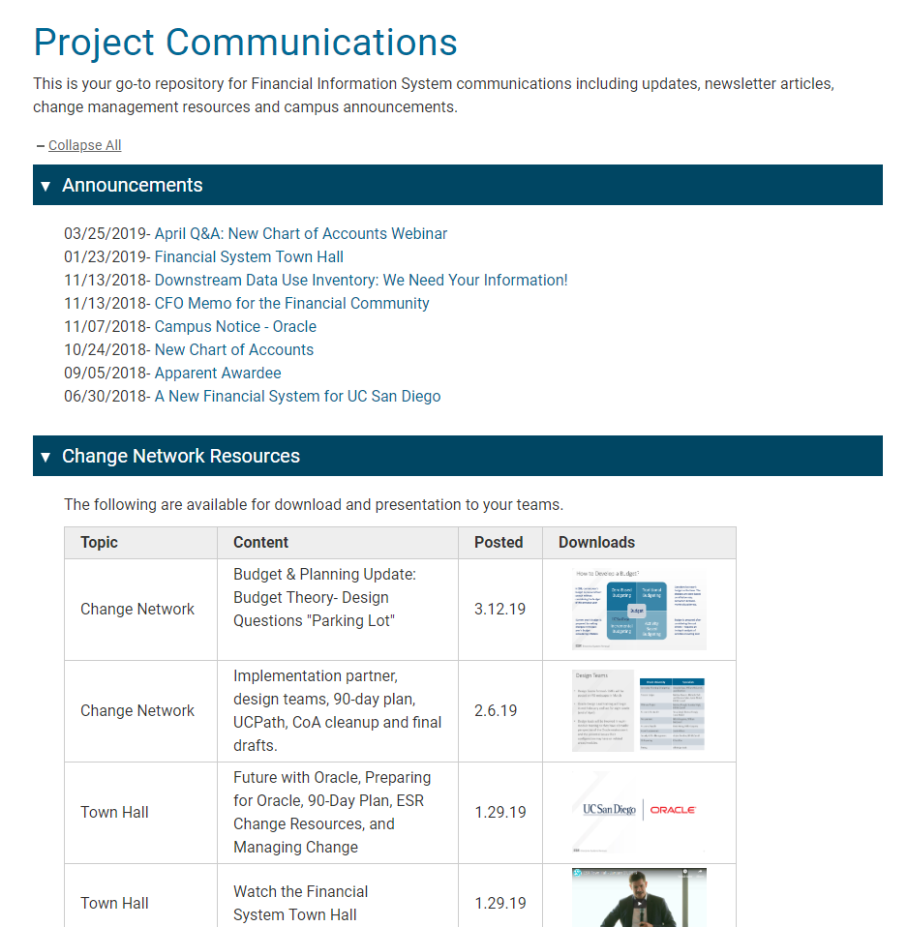
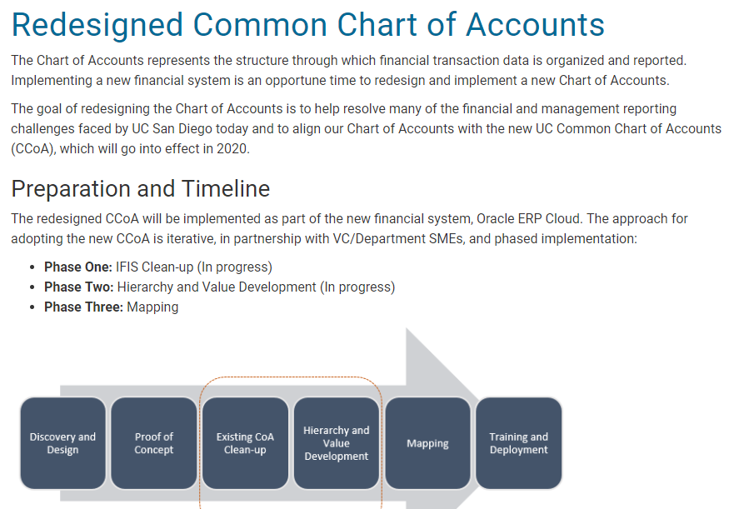
CoA Resources
esr.ucsd.edu/fis

Slide 26

Questions and Answers

Slide 27

THANK YOU!
Email
esrfisp@ucsd.edu

