Slide 1
KR Testing Strategy
An introduction into technical and functional testing

Slide 2
Validate
Initiate
Design
Plan
Validate
Transition
Go Live
Realization
Stabilization
Configure
Iterative system testing cycles; Validating and testing the system and processes
This is the Testing Phase

Slide 3
Part 1
Part 2
Part 3
Testing Objectives:
What is testing and why do it?
Testing Scope:
What is being tested and who are the testers?
Testing Timeline:
When is testing happening?

Slide 4
Part 1
Part 2
Part 3
Testing Objectives:
What is testing and why do it?
Testing Scope:
What is being tested and who are the testers?
Testing Timeline:
When is testing happening?

Slide 5
Testing Objectives
What is being tested and why?
Testing is a method used to determine whether each of the project’s software deliverables meet the defined quality standards established for the software development project.
Goal is production-ready software.

Slide 6
Testing Case Design and Traceability
What are test cases?
As business process work was conducted, it created business process requirements. These requirements were used to develop user stories, which are used to develop use cases.
Use cases are then used to develop test cases and test scenarios, which are then used in user acceptance testing.
Having these various focuses, allows the system to be tested in a variety of ways and traced back to the original business requirements. After all, systems are tools that should be designed to support business (not the other way around).

Slide 7
Part 1
Part 2
Part 3
Testing Objectives:
What is testing and why do it?
Testing Scope:
What is being tested and who are the testers?
Testing Timeline:
When is testing happening?

Slide 8
Testing Scope
Kuali
Research System
What is being tested?
COEUS DATA MIGRATION SCRIPTS
USER INTERFACE FOR:
PROPOSAL DEVELOPMENT, INSTITUTIONAL PROPOSAL, NEGOTIATION, AWARD, AND SUBAWARD MODULES
KR APPLICATION CONFIGURATION
CUSTOM FIELDS, MODIFICATIONS AND WORKFLOWS
KUALI REPORTS
UCSD DATA ANALYTICS OF KR DATA
DATA INTEGRATIONS
KUALI DASHBOARD

Slide 9
Testing Scope
Kuali Research Test Strategy
User Acceptance
Unit Testing
Data Migration
Functional Testing
System Integration Testing
Business Process Testing
Performance Test
Levels of testing

Slide 10
Testing Scope
Testing Strategy:
Scope
Purpose
Assumptions
Overall Approach
Critical Success Factors
Metrics
Test and Defect Management
Kuali Research Test Strategy
User Acceptance
Unit Testing
Data Migration
Functional Testing
System Integration Testing
Business Process Testing
Performance Test
Levels of testing

Slide 11
Testing Scope
Testing Strategy:
Scope
Purpose
Assumptions
Overall Approach
Critical Success Factors
Metrics
Test and Defect Management
Kuali Research Test Strategy
User Acceptance
Unit Testing
Data Migration
Functional Testing
System Integration Testing
Business Process Testing
Performance Test
Levels of testing
Testing Plan:
Test Objectives
Test Assumptions
Test Principles
Test Scope
Test Usability
Test Criteria
Testing Cases:
Design
Development
Execution
Test/Defect Management

Slide 12
Testing Scope
Kuali Research Test Strategy
User Acceptance
Unit Testing
Data Migration
Functional Testing
System Integration Testing
Business Process Testing
Performance Test
Levels of testing
Each level of testing will have at least 2 phases, with the exception of user acceptance testing

Slide 13
Testing Scope
Proves an individual unit of work functions as expected. This is often associated with technical object testing, although it can also be applied to a configuration unit of work.
Ex: specific and detailed technical tests (think lines of code and individual values)
Kuali Research Test Strategy
User Acceptance
Unit Testing
Data Migration
Functional Testing
System Integration Testing
Business Process Testing
Performance Test
Levels of testing

Slide 14
Testing Scope
Kuali Research Test Strategy
User Acceptance
Unit Testing
Data Migration
Functional Testing
System Integration Testing
Business Process Testing
Performance Test
Levels of testing
Determines the accuracy of data converted from the Coeus solution to the KR solution. Developing the code required to migrate and transform data from one solution to another is an important task; however, checking the results and verifying the accuracy of the data should not be trivialized.
Ex: making sure data shows up where it’s meant to be

Slide 15
Testing Scope
Kuali Research Test Strategy
User Acceptance
Unit Testing
Data Migration
Functional Testing
System Integration Testing
Business Process Testing
Performance Test
Levels of testing
Is conducted to test specific KR application’s modules and data integration’s functionality and is not expected to test every discrete permutation of possible values. Discrete test scenarios will be executed to validate existing and new functionality that was introduced into the KR solution are working as designed
Ex: testing to see if data and values are functions as intended

Slide 16
Testing Scope
Kuali Research Test Strategy
User Acceptance
Unit Testing
Data Migration
Functional Testing
System Integration Testing
Business Process Testing
Performance Test
Levels of testing
Verifies the flow of data within the KR solution. SIT will also validate the flow of data between the KR solution and UCSD systems.
Ex: making sure the “hook ups” are working and that data is flowing correctly

Slide 17
Testing Scope
Kuali Research Test Strategy
User Acceptance
Unit Testing
Data Migration
Functional Testing
System Integration Testing
Business Process Testing
Performance Test
Levels of testing
Verifies that the KR application can produce comparable results to the Coeus application and that all necessary business functions are incorporated into the KR solution.
Ex: making sure business processes can be performed as planned

Slide 18
Testing Scope
Kuali Research Test Strategy
User Acceptance
Unit Testing
Data Migration
Functional Testing
System Integration Testing
Business Process Testing
Performance Test
Levels of testing
Evaluates the compliance of a system with specified performance requirements, specifically the speed and efficiency in processing transactions. Estimates the effort to test entering or viewing on-line transactions, processing batch jobs, and generating reports or interfaces. (Network response time, Data Integration response time, Online response time).
Ex: testing to ensure the system is working fast enough

Slide 19
Testing Scope
Will be focused on confirming the functional requirements and business processes documented have been met by the KR solution.
The objective of UAT is to prove that the system does work to the satisfaction of the end user community.
Kuali Research Test Strategy
User Acceptance
Unit Testing
Data Migration
Functional Testing
System Integration Testing
Business Process Testing
Performance Test
Levels of testing

Slide 20
Levels of Testing | Description | Phases | Testers | Status
Unit Test | Proves an individual unit of work functions as expected. This is often associated with technical object testing, although it can also be applied to a configuration unit of work. | Ongoing | KR Technical Team UCSD Technical Team | In Progress – Dec 2019
Data Migration Test | Determines the accuracy of data converted from the Coeus solution to the KR solution. Developing the code required to migrate and transform data from one solution to another is an important task; however, checking the results and verifying the accuracy of the data should not be trivialized. | Phase 1 Test Cycle 1 - DONE Test Cycle 2 - DONE Phase 2 Test Cycle 1 – In Progress Test Cycle 2 – Not Started Test Cycle 3 – Not Started Phase 3 Test Cycle 1 - Not Started Test Cycle 2 – Not Started | UCSD Technical Team UCSD Configuration Team UCSD Test Team UCSD SMEs KR Consultants | In Progress – Jul 2019
Functional Test | Is conducted to test specific KR application’s modules and data integration’s functionality. Functional testing is not expected to test every discrete permutation of possible values. The UCSD Test Team will perform this testing by entering values into the KR application to ensure those values are properly processed and flow to the boundaries of the entire Kuali solution. Discrete test scenarios will be executed to validate existing and new functionality that was introduced into the KR solution are working as designed | Phase 1 Phase 2 | UCSD Technical Team UCSD Configuration Team UCSD Test Team UCSD SMEs KR Consultants | Anticipated May – Jun 2019
System Integration Test (SIT) | Verifies the flow of data within the KR solution. SIT will also validate the flow of data between the KR solution and UCSD systems. | Phase 1 Phase 2 | UCSD Technical Team UCSD Configuration Team UCSD Test Team UCSD SMEs KR Consultants | Anticipated Jun – Jul 2019
Business Process Test | Verifies that the KR application can produce comparable results to the Coeus application and that all necessary business functions are incorporated into the KR solution. To increase the accuracy/efficiency of the Business Process Testing process, the UCSD Test Team will utilize an automated test tool to assist with performance of business process testing. | Phase 1 Phase 2 | UCSD Technical Team UCSD Configuration Team UCSD Test Team UCSD SMEs KR Consultants | Anticipated Jul – Aug 2019
Performance Test | Evaluates the compliance of a system with specified performance requirements, specifically the speed and efficiency in processing transactions. Estimates the effort to test entering or viewing on-line transactions, processing batch jobs, and generating reports or interfaces. (Network response time, Data Integration response time, Online response time) | Phase 1 Phase 2 | UCSD Technical Team UCSD Test Team KR Consultants | Anticipated Aug – Sept 2019
User Acceptance Test (UAT) | Will be focused on confirming the functional requirements and business processes documented have been met by the KR solution. This testing will also focus on the identified business flows and processes that the integrated systems will support, including the inbound and outbound exchange of data and the smooth and timely flow of information. Unlike earlier testing, the objective of UAT is to prove that the system does work to the satisfaction of the end user community. The level of testing undertaken in Functional Test and SIT should ensure that UAT demonstrates a fully working system in a way that builds the confidence of the end users. There will be some errors, either from use by unfamiliar operators using data entry or key sequences not imagined by the project team, or test cases/scenarios not attempted during earlier testing cycles, but the level of errors should not impact end user confidence adversely. This means that any problems reported should be handled in an efficient and transparent manner. There will be two UAT cycles. The first UAT cycle evaluates the pre-production environment, user training, the user and support documentation, and support infrastructure. UAT testers will execute various test scenarios using production ready security profiles. The second UAT cycle will incorporate corrections to errors discovered during testing, updates to user and support documentation and final sign-off. | User Acceptance | UCSD identified staff level users (line staff) UCSD identified management level users (managers) KR Consultants (support to testers only) UCSD Test Team (support to testers only) UCSD Process Lead | Anticipated Oct – Nov 2019
Phase 1: to identify any blocking or high severity defects and is expected that it might be necessary to use some work-arounds in order to execute all the test cases in the first test cycle.
Phase 2: to confirm resolutions to previously identified defects, execute test cases that previously required work-arounds in the first test cycle, correct gaps in the test cases which were identified during execution in the first test cycle.

Slide 21
Testing Teams
Who is testing?
Testing Team | Member
UCSD Technical Team | Robert Dias, Solutions Architect
UCSD Configuration Team | Jason DeFay, Configuration and Business Process Lead Sunny Kochhar, Business Analysis and Configuration Support Evan Kerry, Business Analysis and Configuration Support
UCSD Test Team | David Edmondson, Testing Lead Long Ton-That, Tester Bill Sweetman, Director Financial Information Systems
UCSD Process Lead | Jason DeFay, Configuration and Business Process Lead
KR Technical Team | Terry Durkin, KualiCo – Technical Lead
KR Consultants | Whit Baird, KualiCo – Project Lead Kat Szulc, KualiCo – Functional Lead Kaci Foster, KualiCo – General Manager
UCSD SMEs | Business Process SMEs
UCSD identified staff level users (line staff) | To be named
UCSD identified management level users (managers) | To be named

Slide 22
Part 1
Part 2
Part 3
Testing Objectives:
What is testing and why do it?
Testing Scope:
What is being tested and who are the testers?
Testing Timeline:
When is testing happening?

Slide 23
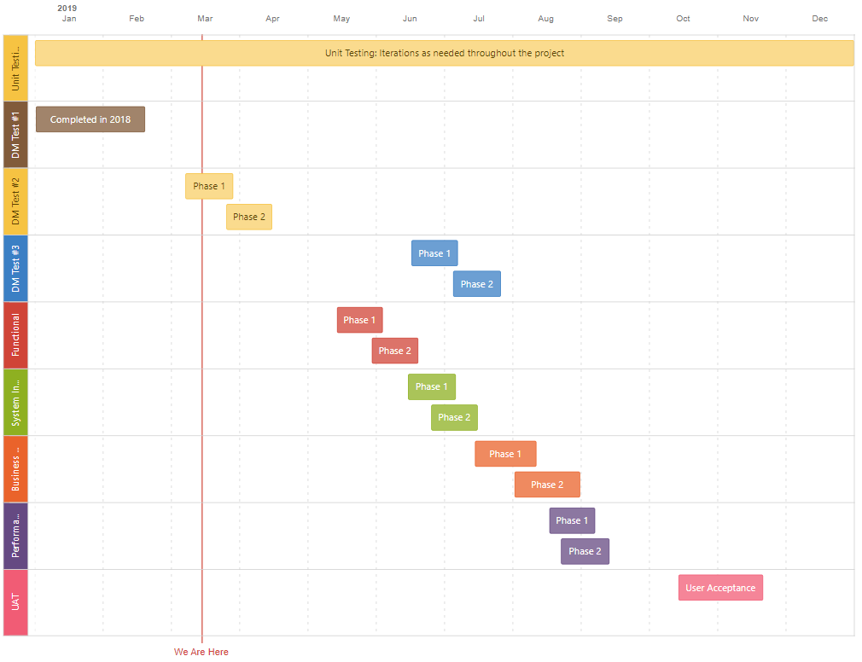
Testing Roadmap Draft
This outlines the high level strategy and is subject to change
Testers:
UCSD Technical Team
UCSD Configuration Team
UCSD Test Team
UCSD Process Lead
UCSD SMEs
UCSD identified staff level users (line staff)
UCSD identified management level users (managers)
KR Consultants
KR Technical Team
Rev 3.5.2019

Slide 24
For questions contact Nicole Joyce at njoyce@ucsd.edu or 858-534-9112.

